Slide 1


Starlings Maths Home Learning
Thursday 4th March

Slide 2
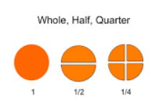
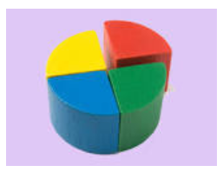
HALVES AND QUARTERS LESSON 4
Good Morning Starlings, in this lesson, you are going to find a quarter (4 equal parts) of a quantity using equal sharing.

Slide 3
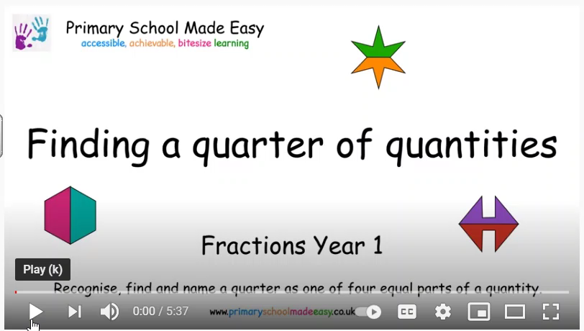
Watch this video to show you how to share or group into quarters:
https://www.youtube.com/watch?v=FwIdiD9d1OY

Slide 4
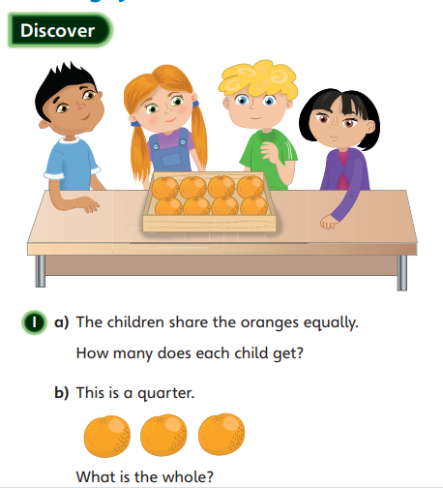
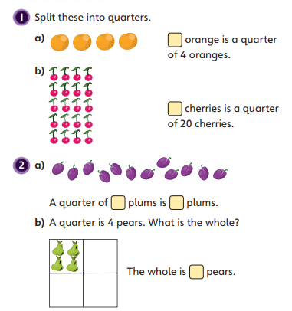
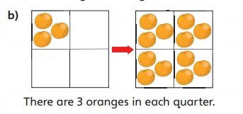

Slide 5
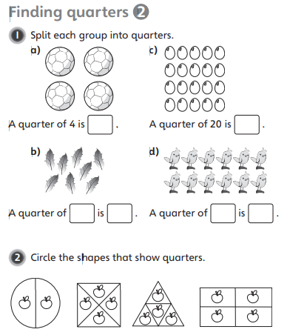
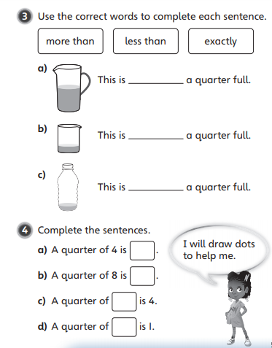

Slide 6

