Slide 1

Starlings English Home Learning
Thursday 4th March

Slide 2
Today we are going to write a letter to tell someone how to help endangered animals.
To do this you will need to:
Go back to the plan you made in yesterday’s lesson (using the planning grid)
Re-read the example letter and look for key features you need to include in your letter
Say your letter out loud
Write your letter independently. Remember, not all words need to be spelt correctly, just give it your best try using phonics and fred talking.
Read and check your letter.
Send your letter.

Slide 3
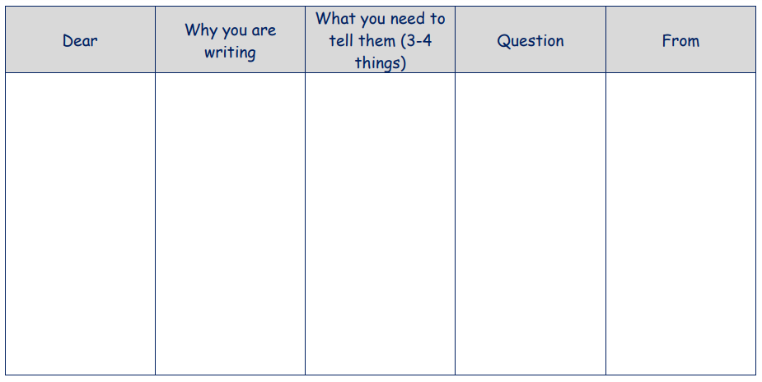

Slide 4
John
I want you to know how you can help to save endangered animals.
Recycle and re-use rather than throwing everything in the bin.
Do not litter!
Make your garden wildlife friendly and welcome creatures like hedgehogs into your garden.
Can you help me?
Mrs. O’Marah

Slide 5
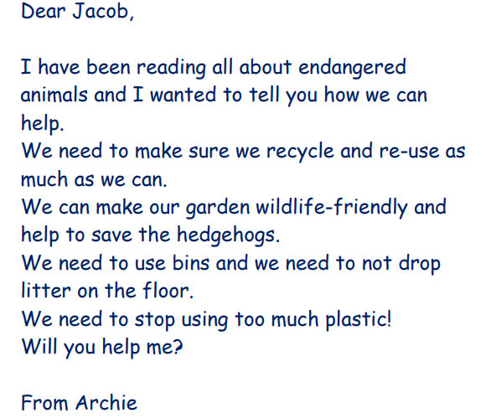

Slide 6
Letter writing checklist
Start with Dear __________ (write the name of the person you’re sending the letter to here)
I am writing because …. (This is where you tell your reader why you are writing the letter)
Write three sentences which tell your reader how they can help endangered animals (Remember to start a new line for each sentence)
Write a will you help me sentence (Don’t forget your question mark)
End with From _______ (Write your name here)

Slide 7
Dear John,
I am writing to you because I want you to know how you can help to save endangered animals.
Did you know that some animals in the World are almost extinct? I have been learning about what we can do to stop this.
Do not throw all your rubbish in the bin. You should recycle and re-use as much as you can.
Do not litter!
Try to make your garden wildlife friendly and welcome creatures like hedgehogs into your garden.
If we work together, the animals can be kept safe. Can you help me?
From Mrs. O’Marah

