Slide 1


Spelling
Date: 04.03.21
Spelling Lesson
Revisiting Spelling rules

Slide 2

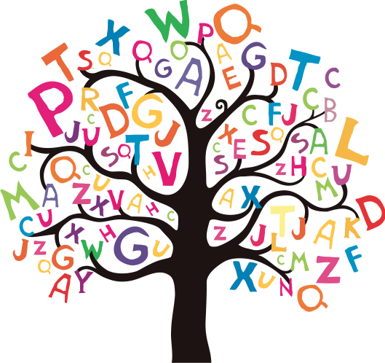
Over the past two months we have been focussing on a variety of Year 5 spelling rules.
Today we are going to revisit and revise these spelling rules using different activities/games.
Here are the rules we have focussed on at home:
Suffix -able (e.g. suitable)
Silent letter t (e.g. listen)
Suffix -ably (e.g. understandably)
Suffix -ibly (e.g. incredibly)
Suffix -ent (confident)
Suffix -ence (e.g. evidence)
‘ee’ sound spelt ‘ei’ (e.g. receive)

Slide 3

Click on the sound button to hear activity 1 read to you.
Activity 1: Spot the Mistake
Words with the –able suffix have been spelt incorrectly in the sentences below.
Rewrite each sentence, correcting the spelling.
Suffix -able
The bike ride was very enjoiable.
I have an adoorable dog.
My mum is very relyable.
We will go through all of the answers together at the end of the lesson.

Slide 4
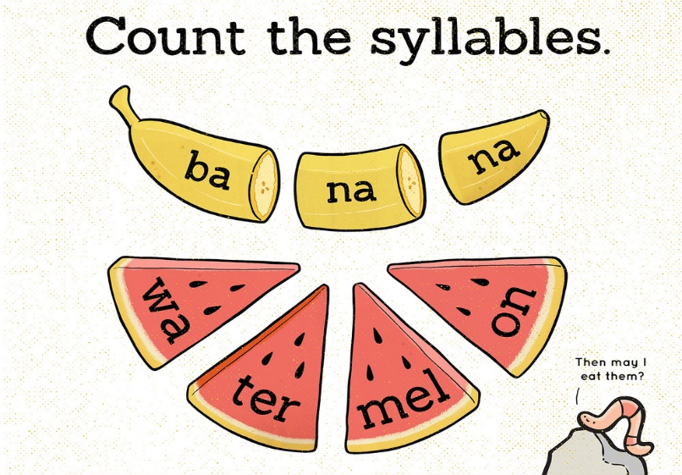
Click on the sound button to hear activity 2 read to you.
Activity 2: Syllable Clap
Count and record how many syllables are in each of the words below. All of the words contain the silent letter ‘t’.
You might find it useful to clap out the words to help you.
Silent letter ‘t’
Glistening
Listen
Softener
Castle
We will go through all of the answers together at the end of the lesson.

Slide 5
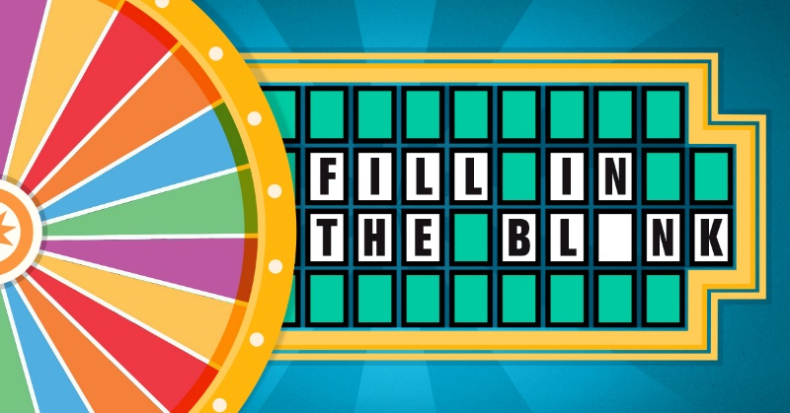
Activity 3: Fill in the blanks
Click on the sound button to hear activity 3 read to you.
Using the word bank, fill in the missing words in the sentences below. All of the words contain the –ably or –ibly suffix. There may be more than one word which fits, so you should choose the most appropriate.
-ably and -ibly suffixes
incredibly | suitably | possibly
adorably | responsibly | understandably
You must act __________ when crossing a road.
The cute dog looked at me ____________.
I dressed ___________ for the cold weather.
____________, the plane landed safely in the water.
We will go through all of the answers together at the end of the lesson.

Slide 6
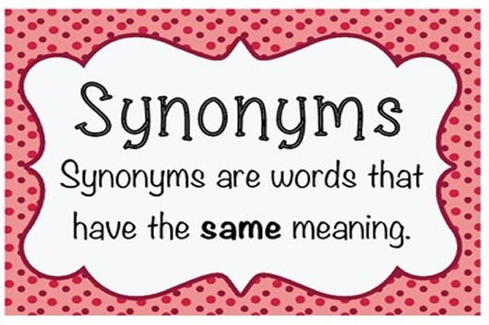
Click on the sound button to hear activity 4 read to you.
Activity 4: Find a Synonym
Write a synonym for each of the words below. All of the words end in –ent or –ence. However, your synonym does not have to.
You may use a thesaurus or the internet to help you.
Suffixes -ent and -ence
Confidence
Different
Efficient
Intelligence
Patient
We will go through all of the answers together at the end of the lesson.

Slide 7
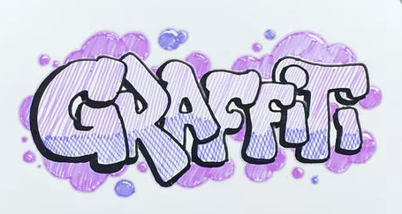
Click on the sound button to hear activity 5 read to you.
Activity 5: Spelling Graffiti
Create your own spelling graffiti for the following words contain the ‘ee’ sound spelt ‘ei’.
‘ee’ sound spelt ‘ei’
Receive
Deceive
Protein
Caffeine
Neither
We will go through all of the answers together at the end of the lesson.

Slide 8
Activity 1:
Enjoyable
Adorable
Reliable
Activity 2:
Glistening - 3
Listen - 2
Softener - 3
Castle - 2
Activity 3:
Responsibly
Adorably
Suitably
Incredibly
Answers:
Click on the sound button to hear this slide read to you.
Activity 4:
Lots of possibilities. Here are some examples:
Confidence – self-assurance, faith, belief, etc.
Different – dissimilar, unlike, unique, etc.
Efficient – logical, well organised, productive, etc.
Intelligence – brilliance, cleverness, brightness, etc.
Patient – tolerant, excusing, calm, understanding, etc.

