Slide 1






English
Thursday 4th March 2021

Slide 2
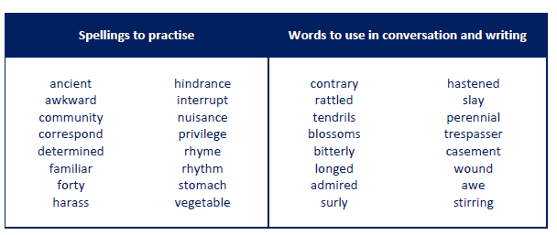
Main outcome of the session:
To infer Mary’s thoughts, feelings and dialogue from her actions.
These are the spelling words that go along with this unit of work exactly like when we’re in school.

Slide 3
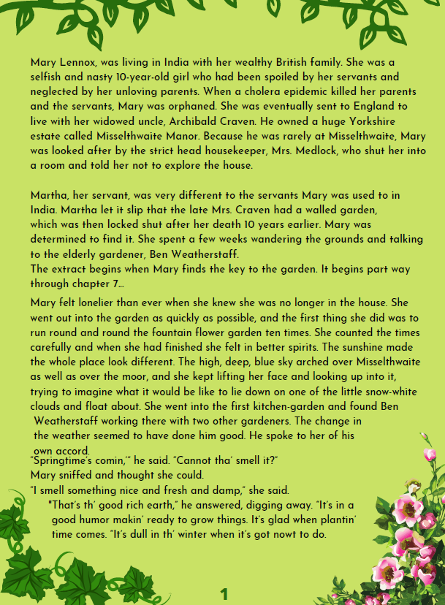
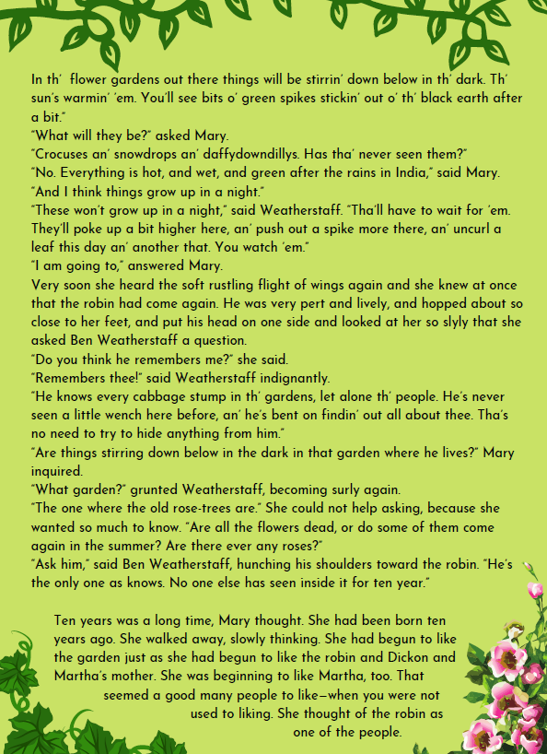
Activity 1
Re-read pages 1-3.
As you’re reading, focus on Mary’s character.

Slide 4
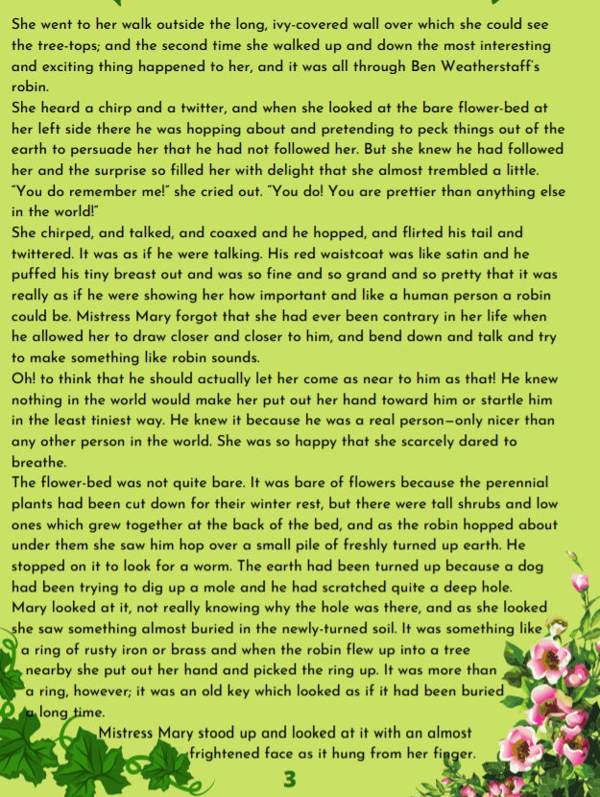
Activity 1
Finish reading page 3 here.
Take some time to think about the following questions:
What can you tell about Mary’s personality so far?
When is she happy?
When is she sad?
When is she excited?
When is she lonely?
When is she worried?
How do you know?
Activity 2
Go through the text and highlight some of Mary’s actions/what she has done e.g. talked to Ben, coaxed the robin, explored the garden.
Consider how these make her feel, what might she be thinking about, what is Mary likely to say?

Slide 5
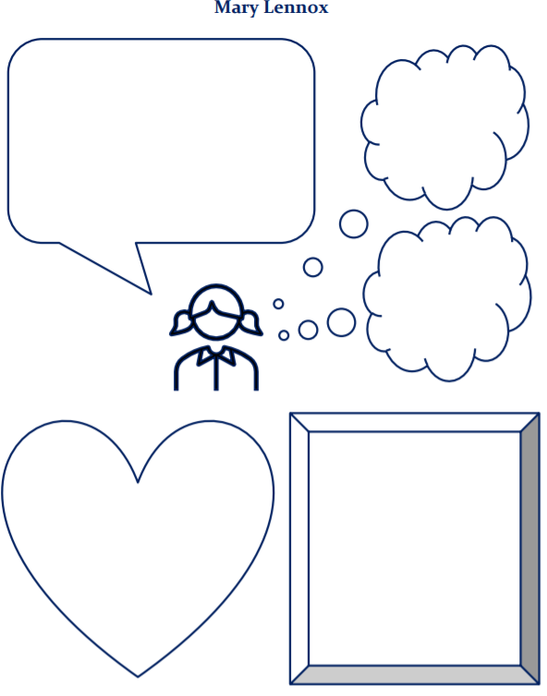
Activity 3
Complete the chart on this slide.
I have also attached it to our class blog.
Add Mary’s actions to the box at the bottom right, her feelings in the heart and thoughts and dialogue in the bubbles.
Activity 4
Once you have completed the chart, I want you to have a think about your first impressions of Mary. What is she like as a person? Answer verbally.
Optional Challenge Activity
Write a short paragraph/a couple of sentences with the title ‘My first impressions of Mary’.

Slide 6

‘The Explorer’ by Katherine Rundell, read by Mrs Whittingham
Please follow this link to see Mrs Whittingham read our new class novel.
https://youtu.be/LK6kQM_ZI0c

