Slide 1

Starlings English Home Learning
Wednesday 3rd March

Slide 2
Today we are going to talk about and plan a letter to save endangered animals
To do this you will need to:
Look at Page 5 of the Museum of Lost Animals text and talk about what information we have learned about how to save endangered animals.
Look at the example letter
Think about who you are going to write your letter to and what information you’re going to tell them in your letter.
Use the planning grid to make notes about what you will put in your letter.
Plan your letter by speaking sentences out loud.

Slide 3
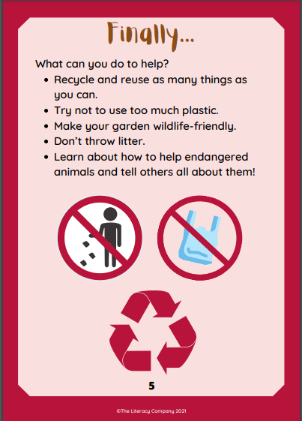

Slide 4
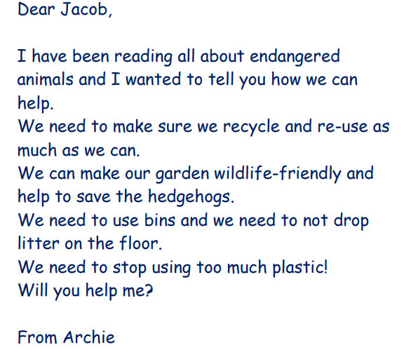

Slide 5
Letter writing checklist
Start with Dear __________ (write the name of the person you’re sending the letter to here)
I am writing because …. (This is where you tell your reader why you are writing the letter)
Write three sentences which tell your reader how they can help endangered animals (Remember to start a new line for each sentence)
Write a will you help me sentence (Don’t forget your question mark)
End with From _______ (Write your name here)

Slide 6
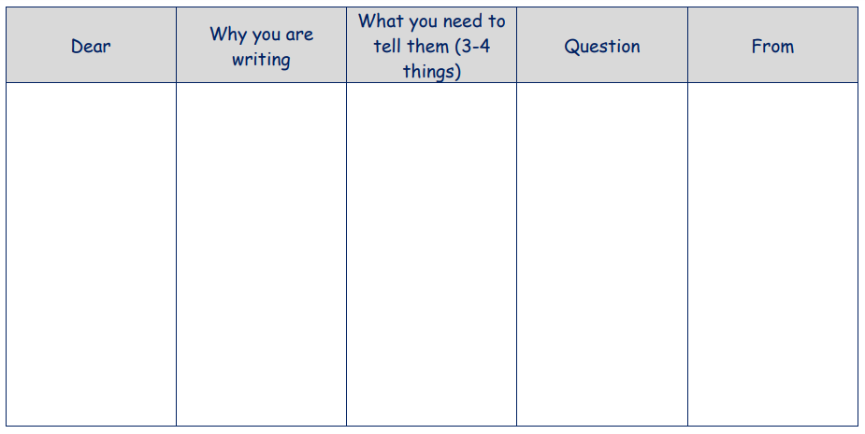

Slide 7
John
I want you to know how you can help to save endangered animals.
Recycle and re-use rather than throwing everything in the bin.
Do not litter!
Make your garden wildlife friendly and welcome creatures like hedgehogs into your garden.
Can you help me?
Mrs. O’Marah

