Slide 1


Starlings Maths Home Learning
Wednesday 3rd March

Slide 2
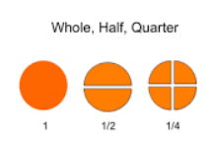
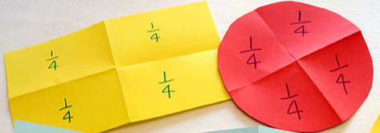
HALVES AND QUARTERS LESSON 3
Good Morning Starlings. In this lesson, you will recognise what a quarter (four equal parts) is and find a quarter of shapes.

Slide 3
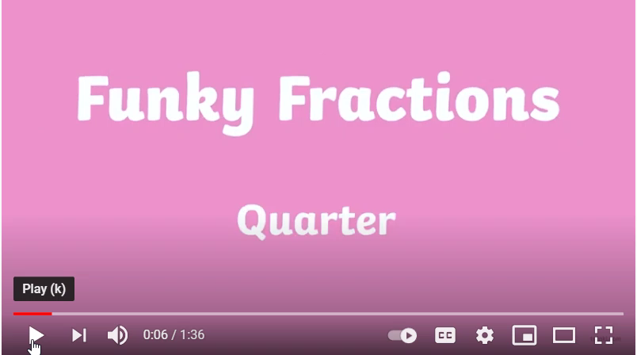
Watch this video to introduce you to quarters:
https://www.youtube.com/watch?v=3SdRStOBYPo

Slide 4
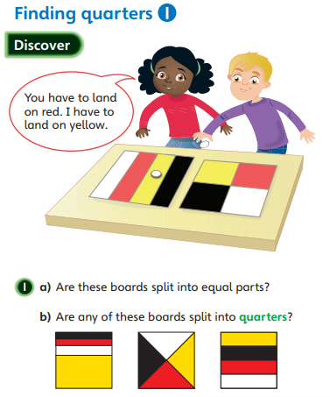
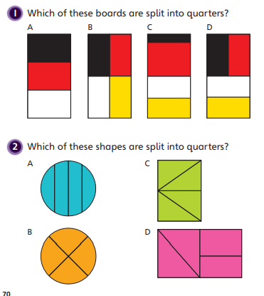
Your first job today is to have some fun folding different shapes into quarters (four equal parts). You can print off my 2D shapes to cut and fold or you can draw your own square, rectangle and circle to fold into quarters.
Now look at my pictures below, you could try and fold these shapes yourself to prove if they are split into quarters or not:

Slide 5
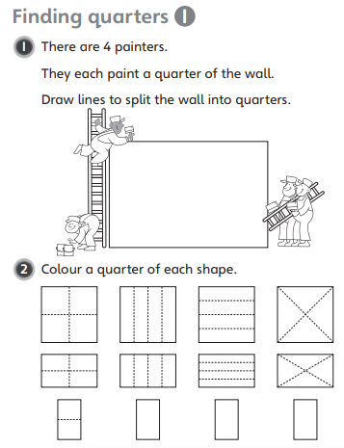
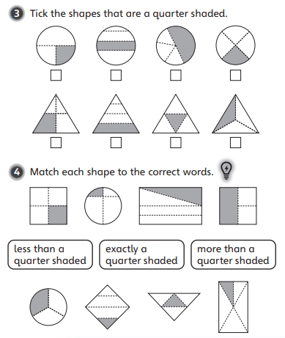

Slide 6
