Slide 1






English
Wednesday 3rd March 2021

Slide 2
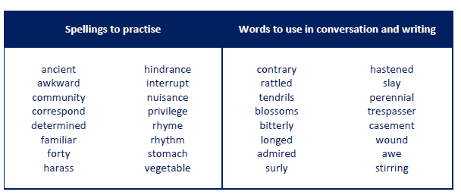
Main outcome of the session:
To write sentences using a semi-colon accurately.
These are the spelling words that go along with this unit of work exactly like when we’re in school.

Slide 3
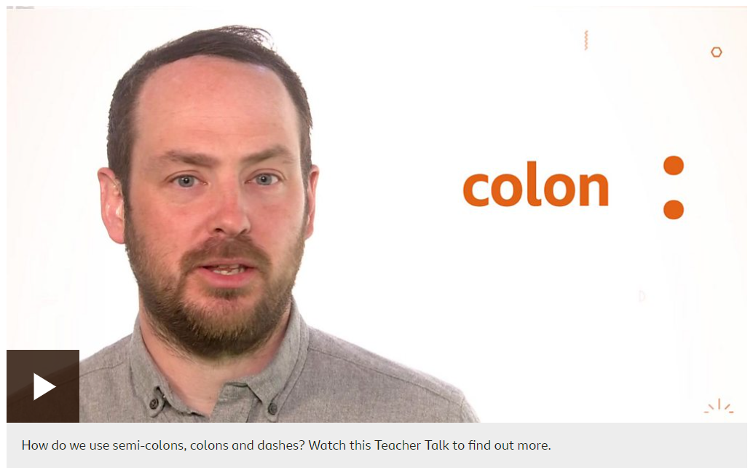
Learn
Semi-colons (;) colons (:) and dashes (–) are important features in punctuation.
Being able to use them correctly will give your writing more impact, making what you say clearer for the reader.
Watch this Teacher Talk video in which Mr Burton explains more on using semi-colons, colons and dashes effectively. Have a go at working out the answers to the examples as you watch!
https://www.bbc.co.uk/bitesize/articles/z92fhcw
Continue reading the down the web page of the link
above. Focus your attention on semi-colons.

Slide 4

Semi-colons ;
A semi-colon (;) can be used to join two clauses concisely.
Semicolons should be added instead of and to add extra information in the second clause or can be used instead of but to add contrasting information.
Here are some examples:
add – Mary noticed the robin; she turned around to see him following her.
contrast – She turned around to see him; he was not there.

Slide 5
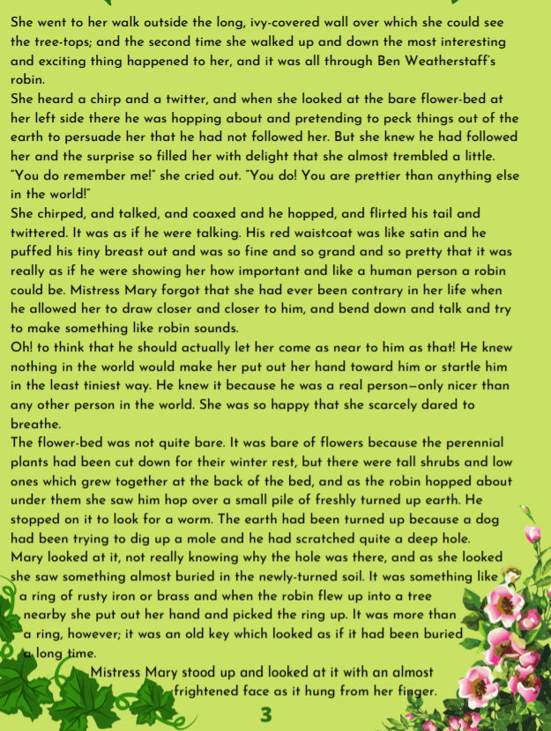
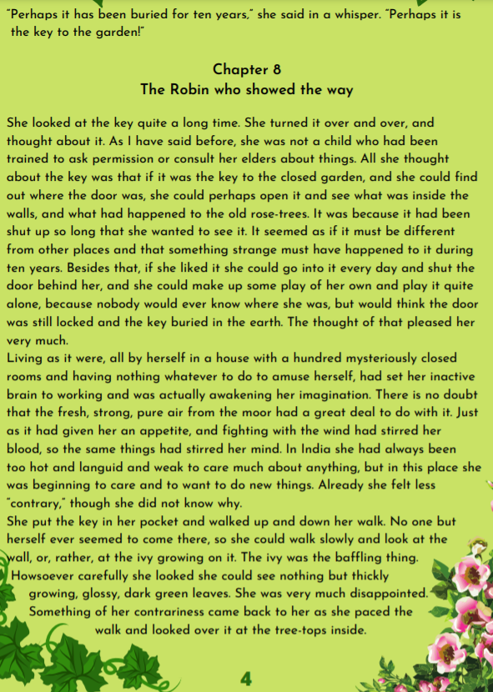
Activity 1
Read to the bottom of page 3 and then read the last line of the chapter at the top of page 4.
Activity 2
On page 3 highlight/underline/ jot down descriptions of the garden.

Slide 6
Click here to listen to me read the pages to you!

Slide 7

Activity 3
Practise writing sentences about the garden using the highlighted descriptions and including semicolons. Please write 3-4 sentences.
The easiest way for you to do this is two write two separate simple sentences that could be joined with an and. These two sentences should be linked. You can write them out in succession with a semicolon between them.
Model Sentence
The flowerbed was not bare; there were tall trees and shrubs at the back of the bed.

Slide 8

‘The Explorer’ by Katherine Rundell, read by Mrs Whittingham
Please follow this link to see Mrs Whittingham read our new class novel.
https://youtu.be/1_7mIyMN9DM

