Slide 1


Mathematics
Date: 03.03.21
Week 8 – Lesson 3
Multiplying 4-digits by 2-digits
Long multiplication

Slide 2
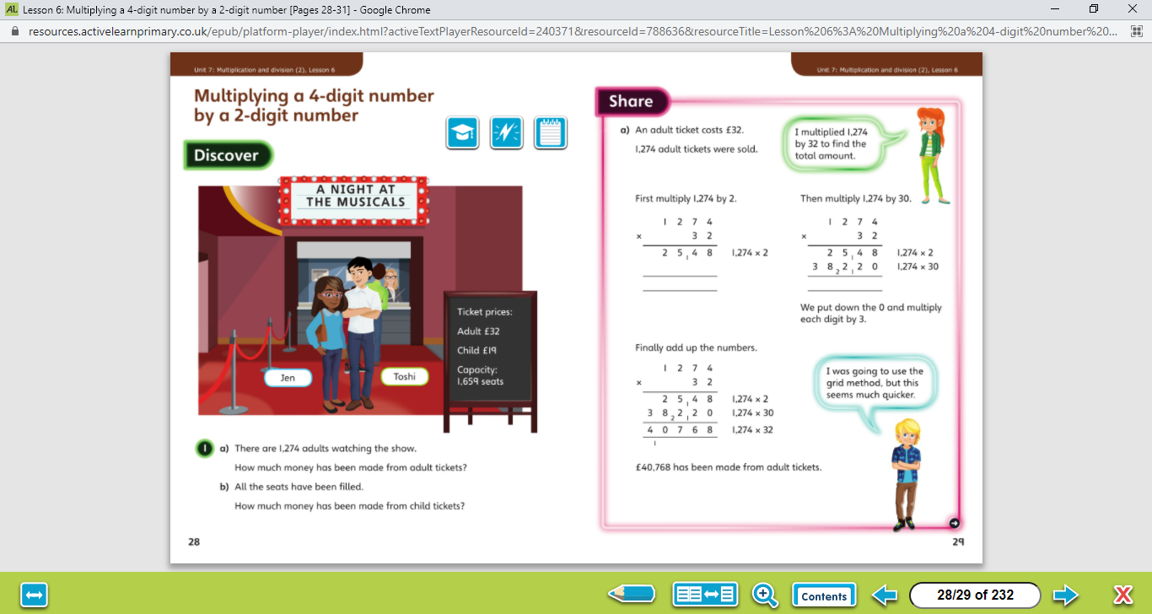

1. Multiply by the ones column
Let’s work together!
2. Add zero as a place holder
3. Multiply by the tens column
4. Add your two answers together
Look at the picture clue. What can you see?
Have a look at the questions.
Click on the sound button to hear the questions read to you. We will also talk through the questions together like we do in school.
We will go through the possible methods and answers on the next slide.

Slide 3
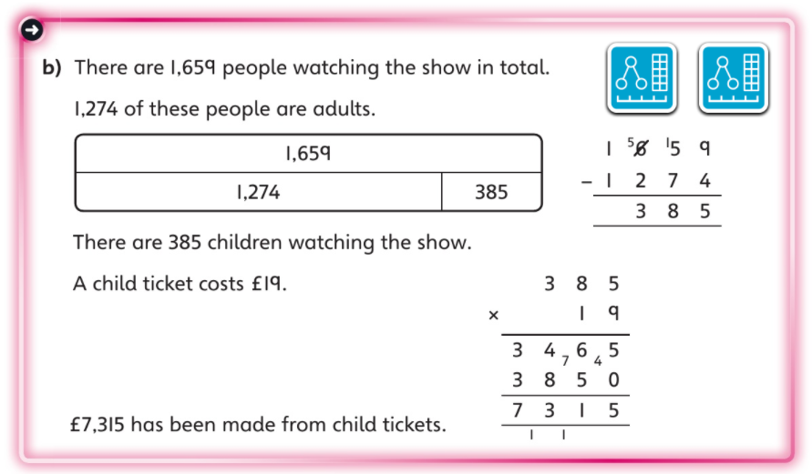
Click on the sound button to hear the answers and possible methods for question A.
Let’s work together!
Click on the sound button to hear the answers and possible methods for question B.

Slide 4

Please watch this video that explains long multiplication for 4-digit x 2-digit calculations:

Slide 5
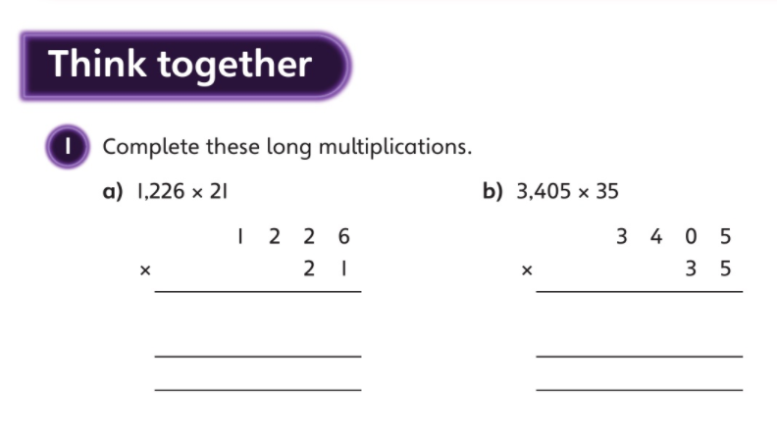
Click on the sound button below to hear the question read to you. We will work together to reach the answer.
Let’s work together!
1. Multiply by the ones column
2. Add zero as a place holder
3. Multiply by the tens column
4. Add your two answers together
Click on the sound button to hear the answers.

Slide 6
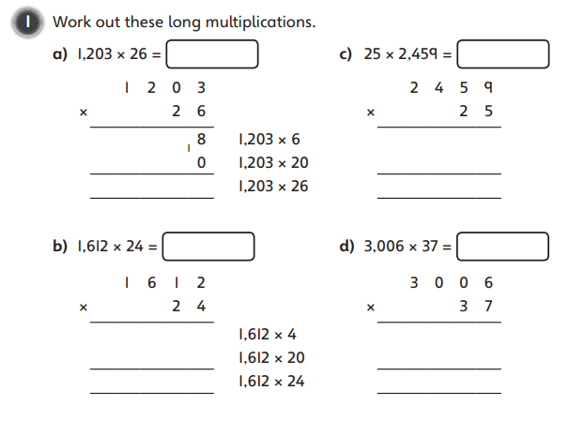
Have a go at these questions independently. Click on the button if you would like the questions read to you.
Your Turn…
1. Multiply by the ones column
2. Add zero as a place holder
3. Multiply by the tens column
4. Add your two answers together
We will go through the answers for questions 1 and 2 after completing all of the questions.

Slide 7
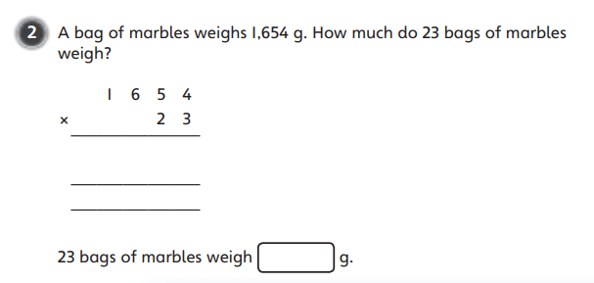
Have a go at these questions independently. Click on the button if you would like the questions read to you.
Your Turn…
1. Multiply by the ones column
2. Add zero as a place holder
3. Multiply by the tens column
4. Add your two answers together
We will go through the answers for questions 1 and 2 after completing all of the questions.

Slide 8
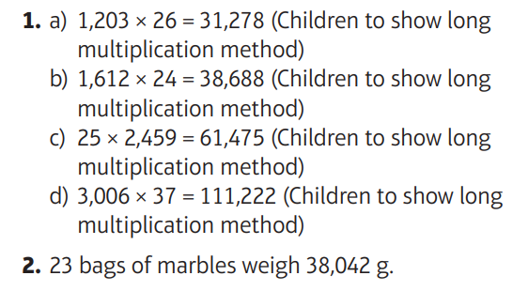
Questions 1 - 2 Answers:
Click on the sound button to hear the answers being read to you.

Slide 9
Well Done
We will practice this method further tomorrow and complete our challenge question at the end of the lesson ☺

