Slide 1


English
Date: 03.03.21
Week 8 – Lesson 3
Great Gods of Norse Mythology

Slide 2

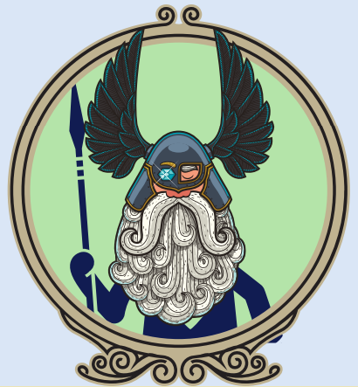
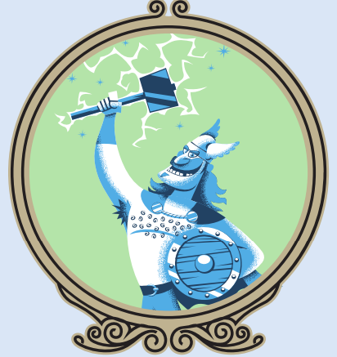
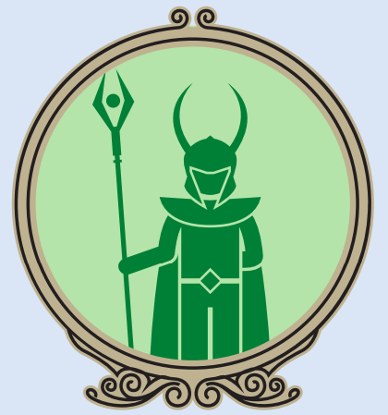
Scan through the whole text to recap what we have learnt about Odin, Thor and Loki.
The text is attached to our blog for you to print or open on your device.

Slide 3
Activity 1:
Click on the sound button to hear activity 1 read to you.
Answer the following questions with ‘true’ or ‘false’.
You may need to refer back to the text to check your answers.
Odin has a long beard: true or false?
Thor is married to Jord: true or false?
Loki is always on Odin and Thor’s side: true or false?

Slide 4
Click on the sound button to hear activity 1 read to you.
Activity 1 Answers:
Did you get the answers correct?
Odin has a long beard: true or false? – TRUE
Thor is married to Jord: true or false? – FALSE – he is married to Sif
Loki is always on Odin and Thor’s side: true or false? – FALSE – he has split feelings

Slide 5
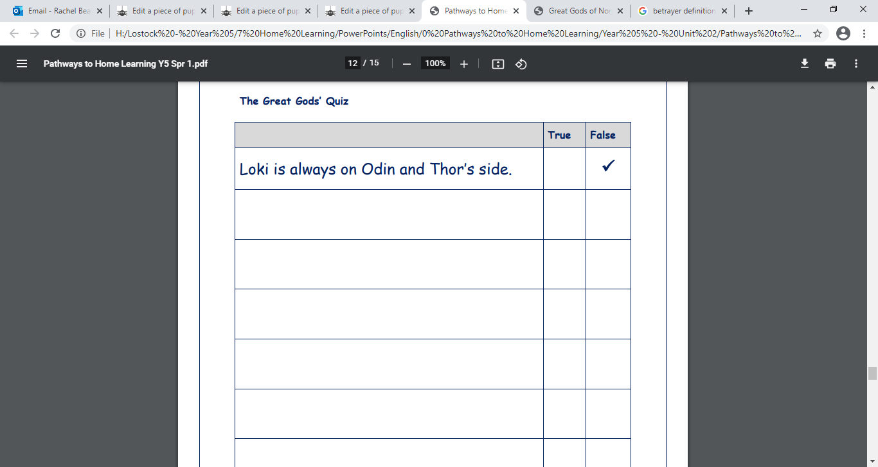
Activity 2:
Click on the sound button to hear activity 2 read to you.
Today I would like you to create your own true or false questions about Odin, Thor and Loki. You could then test someone in your family or a school friend.
You must first read and find a fact.
Then you must decide whether to keep it true and factual but word it differently, or whether to change a detail to create an untrue statement.
Finally, you must write this statement down, ending with: True or False?
There is a template for this activity attached to our blog today, or you can simply write your questions down on some paper.

Slide 6
