Slide 1

Starlings English Home Learning
Tuesday 2nd March

Slide 2
Today we are going to answer questions to show what we have learned about animals.
To do this you will need to:
Re-read the text. Your grown ups can help you, but try to read as much as you can independently.
Print off the quiz resources from the blog
Look at the quiz questions with your grown up, talk about what you think the answer might be and search for your answer in the text.
Write answers to the questions on the quiz sheet
Use the blank quiz sheet and think of questions you can ask your grown up
Remember to use ? at the end of a question sentence

Slide 3


Slide 4
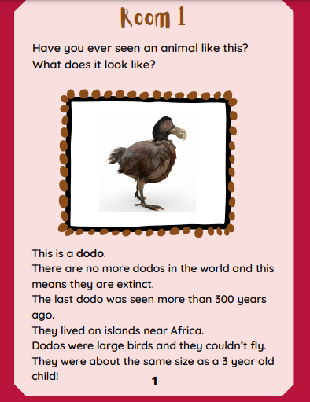

Slide 5
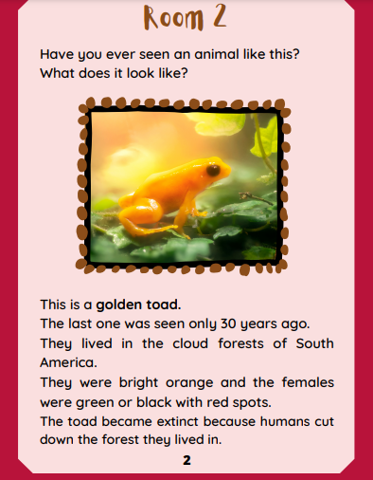

Slide 6
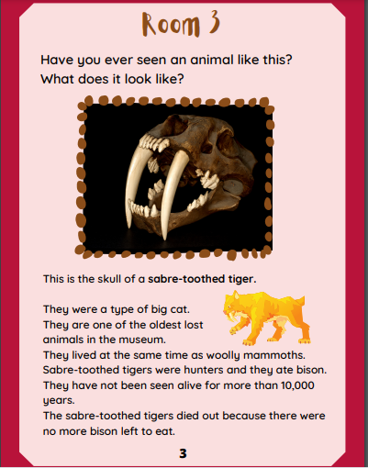

Slide 7
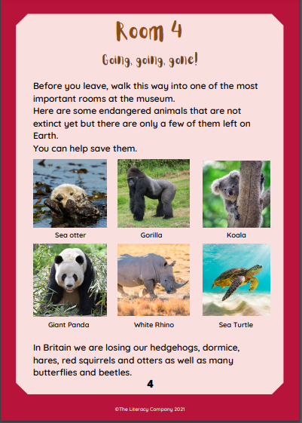

Slide 8
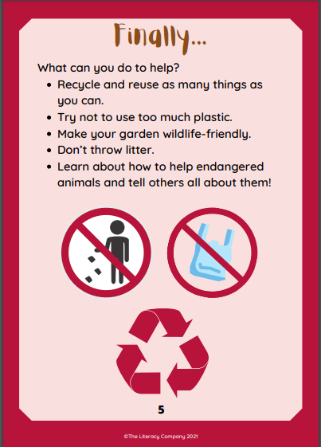

Slide 9
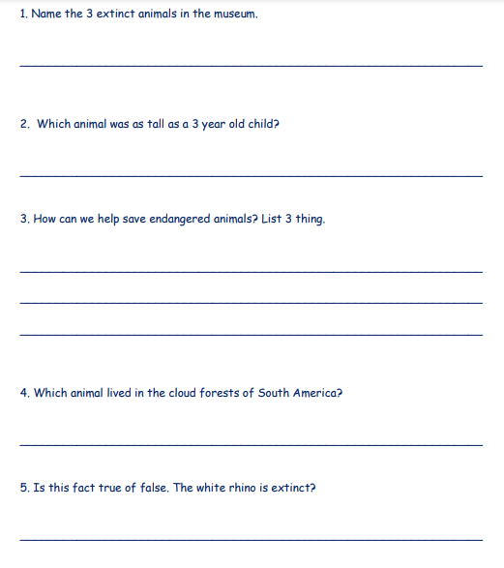

Slide 10
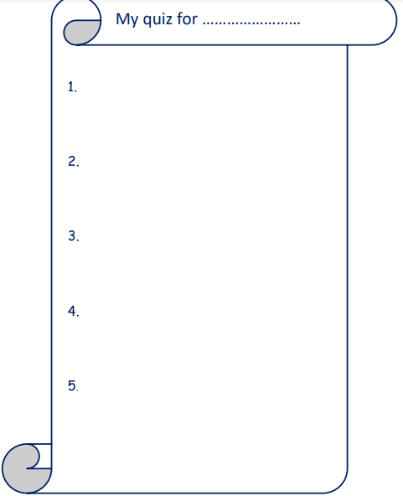

Slide 11
