Slide 1






English
Tuesday 2nd March 2021

Slide 2
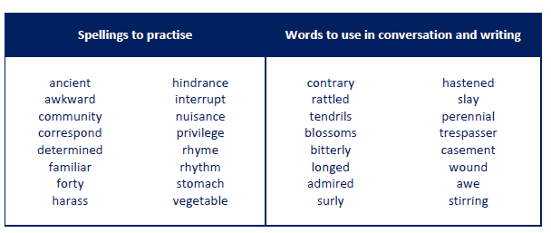
Main outcome of the session:
To investigate the difference between formal and informal speech.
These are the spelling words that go along with this unit of work exactly like when we’re in school.

Slide 3
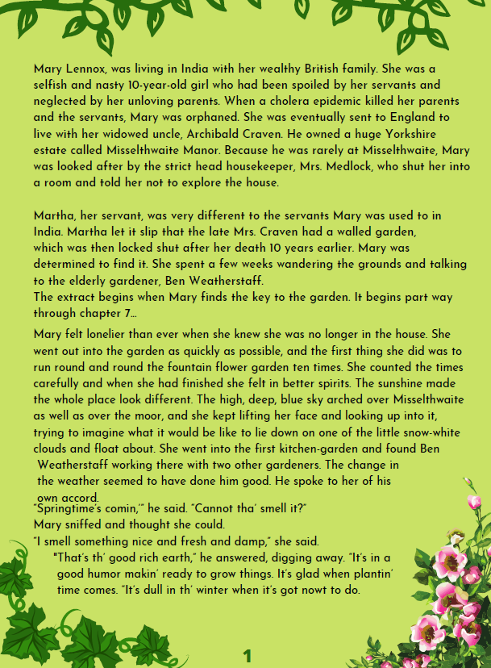
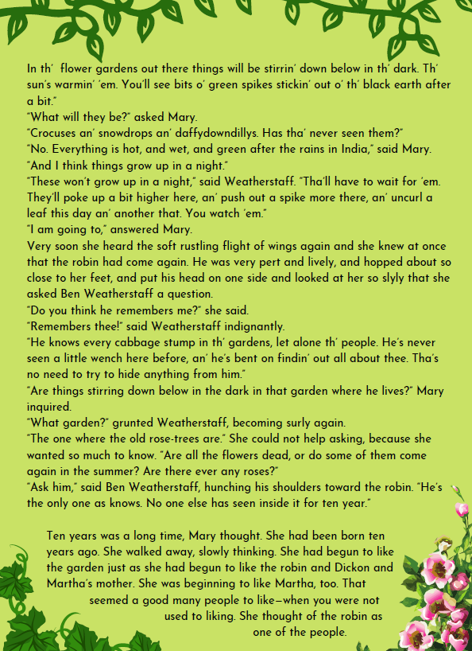
Activity 1
Re-read pages 1 and 2 on this slide.
The first 2 paragraphs on page 1 are a summary of chapters 1-6.
The real text starts part way through chapter 7. Read to near the bottom of page 2 up until ‘No one else has seen inside it for ten year.’
What do you notice about the way they both speak on these pages?

Slide 4
Listen to this slide to hear me reading the text aloud to you!

Slide 5
Activity 2
Look at ‘I am going to’ (Mary) and ‘You watch ‘em’ (Ben) – I have circled it in red.
What do you notice?

Slide 6
Activity 2
Look at ‘I am going to’ (Mary) and ‘You watch ‘em’ (Ben) – I have circled it in red.
What do you notice?
Mary speaks formally and Ben speaks informally with a Yorkshire accent.

Slide 7
Formal & Informal Speech
You have to be able to spot the difference between speaking formally using grammatically correct speech (e.g. during a presentation) and informally, the way you might speak with your family and friends, not always with perfect grammar.
Features of informal speech include:
Missing the ends of words
Muddling was/were or seen/saw
Speaking in contractions e.g. I’m we’re
Speaking with dialect or an accent
Not always making the correct grammatical choice e.g. which, what, that
Activity 3
Look for other examples of formal and informal speech from the text spoken by Mary and Ben and write in speech bubbles like the ones below.

Slide 8
Activity 4
Create a short conversation about the garden in your own words.
First, write speech bubbles for Mary and Ben.
Then, write the conversation using
direct speech punctuation.
Model direct speech punctuation sentences
“ I smell something nice and fresh and damp,” said Mary.
“That’s th’ good rich earth. It’s makin’ ready to grow things. It’s glad when plantin’ time comes,” he answered, digging away.
I smell something nice and fresh and damp.
Mary
That’s th’ good rich earth. It’s ,makin’ ready to grow things. It’s glad when plantin’ time comes.
Ben

Slide 9

‘The Explorer’ by Katherine Rundell, read by Mrs Whittingham
Please follow this link to see Mrs Whittingham read our new class novel.
https://youtu.be/pHL2sIVGg-Y

