Slide 1


Starlings Maths Home Learning
Tuesday 2nd March

Slide 2
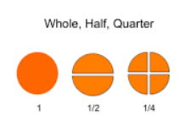
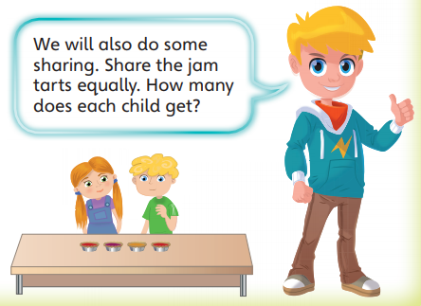
HALVES AND QUARTERS LESSON 2
Good Morning Starlings. Today, we are continuing learning about halves (two equal parts) and you will find half of groups of objects using your knowledge of sharing between two.
I would like you to recognise that the total group is the ‘whole’ and each smaller group is ‘half’ and that you can count each smaller group to check they are equal.

Slide 3
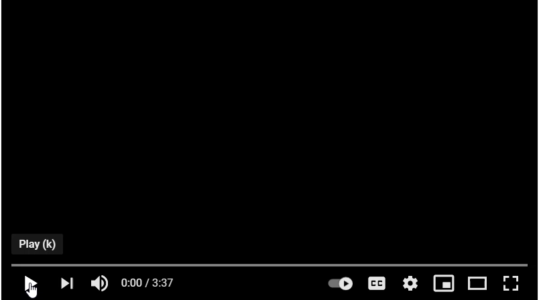
Watch this video to show you how you are going to be sharing objects into two equal parts today:
https://www.youtube.com/watch?v=0mimbjDs-LM

Slide 4
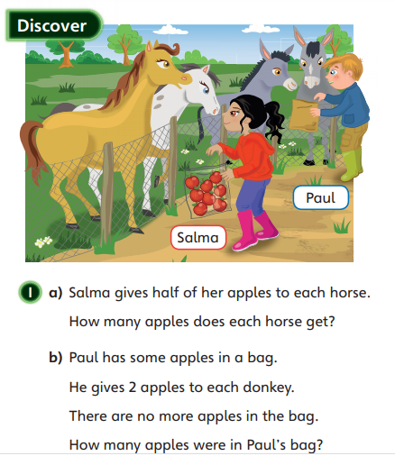
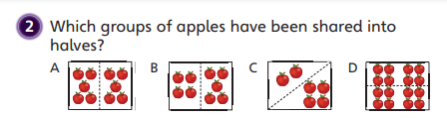
Today I’d like you to go and choose some objects (marbles, lego bricks, pens, teddies or some sweeties if you’re really lucky!) and see if you can share them EQUALLY with your grown up like in the video. Count out that you have an even number of objects (2, 4, 6, 8, 10 etc.) and then share them out equally into two piles – one for me and one for you.
Now see if your grown up can put half of a group of objects down and you tell them what the whole would be. (e.g. Mrs Judge has 3 pens in her half, how many pens would we have if put yours and my pens altogether as a whole?

Slide 5
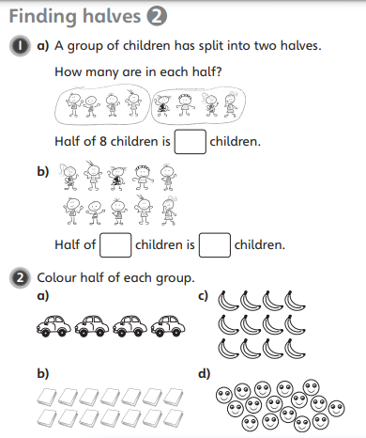
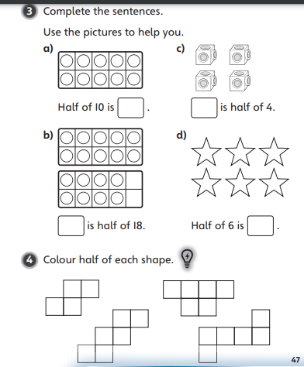

Slide 6

