Slide 1



Mathematics
Date: 02.03.21
Week 8 – Lesson 2
Multiplying 3-digits by 2-digits
Long multiplication

Slide 2

Let’s Recap:

Slide 3
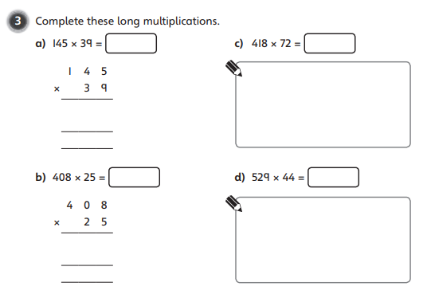
Let’s do question 3a together and then I would like you to have a go at these questions independently. Click on the button if you would like the questions read to you.
Your Turn…
1. Multiply by the ones column
1
3
0
5
2. Add zero as a place holder
4
4
3. Multiply by the tens column
4
3
5
0
1
1
5
6
5
5
4. Add your two answers together
We will go through the answers for questions 3, 4 and 5 after completing all of the questions.

Slide 4
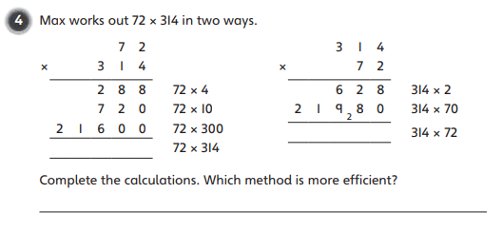
1. Multiply by the ones column
Have a go at these questions independently. Click on the button if you would like the questions read to you.
2. Add zero as a place holder
Your Turn…
3. Multiply by the tens column
4. Add your two answers together
We will go through the answers for questions 3, 4 and 5 after completing all of the questions.

Slide 5
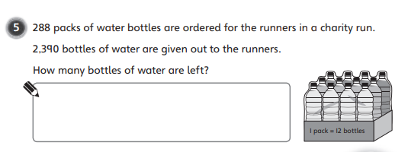
1. Multiply by the ones column
Have a go at these questions independently. Click on the button if you would like the questions read to you.
2. Add zero as a place holder
Your Turn…
3. Multiply by the tens column
4. Add your two answers together
We will go through the answers for questions 3, 4 and 5 after completing all of the questions.

Slide 6
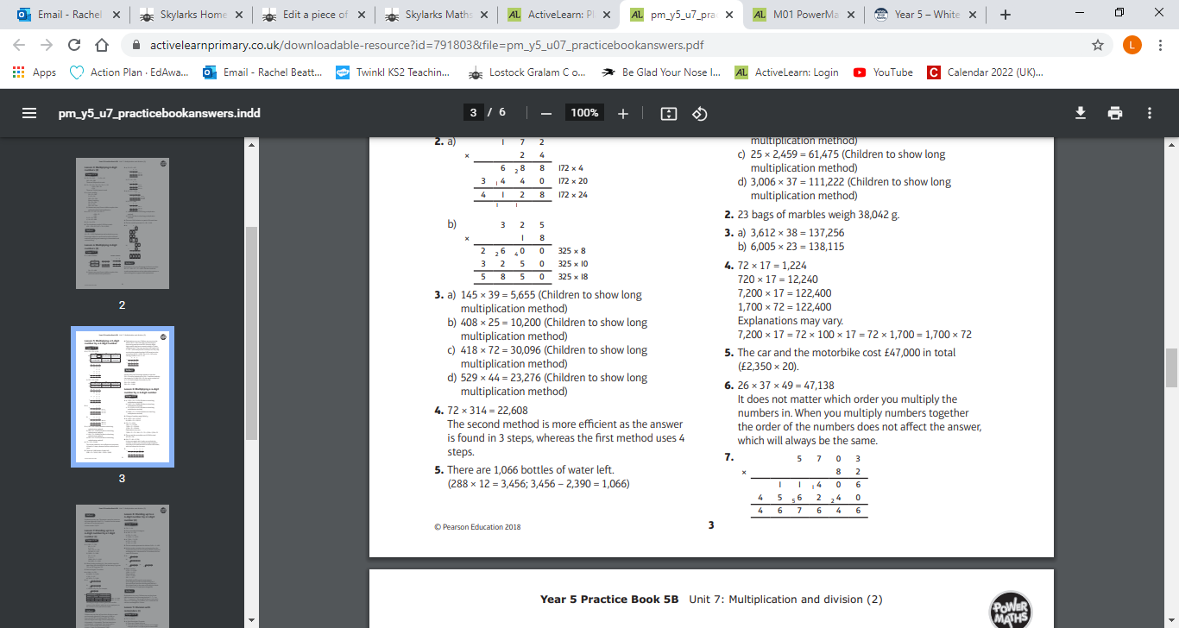
Questions 3 - 5 Answers:
Click on the sound button to hear the answers being read to you.

Slide 7
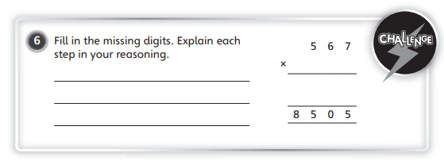
Challenge Time!
Only try this question if you are feeling confident ☺
Your Turn…
Click on the button if you would like the question read to you.
Click on the next slide to hear the answer.

Slide 8
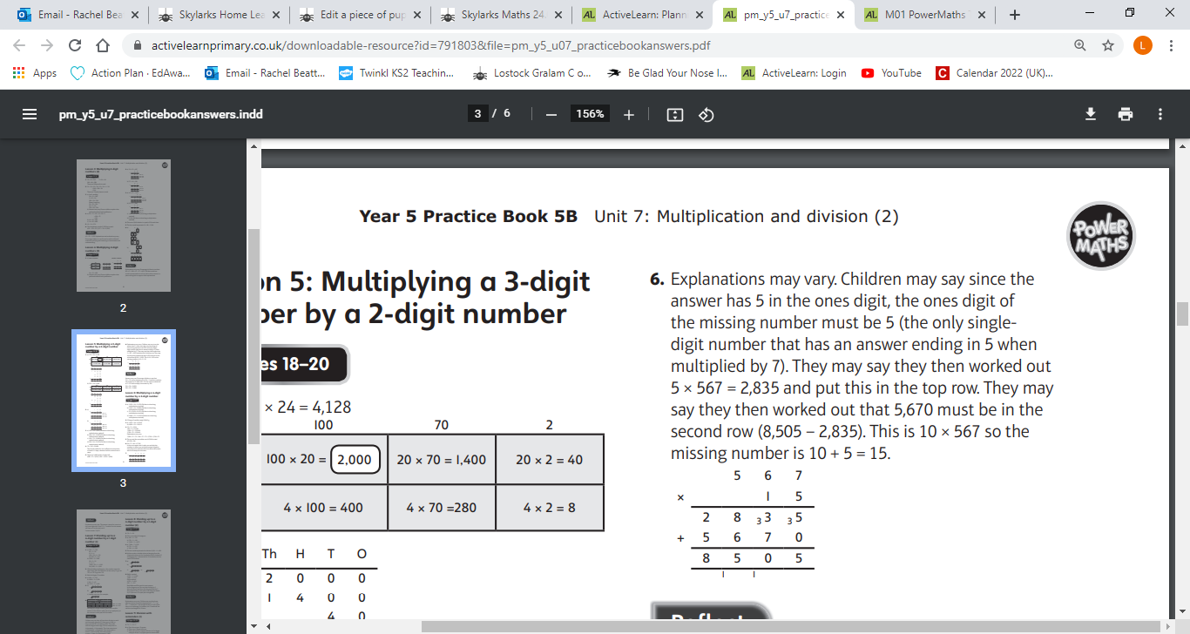
Challenge Time Answer:
Your Turn…
Click on the button if you would like the answer read to you.

