Slide 1


English
Date: 02.03.21
Week 8 – Lesson 2
Great Gods of Norse Mythology

Slide 2
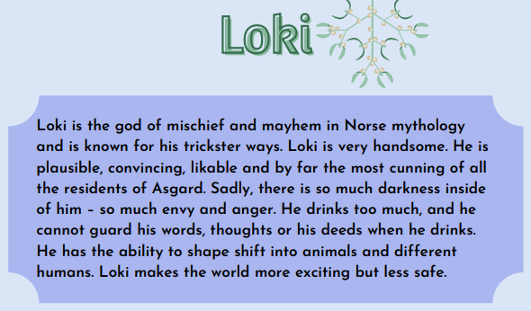

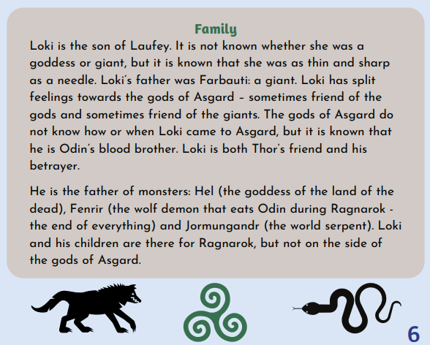
As you are reading/listening, think about what impression you are getting of Loki.
Read pages 6 and 7 of ‘Great Gods of Norse Mythology’ or click on the sound button to hear it being read to you.
The text is also attached to our blog if you want to open or print it this way.

Slide 3
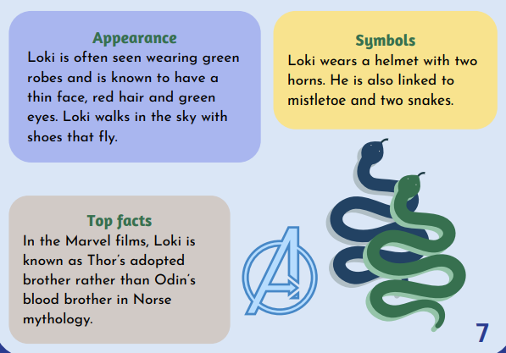
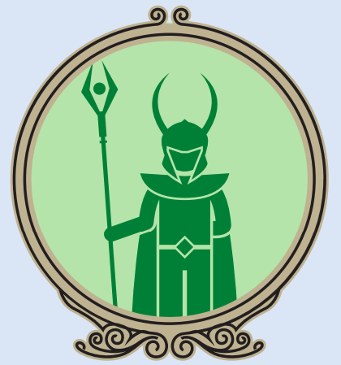
Read pages 6 and 7 of ‘Great Gods of Norse Mythology’ or click on the sound button to hear it being read to you.
The text is also attached to our blog if you want to open or print it this way.
As you are reading/listening, think about what impression you are getting of Loki.

Slide 4
Activity 1:
Click on the sound button to hear activity 1 read to you.
What impression do you get of Loki?
What type of character is he?
These phrases have been copied from the text. What does each of the phrases tell us about Loki?
so much darkness inside of him
Thor’s friend and betrayer
most cunning of all
Does Loki remind you of any other characters from books or films you know?

Slide 5
Activity 2:
Click on the sound button to hear activity 2 read to you.
Create a ‘Top ten’ word list for words which describe Loki.
You may use words from the text and some of your own.
For example:
Cunning
Dark
Betrayer
Sly
Don’t forget you can use a thesaurus or the internet to help you find synonyms or more effective adjectives.

Slide 6
