Slide 1


Monday 1st March
No Outsiders Lesson

Slide 2


Slide 3
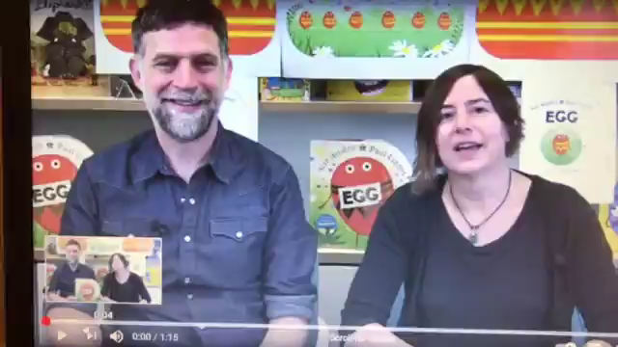
Egg by Sue Hendra and Paul Linnett

Slide 4
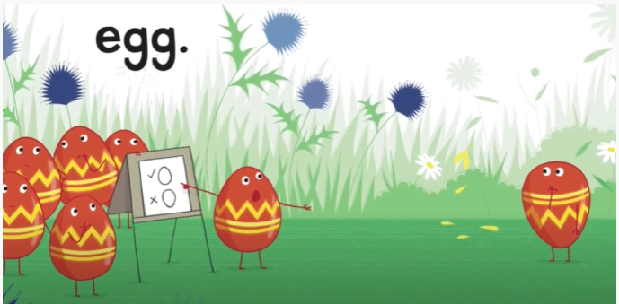


Slide 5
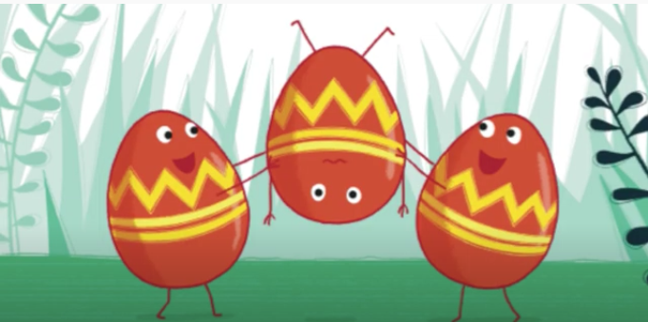


Slide 6
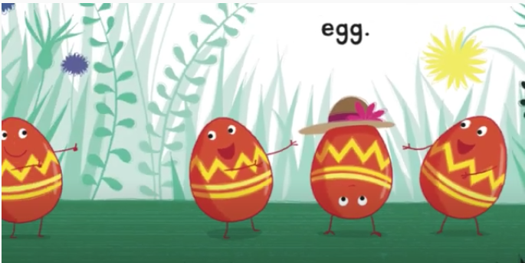

Slide 7
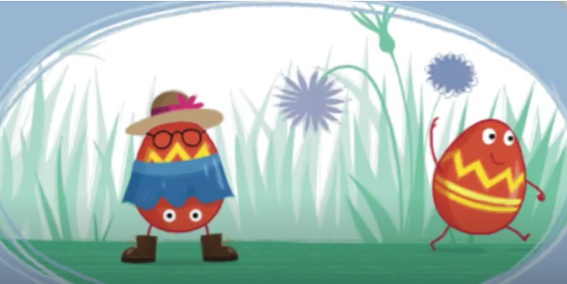

Slide 8
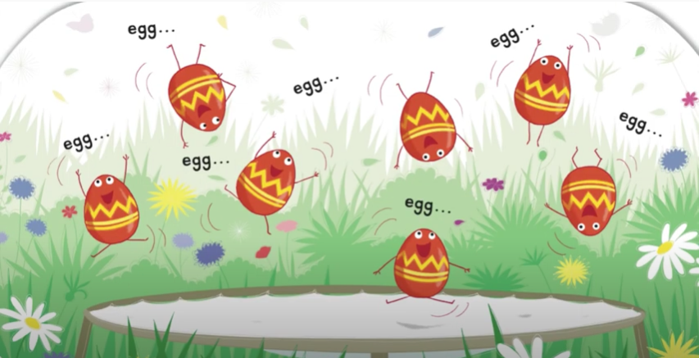

Slide 9
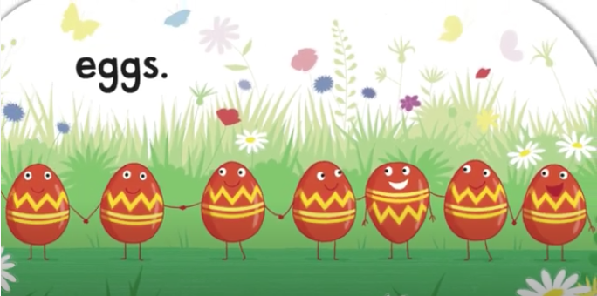

Slide 10
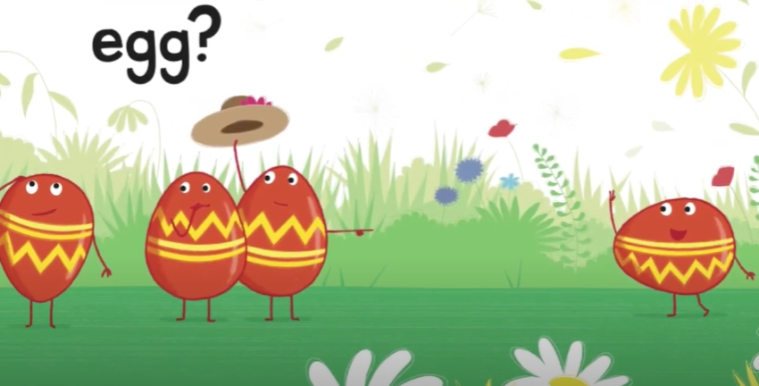


Slide 11
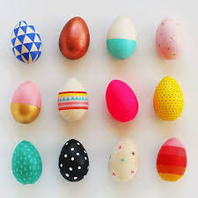
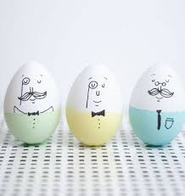
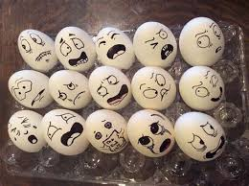
Task
You will need 3 eggs
Can you decorate your eggs to show differences?
You can use a sharpie/marker pen or some paints, whichever you have access to.
If using real eggs is messy, print the next page off and colour the eggs in.

