Slide 1

Starlings English Home Learning
Monday 1st March

Slide 2
Today we are going to write a page for a new room in the museum.
To do this you will need to:
Use the research you completed in Friday’s lesson, pick one animal that you’d like your new page to be about.
Plan what your page will look like using the downloaded sheet
Add facts using the research you completed on Friday, or the information I have provided for you.
Write sentences to share your facts
Check your sentences for capital letters and full stops.

Slide 3
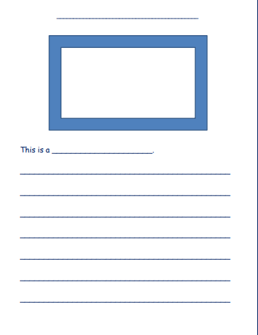

Slide 4
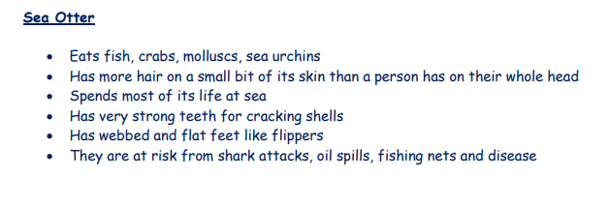
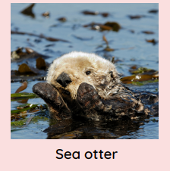
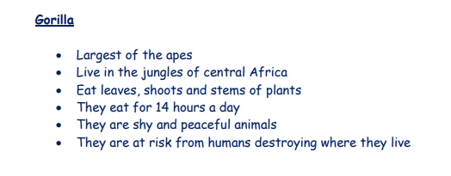
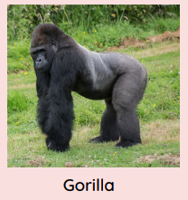

Slide 5
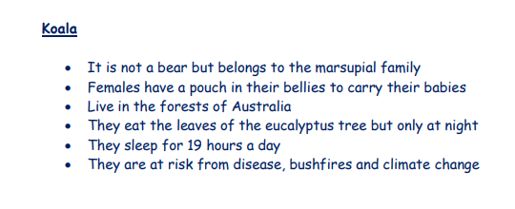
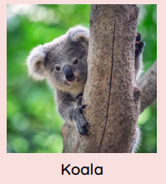
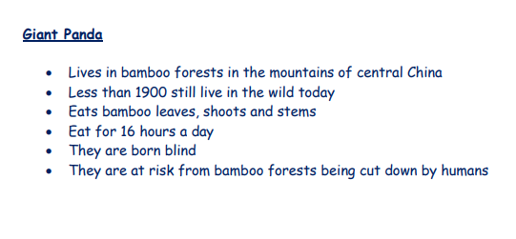
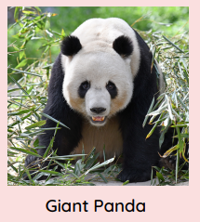

Slide 6
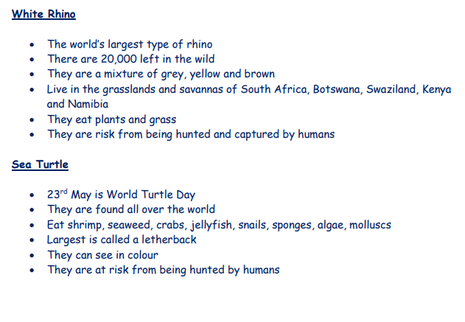
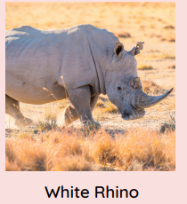
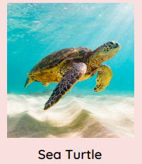

Slide 7
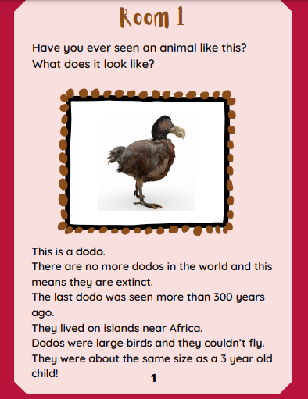

Slide 8
2. Draw a picture of your animal
1. Write 2 questions for the top of your page.
3. Write the name of the animal

Slide 9
Have you ever seen an animal like this?
What other creature does it look like?
This is a Giant Panda

Slide 10
Write sentences to share facts about your chosen animal

Slide 11
The giant panda eats for 16 hours a day and it survives on a diet of bamboo leaves, shoots and stems.
Giant pandas are born blind.
They live in bamboo forests in China and they are an endangered animal because humans are cutting down the bamboo forests.
Did you know there are less than 1900 giant pandas still alive in the wild today?

Slide 12
