Slide 1


Starlings Maths Home Learning
Monday 1st March

Slide 2
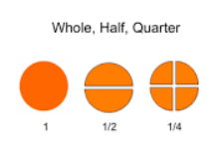
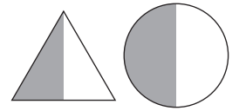

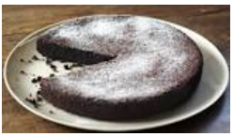
HALVES AND QUARTERS LESSON 1
Hello Starlings and I hope you had a lovely weekend. This week, we are starting a new topic all about halves and quarters. Today, you will recognise what a half is (two equal parts of an object)

Slide 3
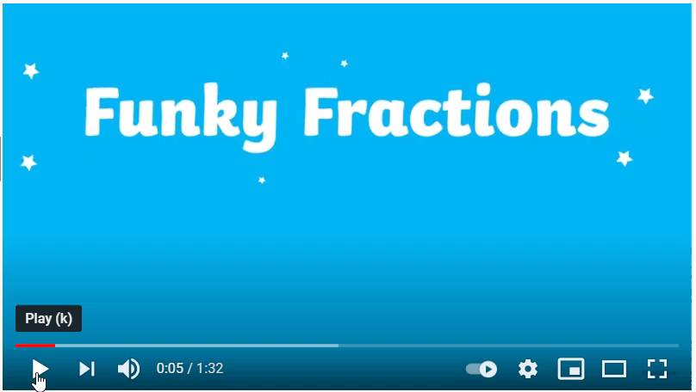
Watch this video to introduce you to halves:
https://www.youtube.com/watch?v=yDhofz3TpEw
https://www.youtube.com/watch?v=yDhofz3TpEw

Slide 4
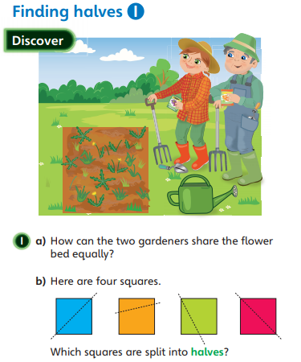
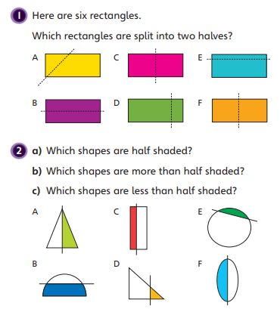
Go and find some paper and scissors. Use the shapes I have attached or ask your grown up to help cut out some 2D shapes (a square, a rectangle, a circle and a triangle). Then I’d like you to fold them or cut them in half. Remember that the pieces need to be equal (the same) to be half.

Slide 5
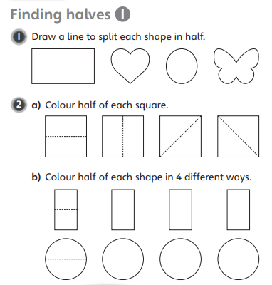
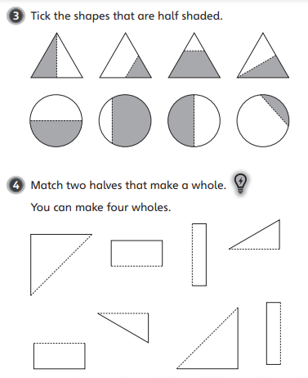

Slide 6

