Slide 1


English
Date: 01.03.21
Week 8 – Lesson 1
Great Gods of Norse Mythology

Slide 2

Let’s Recap Noun Phrases:
Click on the sound button to hear this slide read to you.
Today we are going to be reading about Thor, before writing some expanded noun phrases to describe him.
Remember: Noun phrases create extra detail and description about a noun.
Tree – The tall, overgrown tree that blocked the sun.
Sentence Structure:
Determiner/Article – the, a, some, his, those, their, etc.
Adjective – a describing word
Noun – person, place or thing
You can then challenge yourself to add even more detail at the end of your sentence.
Castle – The ancient, crumbling castle which barely stood upright.
God – A large and muscly god who is very powerful.
Can you expanded these nouns into noun phrases?
Use the steps shown on this slide:
house
flower
sun
Your Turn!

Slide 3
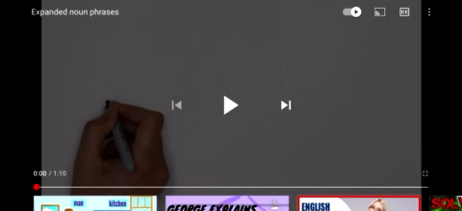
Let’s watch:
As we are reading about Thor on this next slide, try to spot the noun phrases that have been used to describe him. You could underline these, or simply make a mental note of these in your head.

Slide 4
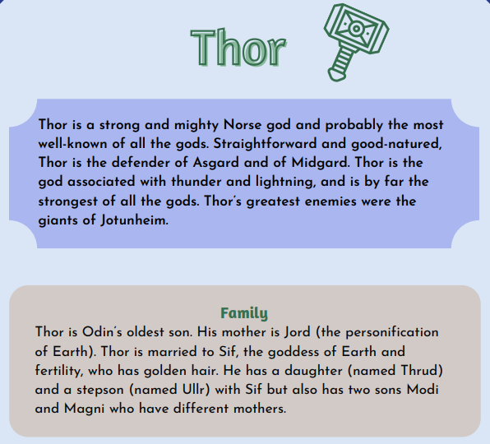
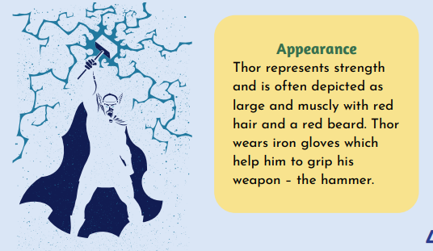
Read pages 3 and 4 of ‘Great Gods of Norse Mythology’ or click on the sound button to hear it being read to you.
As you are reading/listening to the text, try to spot the noun phrases used to describe Thor.
The text is also attached to our blog if you want to open or print it this way.

Slide 5
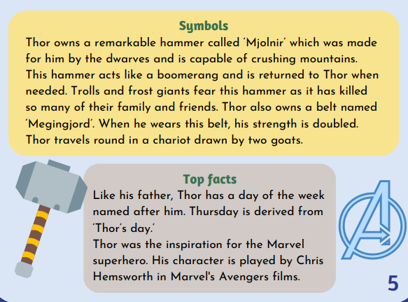
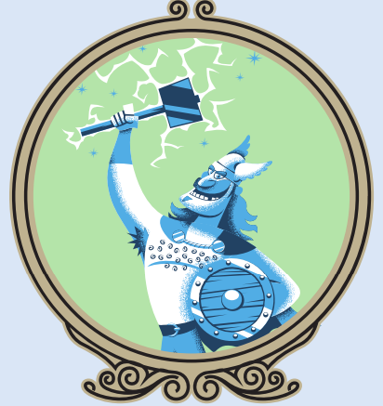
Read pages 3 and 4 of ‘Great Gods of Norse Mythology’ or click on the sound button to hear it being read to you.
The text is also attached to our blog if you want to open or print it this way.
As you are reading/listening to the text, try to spot the noun phrases used to describe Thor.

Slide 6

Activity 1:
Click on the sound button to hear activity 1 read to you.
Use what you have just read and the picture below to create labels for Thor using expanded noun phrases.
You might want to draw your own picture of Thor in the middle of your page.
His two horned helmet on his head.
The brave and mighty god.
Sentence Structure:
Determiner/Article – the, a, some, his, those, their, etc.
Adjective – a describing word
Noun – person, place or thing
You can then challenge yourself to add even more detail at the end of your sentence.
His powerful hammer.

Slide 7
