Slide 1






English
Monday 1st March 2021

Slide 2
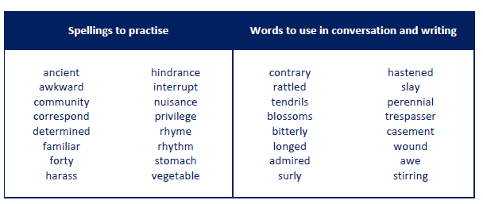
Main outcome of the session:
To be able to understand the information in the text and answer questions about the setting and characters.
These are the spelling words that go along with this unit of work exactly like when we’re in school.

Slide 3
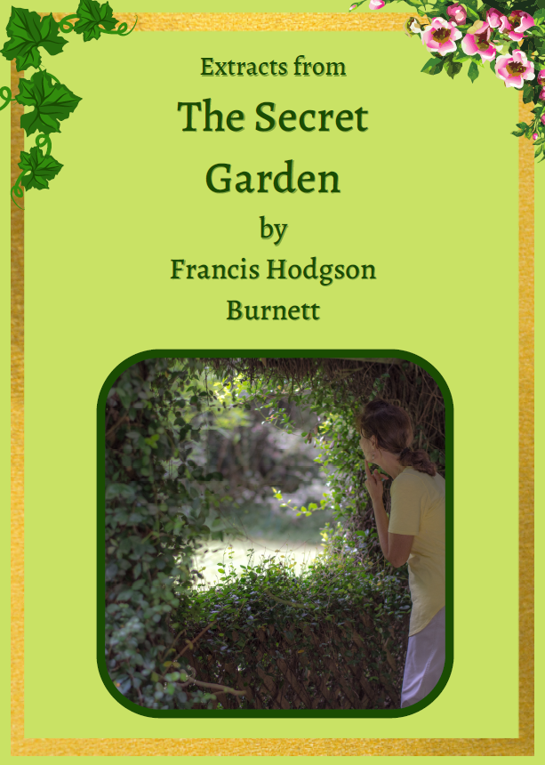
Activity 1
Look at the front cover shown here.
Think about the following questions:
What do you think the text is going to about?
Can you make a prediction based on the front cover about what is going to happen in this text?
Have you watched the recent film version of ‘The Secret Garden’?

Slide 4
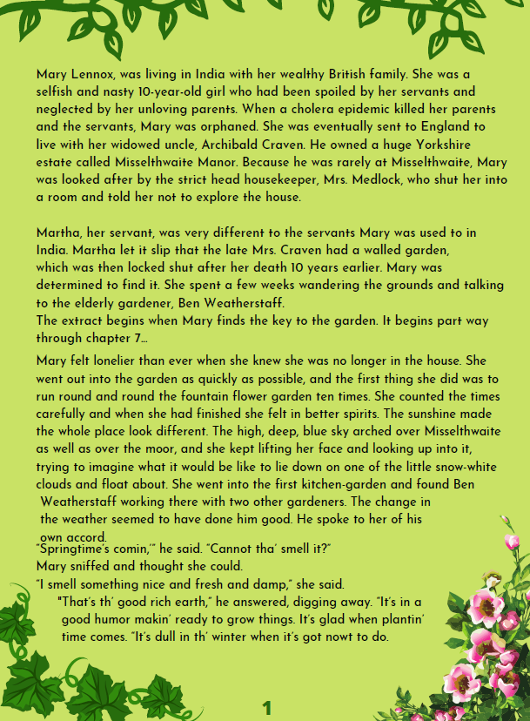
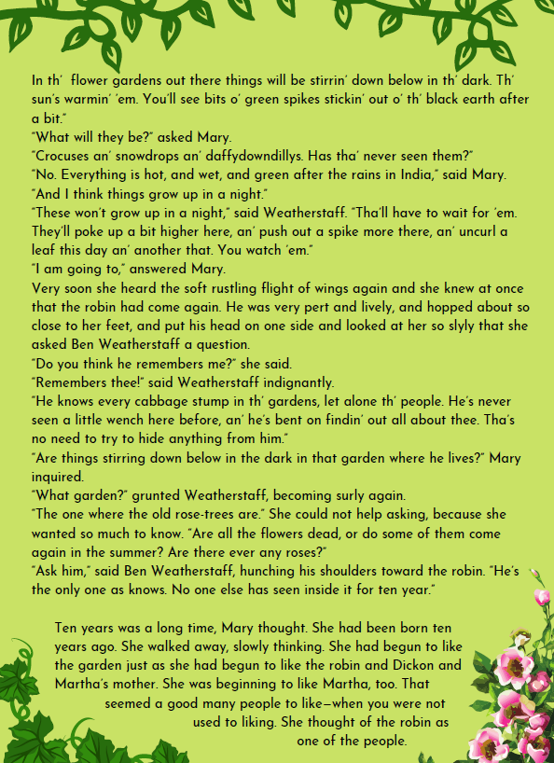
Activity 2
Read pages 1 and 2 on this slide.
The first 2 paragraphs on page 1 are a summary of chapters 1-6.
The real text starts part way through chapter 7. Read to near the bottom of page 2 up until ‘No one else has seen inside it for ten year.’

Slide 5
Listen to this slide to hear me reading the text aloud to you!

Slide 6
Activity 3
I’d like you to spend some time thinking about the characters in this part of the text. What do we know about them so far?
Have a think before moving on to the next activity.

Slide 7
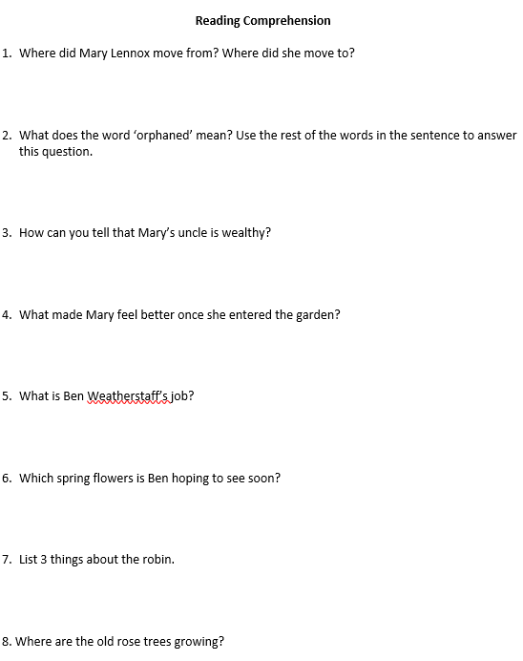
Activity 4
Have a go at the following comprehension questions.
Remember to have the text in front of you and go back to the appropriate part of the text to find the answers.
Continue to the next slide to hear me go through the answers. Please mark your answers as I go through them with you.

Slide 8
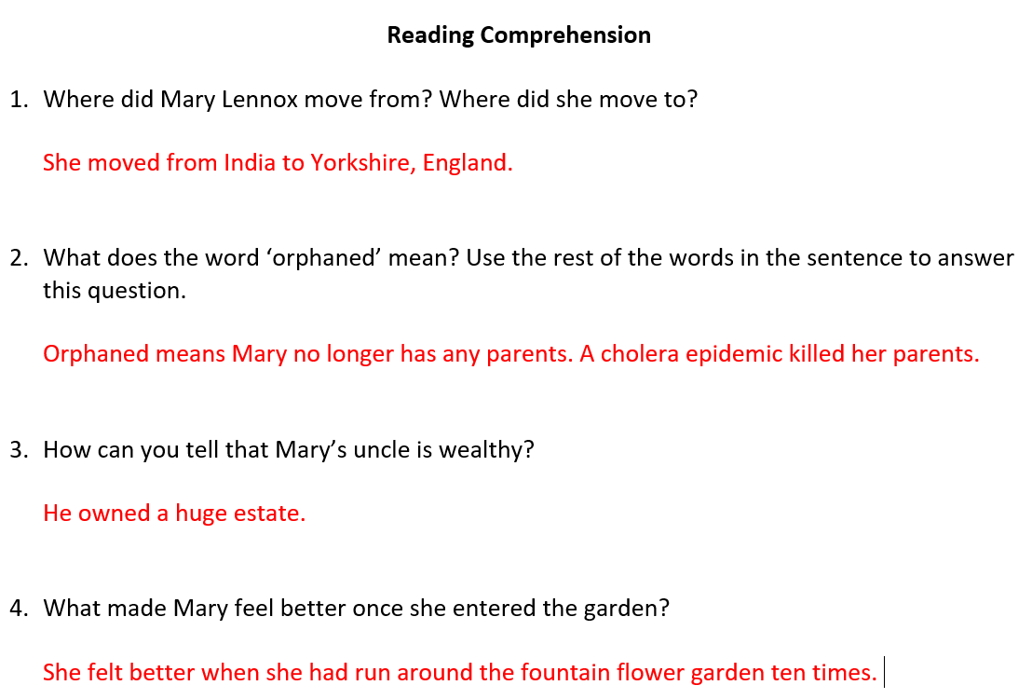
READING COMPREHENSION ANSWERS

Slide 9
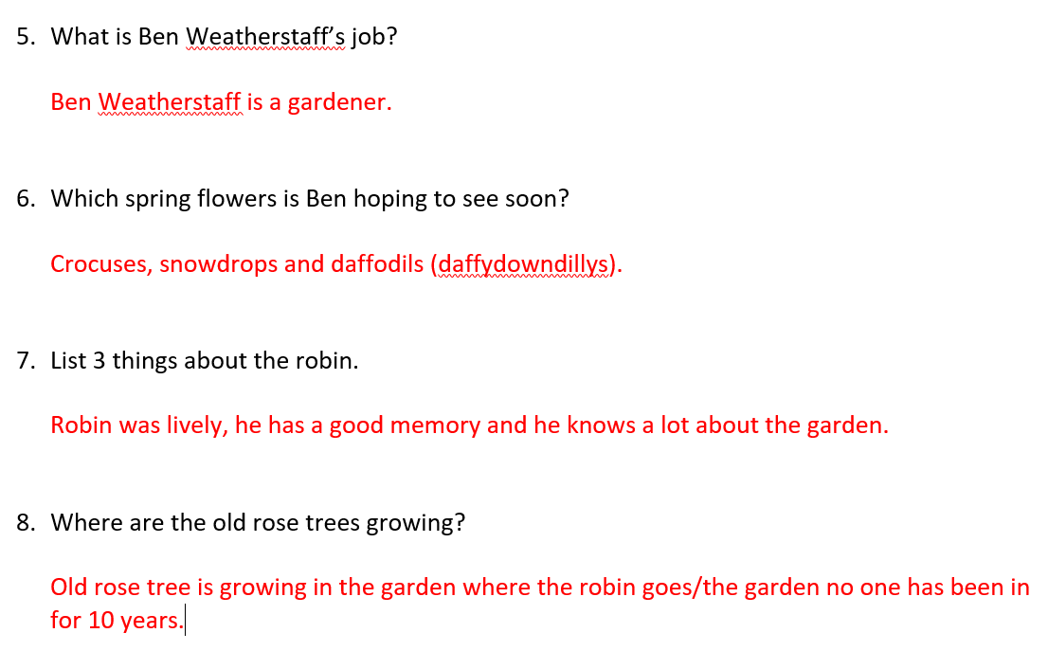
READING COMPREHENSION ANSWERS

