Slide 1
‘Meet the Teacher’
Parents’ Evening
Year 3
2025-26

Slide 2
Who We Are
Mrs. Esling and Miss Matthews (Mrs O’Connor will also be with us during the mornings)
If you need to speak to us, please pop in at either the beginning or end of the day. You can also email admin@lostockgralam.cheshire.sch.uk who will forward any emails on to myself. Class Dojo is not going to be monitored for messages between teachers and families.
The gates will open at 8:35am in the morning and the register will be taken at 8:45am.
The children have a 15 minute morning break and 1 hour for lunch. All children will have a playtime/brain break in the afternoon also.
After school, the gates will be opened and children will be released at 3.15pm.

Slide 3

General Organisation
School Uniform
  • Dark grey skirt, pinafore dress, dark grey trousers
  • Royal blue or white polo t-shirt (available with school logo) or plain white school blouse or shirt.
  • Royal blue sweatshirt, jumper or cardigan (available with school logo).
  • Plain, black, grey or white socks/tights
  • Flat black shoes that the child can fasten or tie independently
  • For the summer months - pale blue and white gingham style checked dress or dark grey school shorts/trousers
  • Long hair to be tied back using plain black/blue hair bands
Healthy snack: fruit, vegetable or healthy snack. Please do not send in any form of chocolate snack or crisps. We have children serious nut or sesame allergies so please do not send in anything with these items in.
Water bottle
Cloakroom and bags

Slide 4
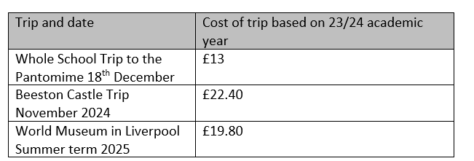
Year 3 Visits & Experiences
Autumn term – Beeston Castle - ‘Pre-Historic Settlers’ and ‘Fortress Castle’ (October)
Panto –December
Summer Term – World Museum Liverpool Ancient Civilisations (Date TBC)
Forest Schools will also take place termly (Tuesday 1st October) –more information to follow.

Slide 5
Year 3 Timetable
 | 8.35 – 9.00 | 9.00 – 10.00 | 10-10.15 | 10.15-10.30 | 10.30-11.30 |  | 11.30-11.50 | 12-1 | 1-1.10 | 1.10-1.30 | 1.30-2.30 | 2.30-3 | 3-3.15
Monday | Morning Activity | PE | Break | Worship | Writing |  | Spelling / Handwriting | Lunch | Ind. Reading | Reading Response | Maths | PSHE Jigsaw | Class Book
Tuesday | TTRS | Maths |  |  | Writing |  | Spelling / Handwriting |  | Ind. Reading | Reading Response | RE | Music
Wednesday | Morning Activity | PE |  |  | PSHE Zones | Writing |  |  | Ind .Reading | Reading Response | Maths | Spelling / Handwriting
Thursday | TTRS | Maths |  |  | Writing |  | Spelling / Handwriting |  | Ind. Reading | Reading Response | Science
Friday | Morning Activity | Maths |  |  | Writing |  | Spelling / Handwriting |  | Ind. Reading | Reading Response | Art/DT/History/ Geography
Notes:
Talk about a typical day in Year 3. Fix-it time at the start of the lesson. Interventions.

Slide 6
Physical Education
PE for Autumn Term 1 is on a Monday and Wednesday. You will be informed of any additional PE slots via email.
This year we will be covering Invasion Games, Dance, Gymnastics & Athletics.
PE uniform can be worn to school on PE/club days.
Daily Mile
On your child’s designated PE day(s) they will come to school wearing their PE kit for the day. We have found that this enables the children to spend less time changing clothes and more time enjoying PE lessons.
Black/navy PE skirt or shorts, black/navy leggings or joggers
Plain white or school logo t-shirt plain blue/black hoodies or school logo hoodies
Trainers to be worn
Children are not to wear earrings on PE days. If they do wear them they need to remove them and put them in their schoolbags. Staff can give the children a post it to wrap them in. Staff are not responsible for the safe keeping of earrings.
If a child has recently had their ears pierced they may cover them in medical tape which we can provide.

Slide 7

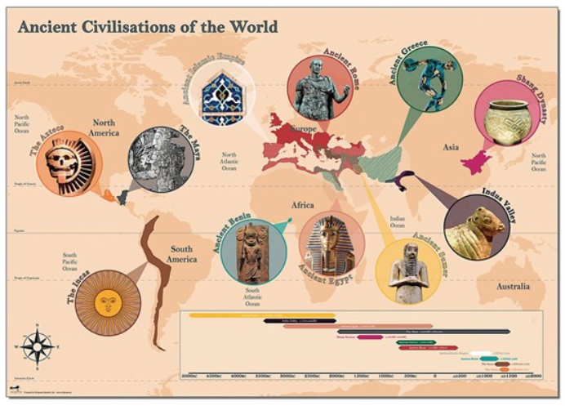
Year 3 Curriculum
The theme for this Year is TIME TRAVELLERS
Autumn term theme – Long, long ago – Stone/Bronze/Iron Age
The curriculum is going to be tailored to the Year 3 children at Lostock through lots of questioning, exploration and investigation.
How have times changed since the Stone Age?
Can I locate these times on a timeline?
What was it like to live in the Stone Age?
Notes:
Put your theme for the year on this slide.

Slide 8




English
Pathways to Writing
Pathways to Reading
Year 3 non-negotiables
Handwriting
Spellings
Presentation
Reading at home – diary signed

Slide 9

Mathematics
Power Maths (mastery approach)
Maths books and presentation
Arithmetic lessons
4 A Day activities
Times tables
173 + 42 = | 628 – 342 =
6 x 5 = | 21 ÷ 3 =

Slide 10
Homework
Reading
Read every night for 10-20 minutes. In line with the latest research and advice from the English Hub we are not sending out reading diaries this year. Phonic and reading information will be placed on Class Dojo and our expectation is that children read every night for 15 - 20 minutes but we want to take off the pressure for parents of writing this in a diary. We know that all the evidence shows that parents reading with their child has a lasting impact on their attainment and their life opportunities.
Spellings
Weekly spellings set on a Friday and practiced for the quiz on the following Friday morning. Please practice these at home. We also practice these throughout the week during our spelling lessons. Spellings for older children will always go on Dojo.
Maths Homework
Times table practice – Times Tables Rock Stars

Slide 11
Behaviour
3 simple rules: Ready Respectful and Safe
Supports our Christian ethos of living well together, kindness, dignity and respect
Positive reinforcements (Recognition Boards, Positive Notes Home, Christian Value stickers, Sunflower Award (drink and biscuit), Top Table, Sunflower stickers)
Praise in public and reprimand in private
Restorative conversations
Consistent in every classroom and with every adult

Slide 12
Attendance
Attendance record and lessons missed:
95% attendance means a child misses about 10 days or 2 weeks of lessons in the school year.
90% attendance means a child misses four weeks of lessons in the school year.
Punctuality:
Arriving 5 minutes late every day adds up to over 3 days lost each year,
Arriving 15 minutes late every day adds up to 2 weeks absence a year
Arriving 30 minutes late every adds up to 19 days absence a year
Under the new attendance framework fines and prosecutions will be increased. If you get a second fine within a 3 year period, the fine will increase from £80 to £160. Fines are capped at 2 within 3 years. Once this limit is reached, other action like a parenting order or prosecution will be considered.
What you can do:
Have a regular routine for the start of each day.
Help your child get their clothes and equipment ready before they go to bed.
Set a reasonable bed time to make sure they get enough sleep.
Get your child to school on time.
Notes:
From August 2024, the fine for school absences across the country will be £80 if paid within 21 days, or £160 if paid within 28 days. This rate is in line with inflation and is the first increase since 2012.
In the case of repeated fines, if a parent receives a second fine for the same child within any three-year period, this will be charged at the higher rate of £160.
Fines per parent will be capped to two fines within any three-year period. Once this limit has been reached, other action like a parenting order or prosecution will be considered.
If you’re prosecuted and attend court because your child hasn’t been attending school, you could get a fine of up to £2,500.

Slide 13


Keeping up to date:
Instagram: @lostockgralamprimary
Website – class page

Slide 14
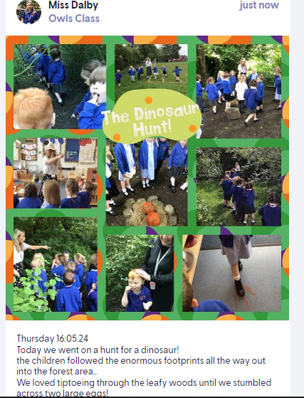
Class Dojo
Class Dojo is a secure, interactive system for parents to access shared pictures for their child’s class.
Each class will have their own page that the teacher will update twice weekly with lovely pictures and moments that have happened across the week.
Only parents added by admin or teachers are able to view the content on each class page, providing a safe platform to share the children’s learning.
We are not using the platform for messages between teachers and families.
If you need to contact school for any reason regarding your child please can you either ring the office or email admin@lostockgralam.cheshire.sch.uk. This ensures the correct members of staff see the message and it can be actioned straight away.

Slide 15
Thank you for coming!

