Slide 1


Science
Scientists and Inventors
Year One
Science | Year 3 | Scientists and Inventors | Journey to the Centre of the Earth | Lesson 5

Slide 3
Aim
To describe what Inge Lehmann discovered about Earth’s core.
Success Criteria
I can describe Inge Lehmann’s life and work.
I can explain what she discovered about Earth’s core.
I can explain how Earth’s core helps create igneous rocks.

Slide 4

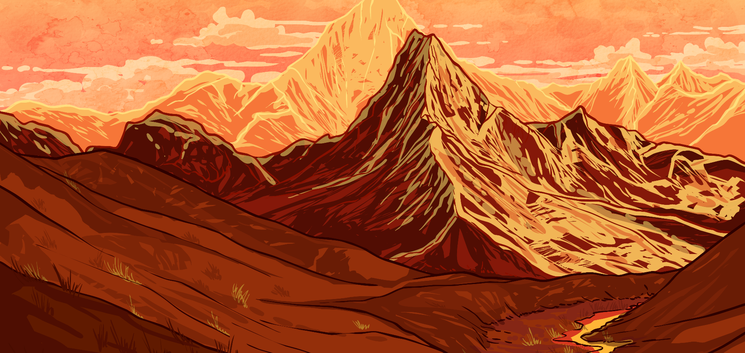
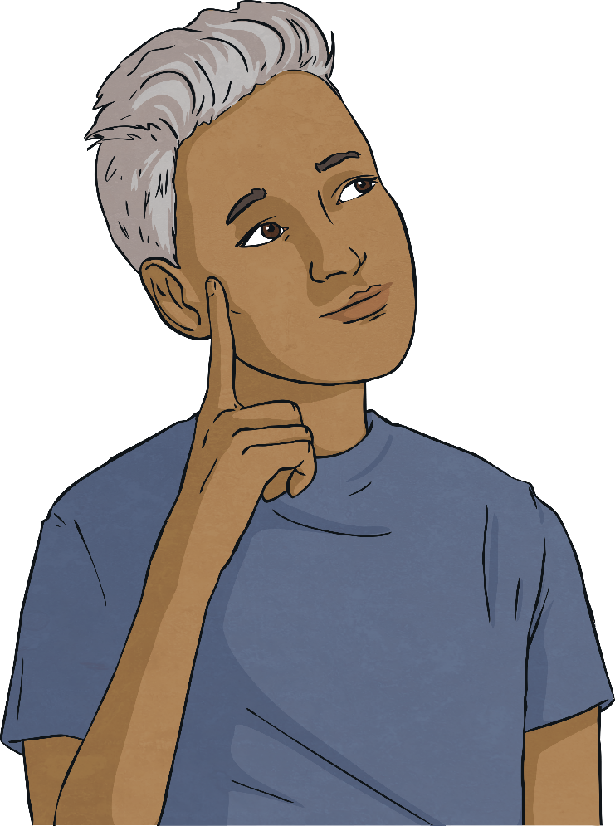
What’s Under Our Feet?
?
The ground we walk on feels solid.
But what is underneath the ground?
Talk to your partner about your ideas.
For a long time, scientists wondered about this. Many people were fascinated with the idea of what was under our feet. Some people even wondered whether there could be another inhabited world beneath the ground! Nobody can see the centre of Earth, so scientists had to use other methods to find out the answer.

Slide 5


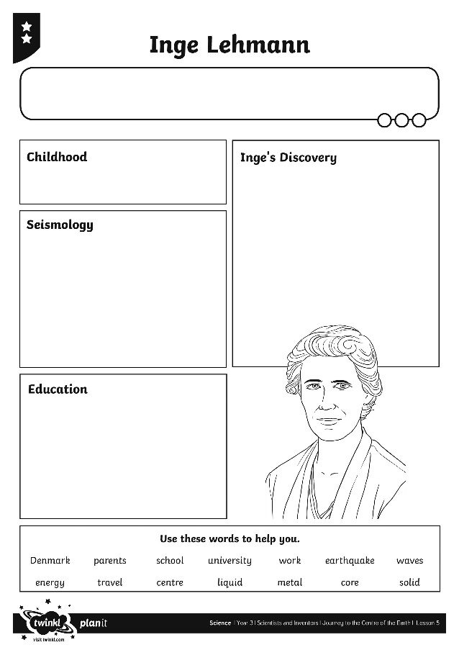

Inge Lehmann
Inge Lehmann was the scientist who finally discovered what lies in the centre of Earth.
Your Inge Lehmann Activity Sheet shows a picture of Inge Lehmann, and has space to fill in facts about her life and work.
Complete your activity sheet and learn more about this important woman.

Slide 6
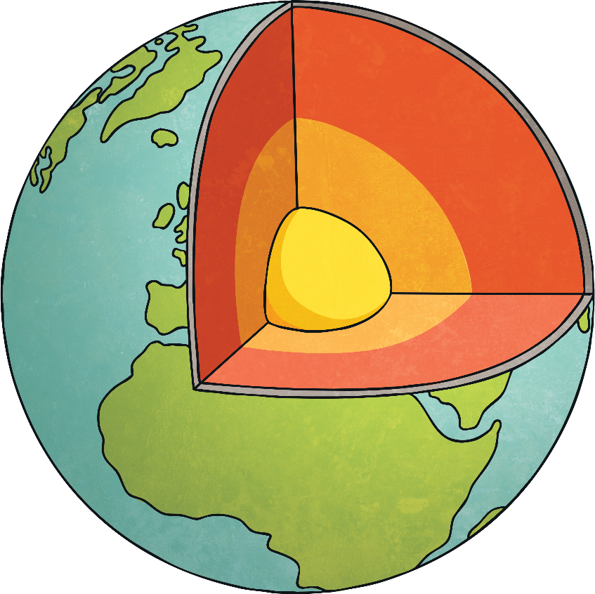
The Centre of the Earth
Inge discovered that below Earth's surface was a solid core surrounded by molten liquid rock.
Before her discovery, scientists thought that Earth's core was liquid too.
Her ideas explained the strange readings from earthquake waves that had previously puzzled scientists.
Thanks to Inge's work, we now know that Earth's core is made of solid iron and nickel and that it is about as hot as the surface of the Sun! It has a radius of about 1220km, so it is slightly smaller than the Moon.
Earth's core is solid because of the pressure from the outer layers of Earth pushing down on it.

Slide 7
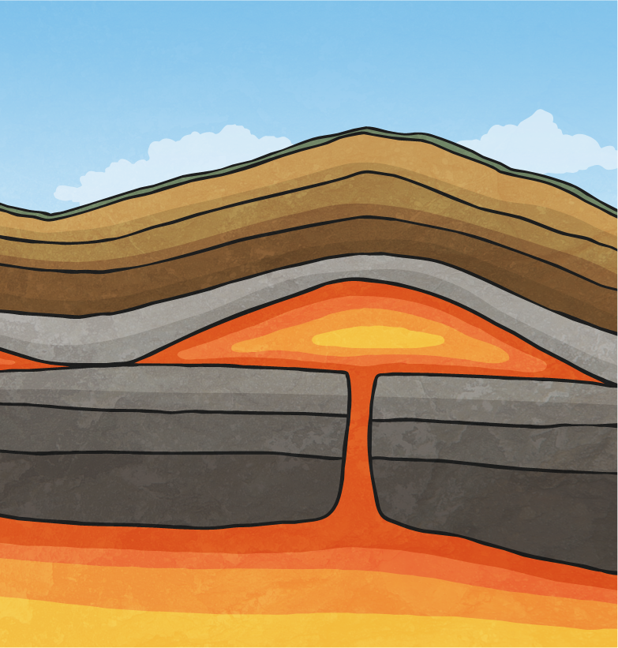
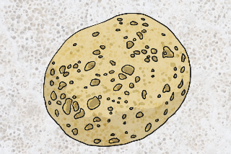
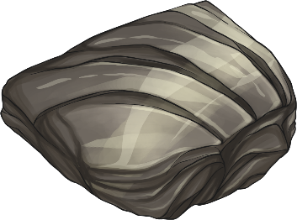
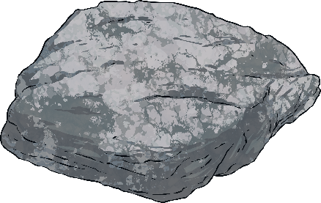
The Centre of the Earth
The immense heat of Earth's solid core is enough to melt rocks. This melted rock is known as magma.
Magma makes up a layer between Earth's core and the surface (the ground we stand on).
As the magma cools near the surface of Earth, it starts to turn back into solid rock.
The rocks formed by cooling magma are called igneous rocks.
Examples of igneous rock include pumice, granite and obsidian.

Slide 8

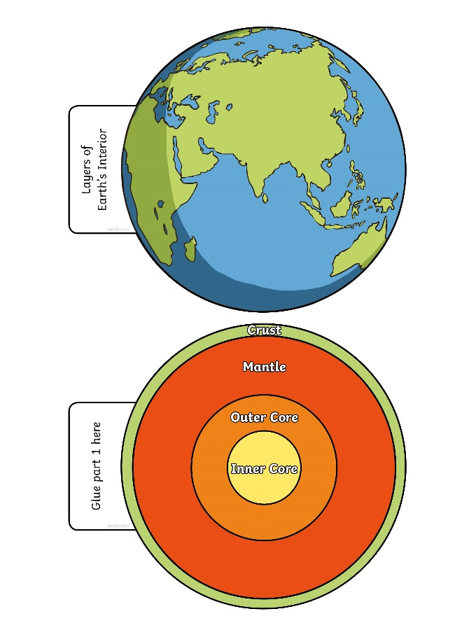
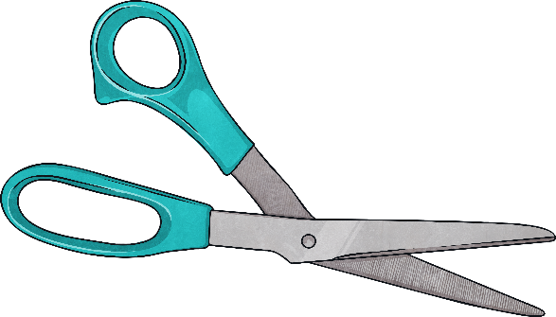
Earth Layers
Without Inge's hard work and research, these facts may never have been known!
Use your Earth Layers Interactive Visual Aid to create a paper model of Earth and its core.
Can you add information about Earth's core to your paper model? See how many facts you can think of!

Slide 9

Aim
To describe what Inge Lehmann discovered about Earth’s core.
Success Criteria
I can describe Inge Lehmann’s life and work.
I can explain what she discovered about Earth’s core.
I can explain how Earth’s core helps create igneous rocks.

