Slide 1
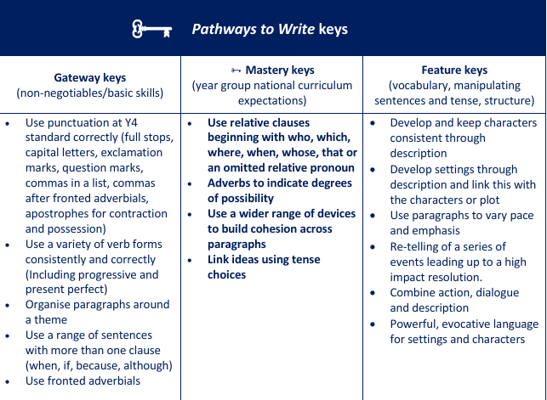
Maths
Decimals:
Step 4 Add decimals with the same number of decimal places
Step 5 Subtract decimals with the same number of decimal places
Step 6 Add decimals with different numbers of decimal places
Step 7 Subtract decimals with different numbers of decimal places
Step 8 Efficient strategies for adding and subtracting decimals
Step 9 Decimal sequences
Step 10 Multiply by 10, 100 and 1,000
Step 11 Divide by 10, 100 and 1,000
Step 12 Multiply and divide decimals - missing values
Negative Numbers:
Step 1 Understand negative numbers
Step 2 Count through zero in 1s
Step 3 Count through zero in multiples
Step 4 Compare and order negative numbers
Step 5 Find the difference
Converting Units:
Step 1 Kilograms and kilometres
Step 2 Millimetres and millilitres
Step 3 Convert units of length
Step 4 Convert between metric and imperial units
Step 5 Convert units of time
Step 6 Calculate with timetables
Volume:
Step 1 Cubic centimetres
Step 2 Compare volume
Step 3 Estimate volume
Step 4 Estimate capacity
Year 5
Summer 2
Science
Reproduction A:
Step 2 Reproductive parts in plants
Step 3 Pollination
Step 4 Asexual reproduction
Reversible and Irreversible Changes:
Step 1 Dissolving
Step 2 Separate materials - filtering and sieving
Step 3 Solutions and evaporating
Step 4 Reversible changes
Computing:
Micro: bits
RE:
What matters most to humanists and Christians?
DT: Cams
PE:
Rounders and Athletics
French:
School Life
English: Fiction (Adventure Story)
Main text: The Hunter By Paul Geraghty
Writing Outcome: To write a narrative based on the structure of The Hunter by changing the characters, animal and setting
PSHE (Mrs. Poole)
Aiming High
Music:
Reflect, Rewind and Replay
Geography: Mountains
Explain how mountains are formed and where the major mountain ranges in the world (Build on plate tectonics from Y3)
Identify common features of a mountain environment and compare it to where we live
Investigate the climate of mountain ranges
Explore the human and physical features of a mountain range in North America- The Rockies
Describe the various uses of mountains and mountain ranges
Explain the positive and negative aspects of tourism in mountain environments

