Slide 1
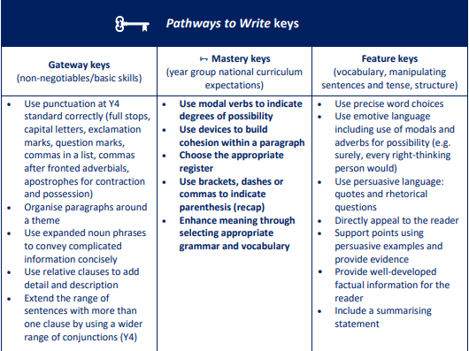
Maths
Shape:
Step 1 Understand and use degrees
Step 2 Classify angles
Step 3 Estimate angles
Step 4 Measure angles up to 180°
Step 5 Draw lines and angles accurately
Step 6 Calculate angles around a point
Step 7 Calculate angles on a straight line
Step 8 Lengths and angles in shapes
Step 9 Regular and irregular polygons
Step 10 3-D shapes
Position and Direction:
Step 1 Read and plot coordinates
Step 2 Problem solving with coordinates
Step 3 Translation
Step 4 Translation with coordinates
Step 5 Lines of symmetry
Step 6 Reflection in horizontal and vertical lines
Year 5
Summer 1
Science
Animals including humans:
Step 5 Gestation periods of mammals and lifespan
Life Cycles:
Step 1 Life cycles of mammals and amphibians (frogs)
Step 3 Life cycles of insects and birds
Reproduction A:
Step 1 Sexual reproduction in mammals
Step 2 Reproductive parts in plants
RE: Christianity
How can following God bring freedom and justice?
Art:
2D Drawing to 3D Making
English:
Main text: The Paperbag Prince by Colin Thompson
Writing Outcome: To write a persuasive leaflet to give information about waste management (selecting an
appropriate audience e.g. for councils to distribute to home and schools)
PE:
Dance and Rounders
PSHE (Mrs. Poole)
It’s My Body
Music: Motown
Dancing in the Street
Computing:
Word Processing (Google Slides) and Micro: bits
French:
Friends and Family and
School Life
History: Local Study- Industrial Revolution. Silk, Cotton and Canals
Explain the role of technological inventions in the Industrial Revolution
Describe Quarry Bank Mill and its significance to our local area.
Explain Macclesfield’s contribution to the Industrial Revolution
Describe the impact of the building of canal networks
Evaluate how life changed in the North-West during the Industrial Revolution.

