Slide 1
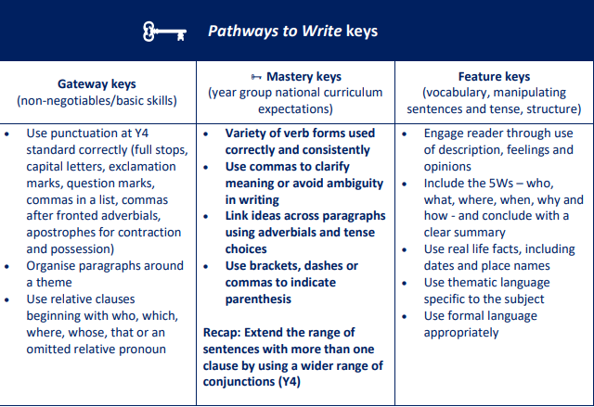
Maths
Decimals and Percentages
Step 8 Order and compare decimals (same number of decimal places)
Step 9 Order and compare any decimals with up to 3 decimal places
Step 10 Round to the nearest whole number
Step 11 Round to 1 decimal place
Step 12 Understand percentages
Step 13 Percentages as fractions
Step 14 Percentages as decimals
Step 15 Equivalent fractions, decimals and percentages
Perimeter and Area
Step 1 Perimeter of rectangles
Step 2 Perimeter of rectilinear shapes
Step 3 Perimeter of polygons
Step 4 Area of rectangles
Step 5 Area of compound shapes
Step 6 Estimate area
Statistics
Step 1 Draw line graphs
Step 2 Read and interpret line graphs
Step 3 Read and interpret tables
Step 4 Two-way tables
Step 5 Read and interpret timetables
Year 5
Spring 2
Science
Materials
Step 4 Investigate - insulating heat experiment
Step 5 Evaluate - insulating heat experiment
Step 6 Uses of everyday materials - plastic, wood and metal
Animals including humans
Step 1 The human life cycle
Step 2 Babies and children
Step 3 Adolescence and puberty
Step 4 Adults and the elderly
PE:
Athletics and Cricket
RE:
Creation and science; conflicting or complementary?
PSHE (Mrs. Poole)
Be Yourself
DT:
Frame Structures
English
Main text: The Darkest Dark
Writing Outcome: To write a formal biography about Chris Hadfield
Music: Hip-hop
The Fresh Prince of Bel-Air
French:
That’s Tasty and Friends and Family
Computing:
Spreadsheets and Micro: bits
Geography: Coasts
Identify different types of beaches
Use maps and secondary sources to research and describe coastal areas of the UK (Build on Y2 coastal study of Blackpool)
Describe how changes in land use will affect people and the environment in different ways
History: Local Study- Industrial Revolution. Silk, Cotton and Canals
Explain what the Industrial Revolution was.
Explain the role of technological inventions in the Industrial Revolution

