Slide 1
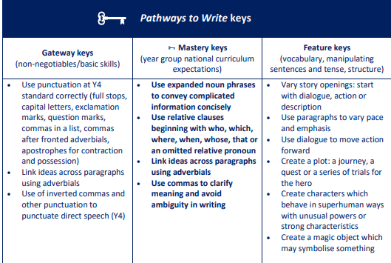
Maths
Multiplication and Division
Step 1 Multiply up to a 4-digit number by a 1-digit number
Step 2 Multiply a 2-digit number by a 2-digit number (area model)
Step 3 Multiply a 2-digit number by a 2-digit number
Step 4 Multiply a 3-digit number by a 2-digit number
Step 5 Multiply a 4-digit number by a 2-digit number
Step 6 Solve problems with multiplication
Step 7 Short division
Step 8 Divide a 4-digit number by a 1-digit number
Step 9 Divide with remainders
Step 10 Efficient division
Step 11 Solve problems with multiplication and division
Fractions B
Step 1 Multiply a unit fraction by an integer
Step 2 Multiply a non-unit fraction by an integer
Step 3 Multiply a mixed number by an integer
Step 4 Calculate a fraction of a quantity
Step 5 Fraction of an amount
Step 6 Find the whole
Step 7 Use fractions as operators
Science
Sustainability
Step 1 What is global warming?
Step 2 What are the impacts of global warming on living things
Materials
Step 1 Test materials - magnetic, transparency and hardness
Step 2 Test materials - electrical conductivity
Step 3 Plan - insulating heat experiment
Step 4 Investigate - insulating heat experiment
Step 5 Evaluate - insulating heat experiment
Step 6 Uses of everyday materials - plastic, wood and metal
Year 5
Spring 1
PE:
Outdoor Adventurous Activity and Football (Mrs. Poole)
Art: Making Monotypes Artist- Kevork Mourad
English
Main text: Arthur and the Golden Rope by Joe Todd- Stanton
Writing Outcome: To write a myth: to create characters (heroes, villains and monsters) and settings.
RE:
Why is the Torah so important to Jewish people?
PSHE (Mrs. Poole)
Celebrating difference- Diverse Britain
Geography: Coasts
Explain what coasts are and how they are formed
Describe the physical features of coasts and the processes of erosion that affect them
Explore different strategies of coastal management
Identify different types of beaches
Use maps and secondary sources to research and describe coastal areas of the UK (Build on Y2 coastal study of Blackpool)
Describe how changes in land use will affect people and the environment in different ways
Computing:
Game Creator and Spreadsheets
Music: Pop
To Make you feel my Love
French:
All About Ourselves and
That’s Tasty
History: The Ancient Greeks
Explore key idea and questions from Ancient Greek philosophy
Describe how Ancient Greek democracy has evolved

