Slide 1

Welcome to Year 1!

Slide 2

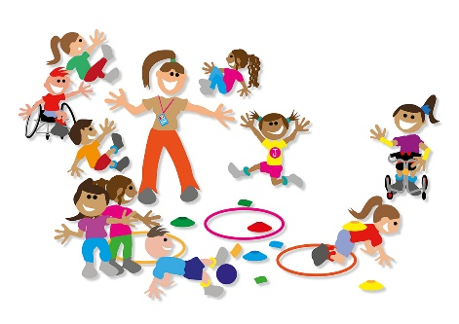


General Information
School reading books will be changed once a week on a Friday. Please share these books with your child as often as possible - we recommend at least 10 minutes a day, as well as re-reading each book at least three times (or more!)
This is so, the children can practise using their reading skills with a familiar text. Please remember to have the Reading Record and books in your child’s bag every day.
We are timetabled to have PE every Tuesday and Friday.
Please remember to come dressed in PE kits on those days.
Homework is set on a Friday and will consist of 2 or 3 Mathletics activities and spellings, as well as daily reading. Login details for Mathletics can be found in the front of reading records.
Reading
PE lessons
Homework

Slide 3

Daily Routine
A typical day – times may vary slightly
8.45 – 9.00 Children arrive & do an Early Bird Activity
9.00 – 9.25 Register then handwriting / phonics interventions
9.25 – 9.35 Assembly
9.35 – 10.25 Session 1 - Maths
10.25 – 10.45 Playtime with snack
10.45 – 11.45 Session 2 - English
11.45 – 12.00 Reading
12.00 – 12.45 Lunch
12.45 – 1.15 Phonics
1.15 – 2.15 Whole Class learning (Science, Art, Music, History, Geography, ICT, PE)
2.15 – 2.30 Break/Fruit time
2.30 – 3.00 Whole Class learning (As above)
3.00 – 3.15 Story time & Home time

Slide 4

English
In English we use ‘Pathways to Write’
We are starting with the wonderful story of
‘Lost and Found’ by Oliver Jeffers
Learning Objectives for this half term:
Plan simple sentences by saying out loud what the writing will be about.
Orally compose a sentence before writing it and recognise sentence boundaries.
Use capital letters, finger spaces and full stops.
Check written work makes sense through rereading with other pupils and the teacher.
Read work aloud clearly.

Slide 5

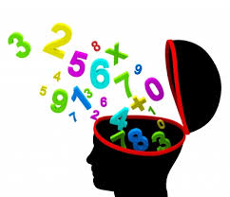
Maths
During our maths sessions we have a whole class input followed by group and independent activities
Mental maths test - weekly
Arithmetic test - weekly

Slide 6
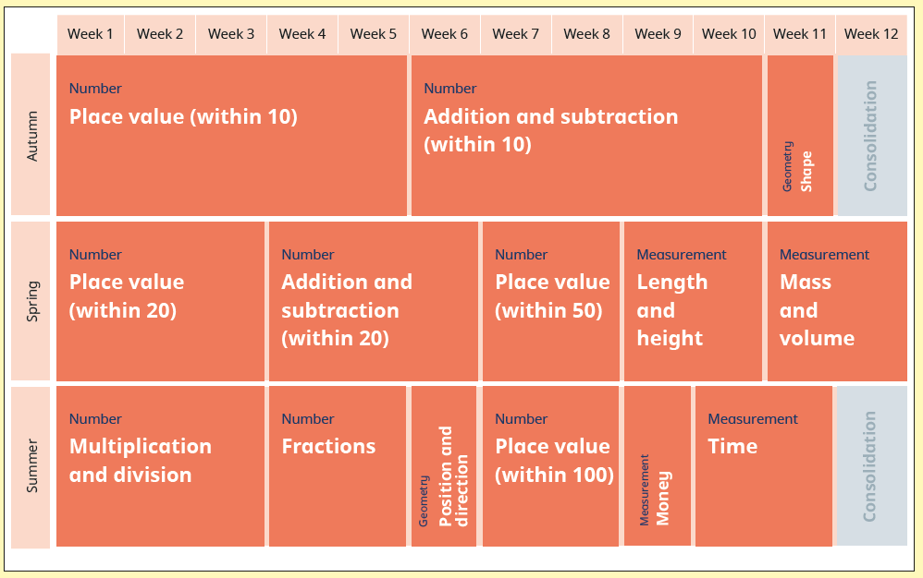
Year 1 Maths - Yearly Overview

Slide 7


Phonics
We follow the ELS (Essential Letters and Sounds programme)
30 minutes everyday
The programme is based around a ‘show, copy, repeat’ sequence
until the children are independent.
The children hear and say each sound (phoneme), first in isolation, and then
within words and sentences. They use ‘robot arms’ to segment the sounds and
then blend the sounds together saying the whole word
They are encouraged to use this segmenting and
blending technique when writing
Decodable books: A text which is entirely decodable
based on the sounds and graphemes that have been taught
Getting all
children to read
well, quickly

Slide 8
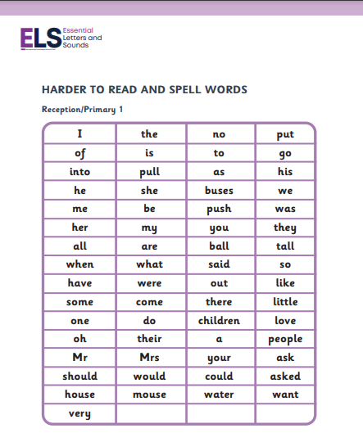
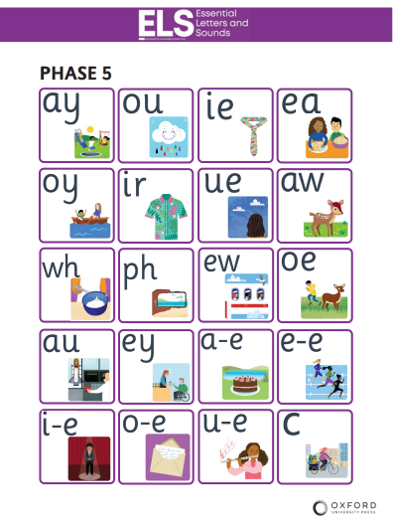
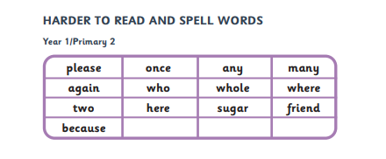
Year 1 Harder to Read and Spell Words
Phase 5 sounds

Slide 9
Glossary of Terminology
Digraphs: Two letters making one sound: ch, sh, th, ng
Vowel Digraphs: oa, ee, ai, oi
Split digraphs: Two vowels that make one sound but are split by one or more consonants: a-e, e-e, i-e, o-e, u-e (as in ‘make’ or ‘inside’)
Trigraphs: three letters making one sound: igh, air, ure
Grapheme: A letter or a group of letters representing one phoneme: ough - though

Slide 10

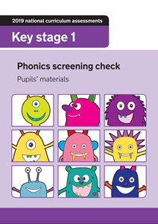
Year 1 Screening Test
40 words - 50% real and 50% Pseudo ‘alien’ words
Assesses decoding skills only
Done with class teacher
June 2025
Pass mark around 32 each year

Slide 11
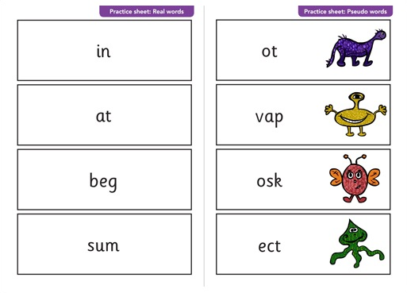
Examples of the real & alien words

Slide 12
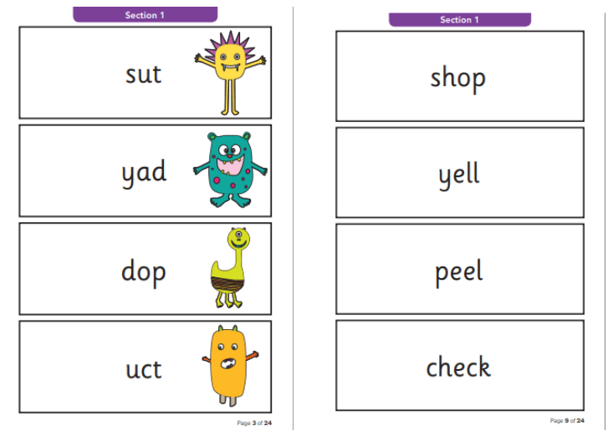

Slide 13
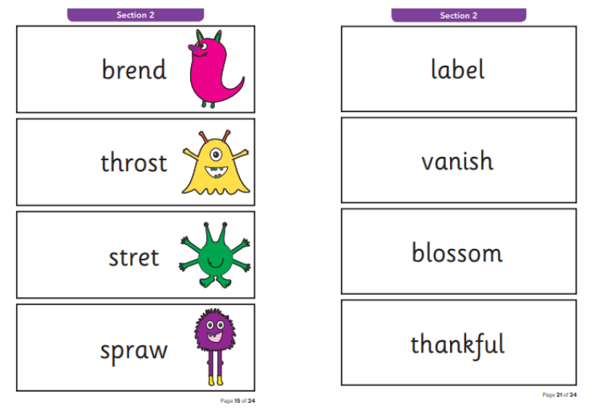

Slide 14


Reading - How can you help?
REMEMBER:
Phonics is not the only way you become a good reader.
Try to read with your child each day, or as often as you can, and encourage
them to:
Sound out the words and blend the sounds together.
Re-read sentences to check they make sense and to develop fluency
Use pictures for clues.
Ask questions/talk about the book.
Most importantly – share and enjoy different books together

Slide 15
Attendance
Good attendance in school is essential for learning:
Attendance of 95% in a year means that a child has missed 9.5 days
of school.
Attendance of 90% in a year means that a child has missed 19 days
of school.
Attendance below 90% is very low and is classified by the
Department of Education as a child being persistently absent.
It is also very important that children are in the classrooms ready to start learning at 9am.

Slide 16
Useful information
You can find lots of useful information on our
school website:
https://www.mottramacademy.org.uk/

Slide 17


Any Questions?
Please don’t hesitate to contact me if you have any questions or queries.
llomas@mottramacademy.org.uk

