Slide 1
Welcome to Year 6
Mr Jackson
ajackson@mottramacademy.org.uk

Slide 2
Tonight’s Agenda
Timetable
Topics and curriculum
SATS
Homework
Trips
Help from home

Slide 3
Year 6 Timetable
English and maths daily
Whole class reading and spelling recaps 3 times a week
Foundation subjects every afternoon
Opportunities to read and discuss texts daily
Additional sessions for extra support where needed
P.E. Tuesday (swimming) and Thursday this term

Slide 4
English
Reading, writing, grammar and punctuation linked to a key book or text.
E.g. Maya myths and legends – Rain Player
Specific punctuation and grammar (PaG) sessions where needed, including at the start of lessons to recap.
Handwriting must be legible and joined.
Spelling recaps – 3 times a week – following patterns, previous patterns learnt and common misspellings.
Reading – Whole class reading comprehensions, class novels and 1-1 reading as appropriate.

Slide 5
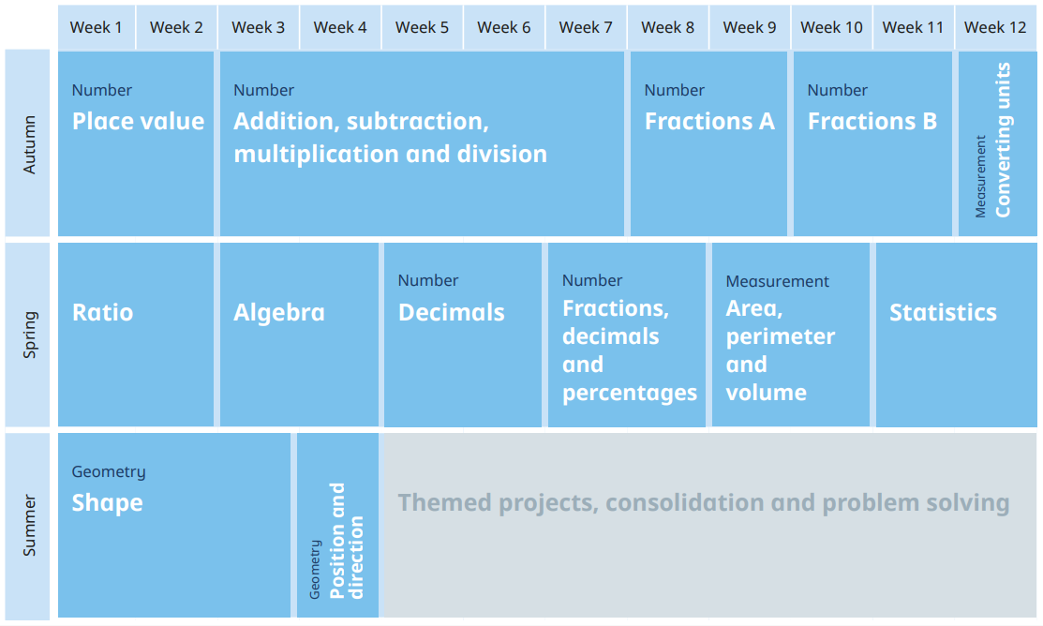
We follow White Rose Maths for our scheme of learning. Areas will be revisited and further consolidated as needed. This is supported with weekly arithmetic and mental maths.

Slide 6
Year 6 Topics and Curriculum
Theme webs updated onto website. These provide an overview of what we will be learning about that term/half term.
Each term will involve a variety and balance of different of subjects.
For each topic, including science, there is a knowledge organiser which contains key learning points and words.
Let’s take a look at the yearly overview, theme web for this half-term, maths yearly overview and an example knowledge organiser.

Slide 7
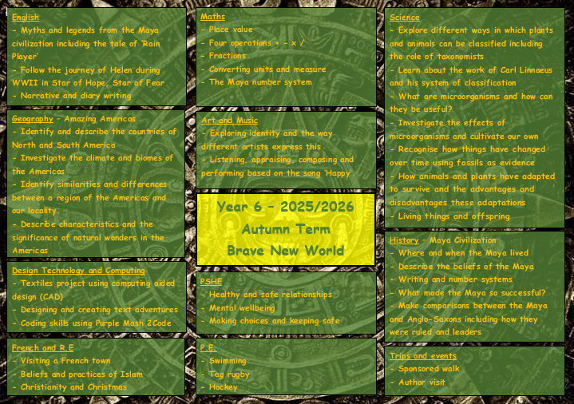

Slide 8
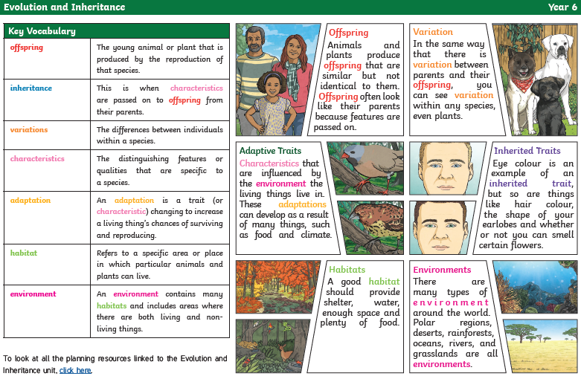

Slide 9
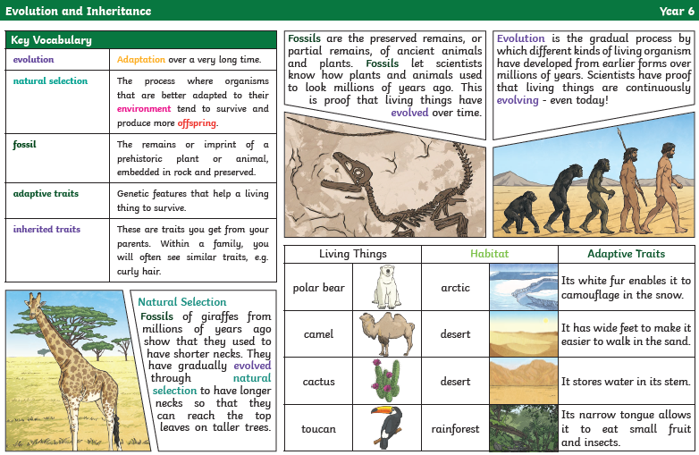

Slide 10

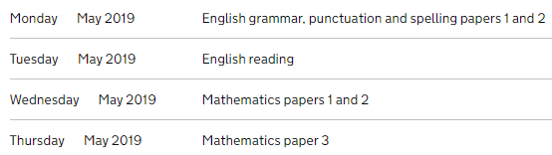
SATS
Paper 1 – Arithmetic (calculations)
Paper 2 & 3 - Reasoning (problem solving)
The Year 6 SATS will be taking place in May next year. They usually follow the format above with a focus on English at the start of the week and maths in the second part.
Take a look at the following example SATS questions. How many would you feel confident with?

Slide 11
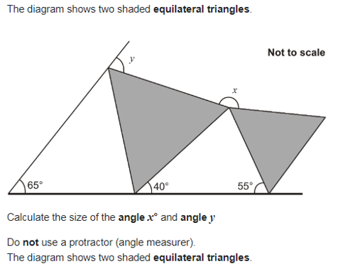

Slide 12
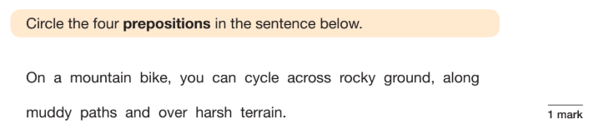
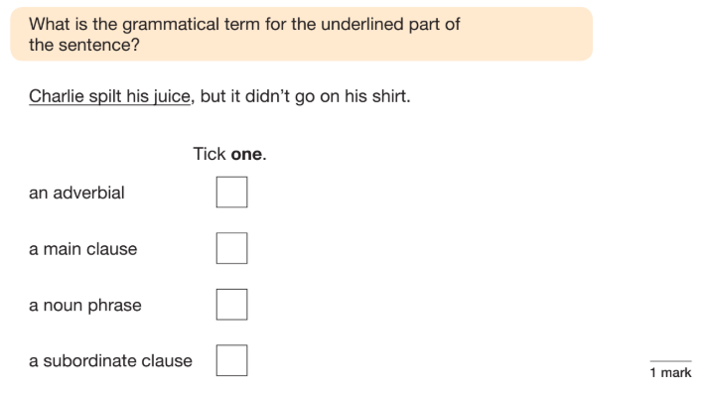
How good is your spelling, punctuation and grammar?

Slide 13
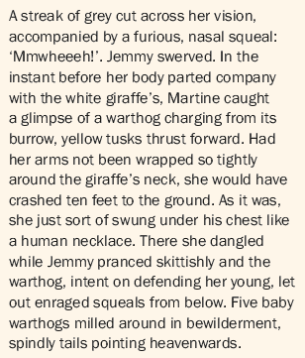
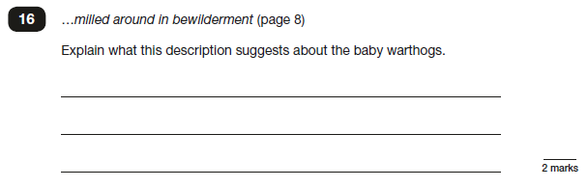

Slide 14
How do we prepare for SATs? - Teaching for understanding - Examples in everyday teaching - Specific practise - Example papers We will complete a set of practice papers each term. This will give the class opportunity to show what they are confident with, what they find tricky, and help familiarise themselves with what to expect. Feedback will be shared with parents. We approach SATS with a calm focus so the class can show just what they are capable of! If you do want to look at some examples, please use the 2016 Sample, 2016, 2017, 2018 and/or 2019 dates. The others I will use for assessment.

Slide 15
SATs Prep
Little and often is key. If you have any concerns, make a start now.
Get your child to be vocal. What are you finding tricky? How can we help?
Work and learning from home → complete the homework tasks and daily reading.
We have some intervention time in school to give additional support.

Slide 16
Writing expectations
Writing is teacher assessed in school (no tests). The final date for teacher assessments is in the Summer Term around June.
There is a spelling section as part of Year 6 SATS.
Children need to be able to write for a range of purposes and audiences, adapting their understanding of vocabulary, grammar and punctuation appropriately.
Want to see examples of the standard Year 6 are expected to write at?
Writing exemplifications can be found here.
https://www.gov.uk/government/publications/2018-teacher-assessment-exemplification-ks2-english-writing

Slide 17
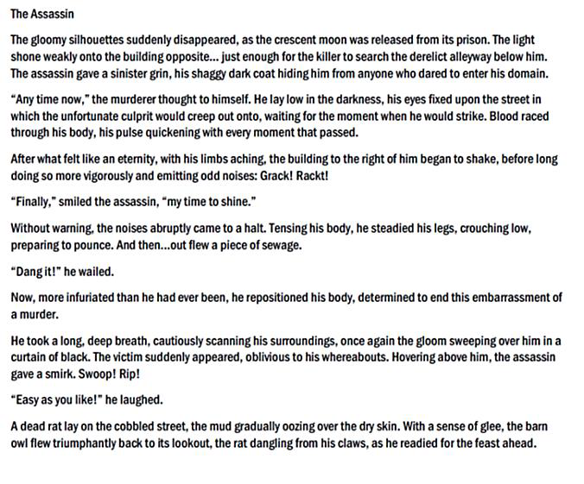

Slide 18
Homework
Reading – Daily reading and updates to reading journal. I will monitor books to ensure they are an appropriate level. Later this term, weekly reading comprehensions will be set from a workbook.
Maths – weekly Mathletics tasks or worksheets, Times Table Rock Stars.
Spellings – weekly list. We will recap previous spelling patterns and lists, including from KS1 and KS2, in school.
Topic – once per term related to our theme.
Any questions or concerns with homework, please ask your child to speak to me in school to sort. The class have all their logins in their reading journals.

Slide 19
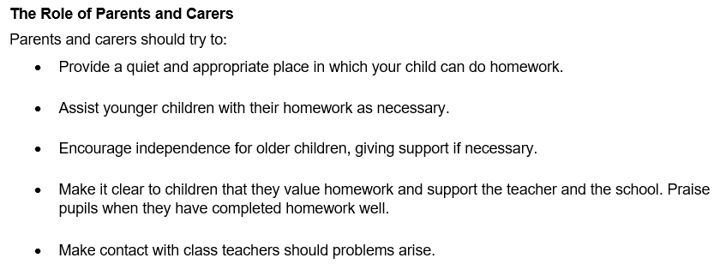
A polite reminder from our homework policy…

Slide 20
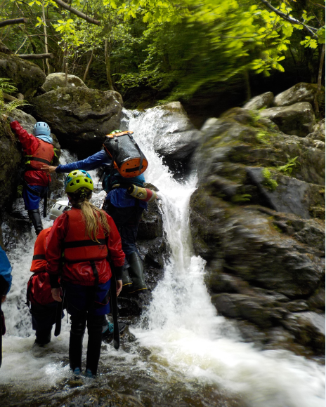
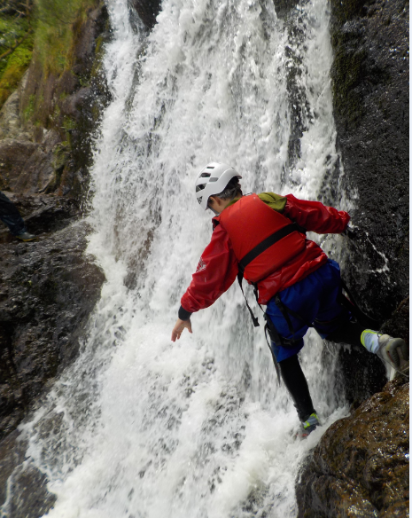

Slide 21
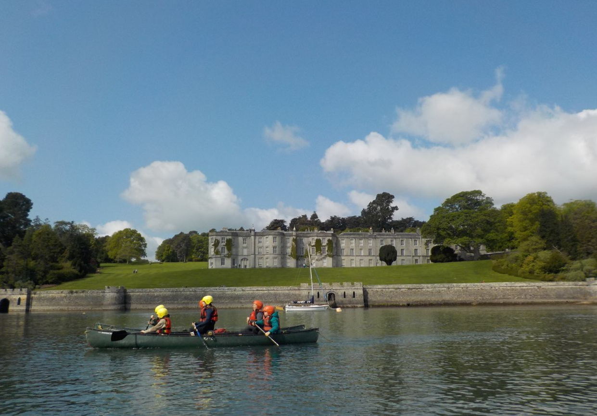

Slide 22
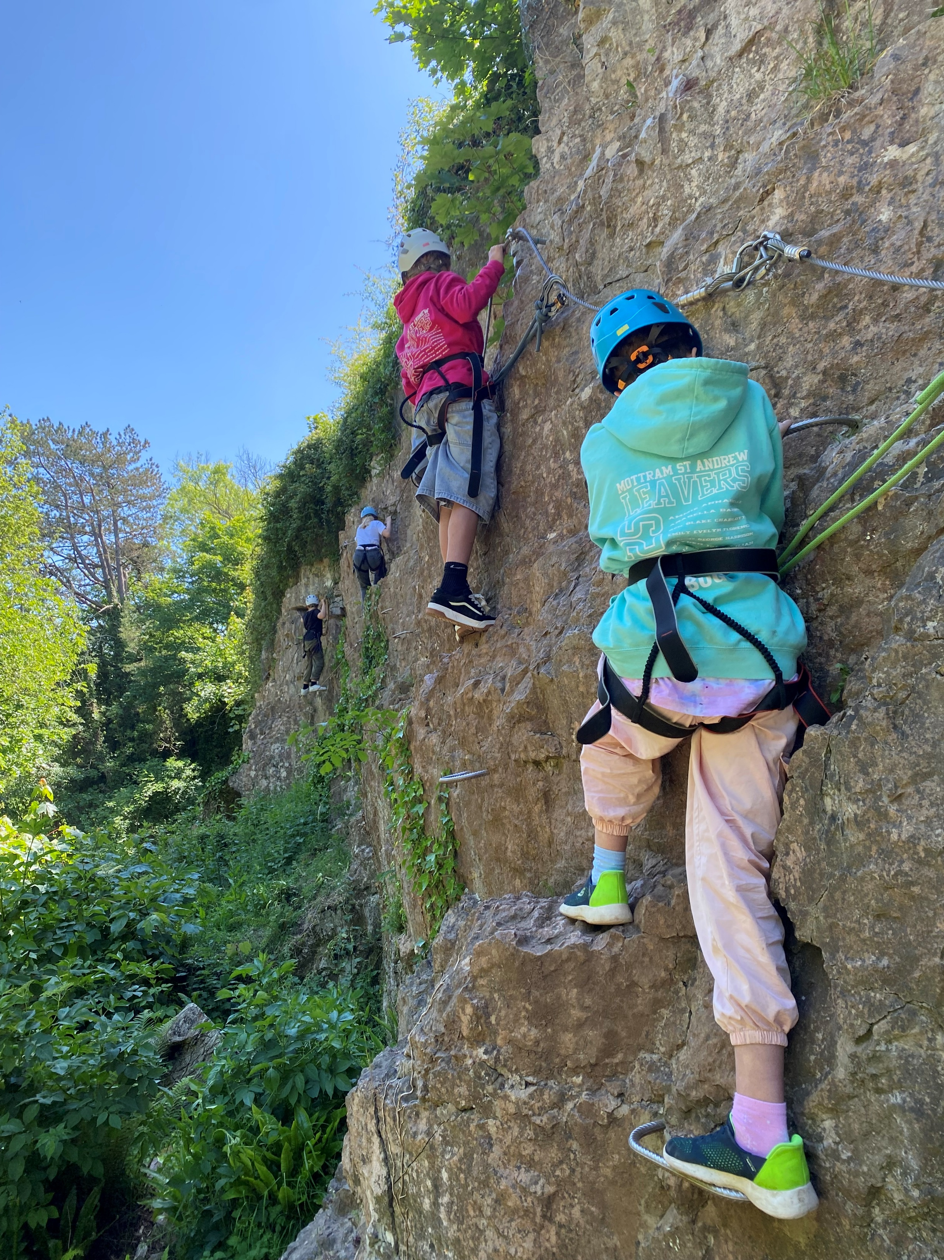
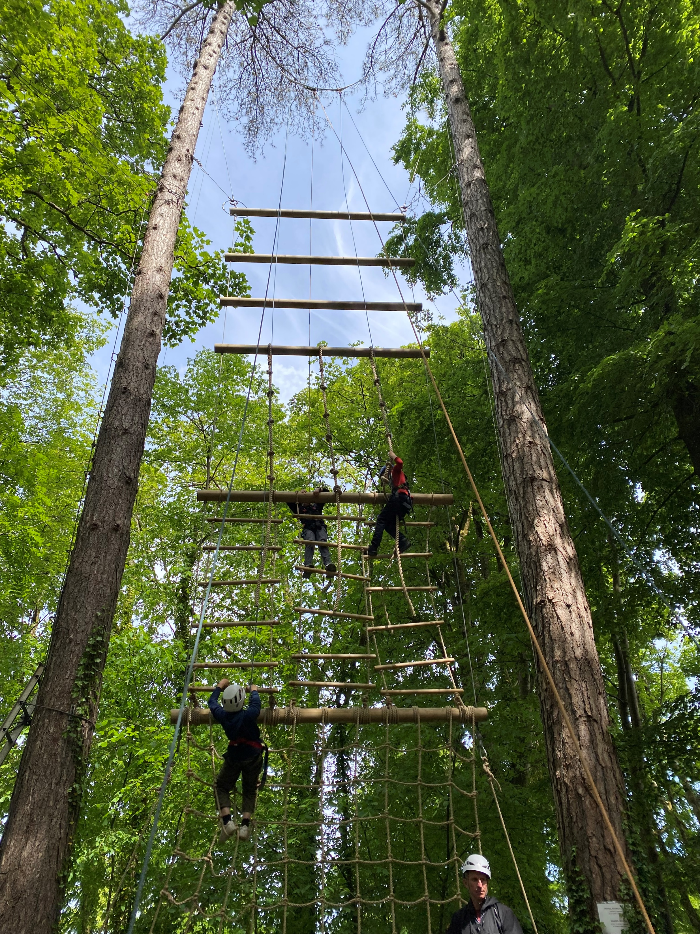

Slide 23
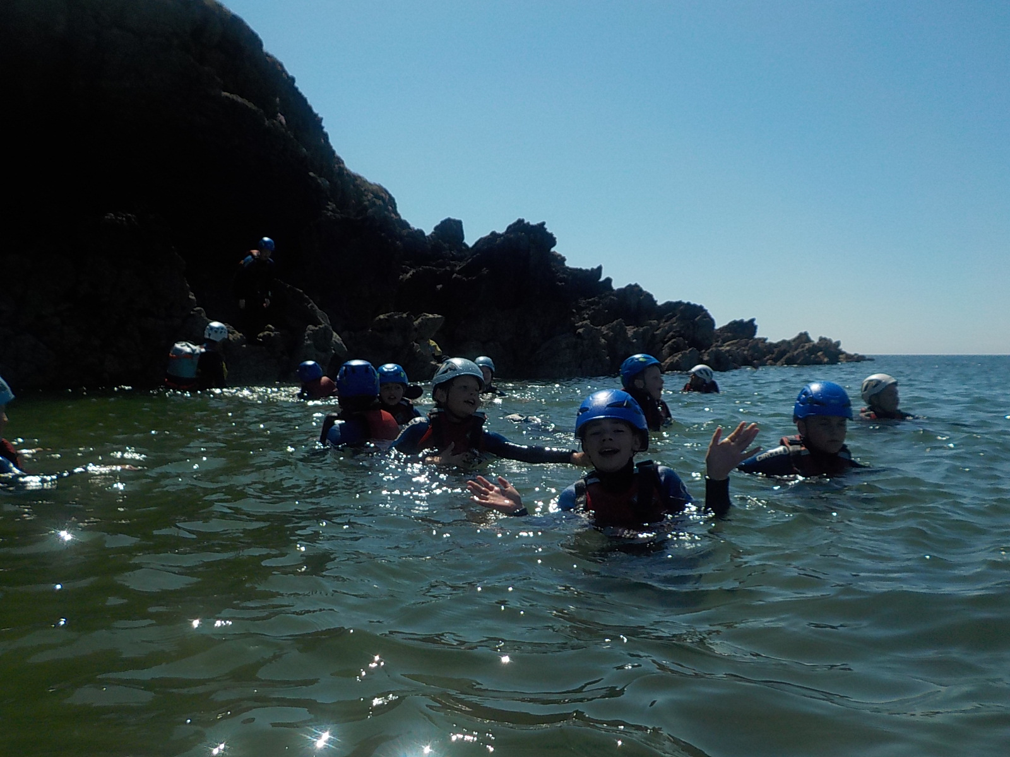
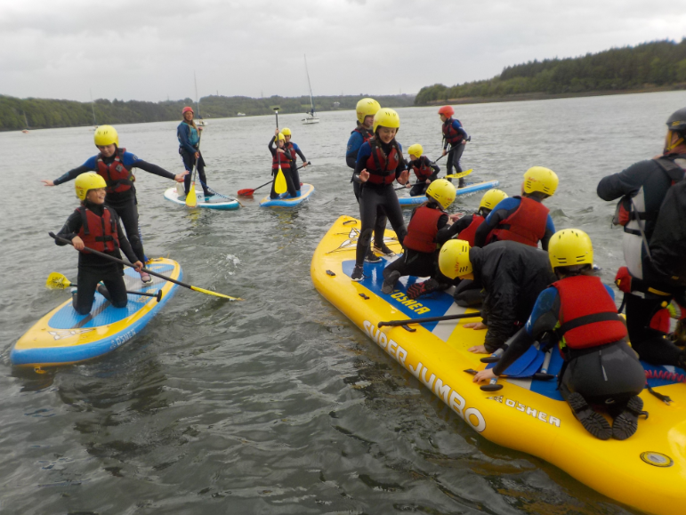
Conway Centre Anglesey
18th – 22nd May
Monday – Friday (4 nights of freedom)
A real variety of ‘proper’ outdoor activities - it is my favourite part of the year.
If you or your child have any worries or concerns about the residential, please get in touch.

Slide 24
Other events and trips
Sponsored walk Carols in the chapel
Imperial War Museum North Young Voices
Creativity/Arts Week Macclesfield Crucial Crew (safety)
Bikeability Secondary school transition days
Year 6 production Leavers assembly
Inter-school sports events and activities

Slide 25
Support from home
Year 6 Expected Standard is difficult and challenging to achieve.
Listen, work hard at the right times and ask questions. Be positive!
Little and often is key – reading, spelling and maths. Daily reading is very important!
Completing homework on time (good for secondary prep)
Children must be fluent with their times tables.
Take care and pride with work. High expectations – neat, joined handwriting.
SATS are important. We want to the children to reflect all they are capable of.
BBC Bitesize has a wide range of fantastic resources for recapping.
Attendance is vital throughout the entire year. Work is planned across several weeks. It disrupts learning of not only your child but the class too.

Slide 26
Attendance
Good attendance in school is essential for all learning:
Attendance of 95% in a year means that a child has missed 9.5 days of school.
Attendance of 90% in a year means that a child has missed 19 days of school.
Attendance below 90% is very low and is classified by the Department of Education as a child being persistently absent.
Assessments are still taking place after SATS. It is a key time for writing and science. Writing is the most difficult to attain.
It important that children are in the classrooms promptly, ready to start learning at 9am.

