Slide 1
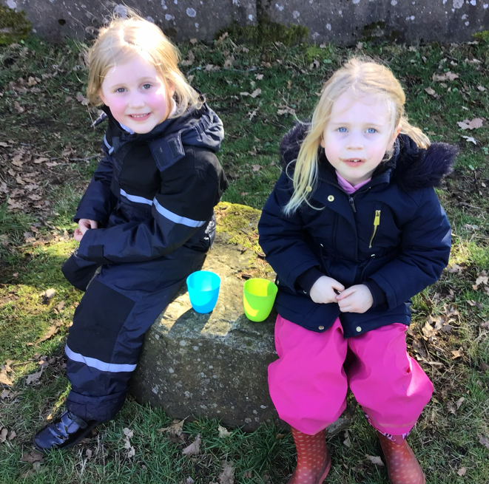
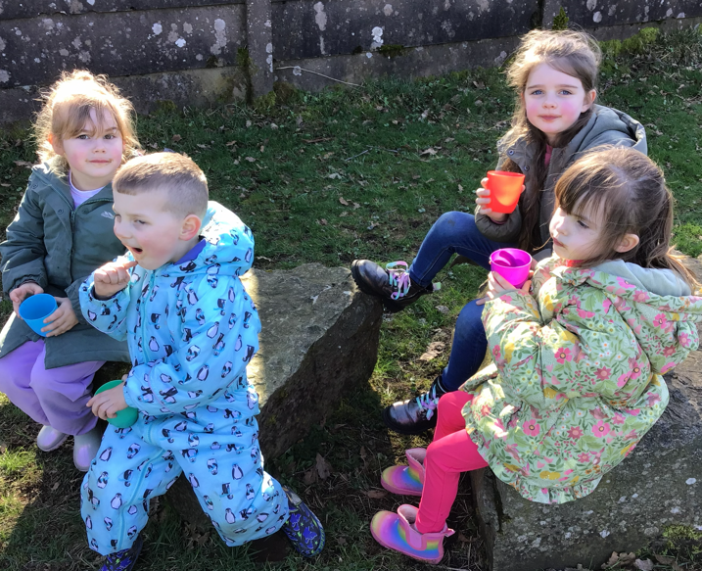
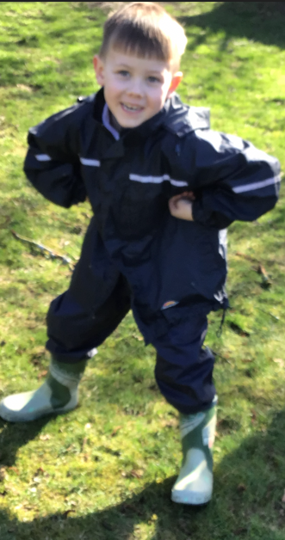
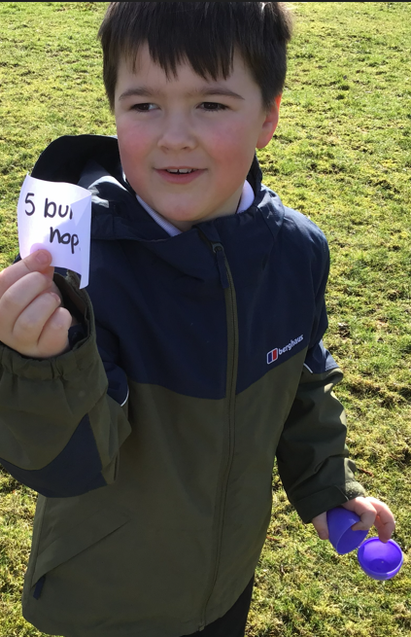
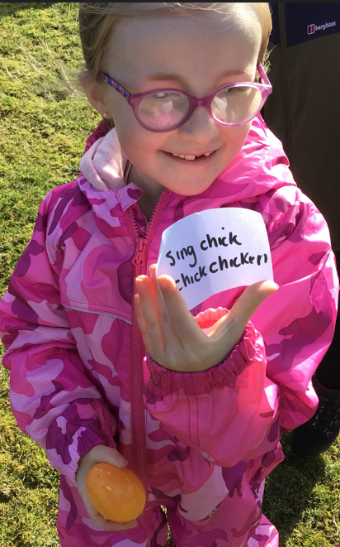
Forest School 17th March 2026
Class 1’s Forest School session were blessed with some fabulous warm spring sunshine. They discussed and looked the signs of spring, and also listened to the birds. They had a great time completing an Easter egg hunt. Children had to find the hidden eggs, bring them to an adult who opened the eggs (which had a forfeit inside), the children read the forfeit and had to do whatever it said. Things like: hop like a bunny, leap like a lamb, sing ‘Run Rabbit’ and dance like a chicken to mention a few. They then had a snack and a drink before having some free time to explore the site.

Slide 2
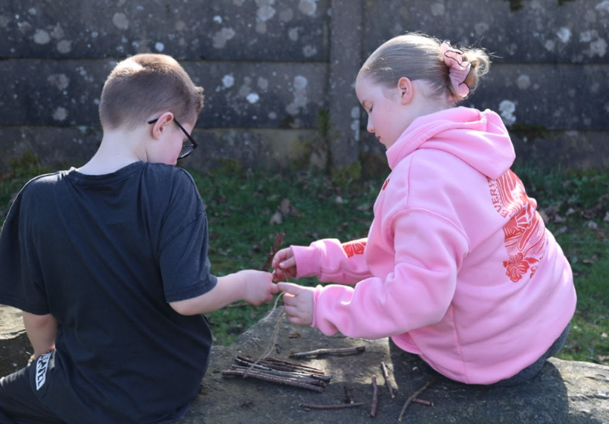
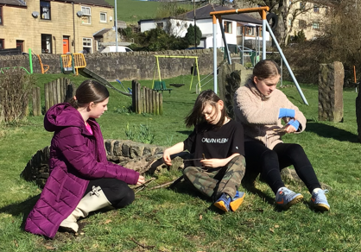
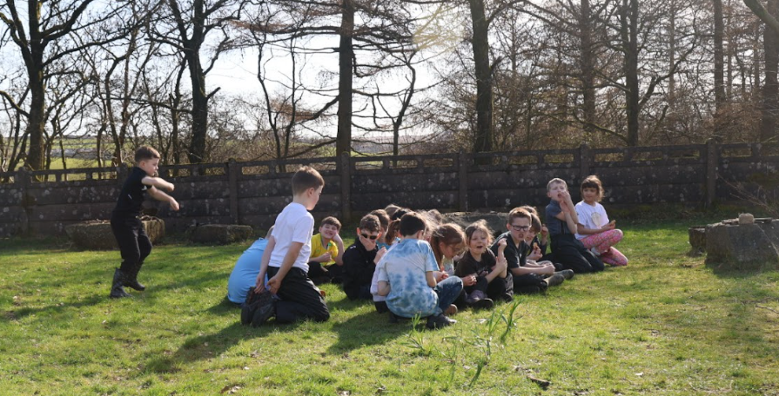
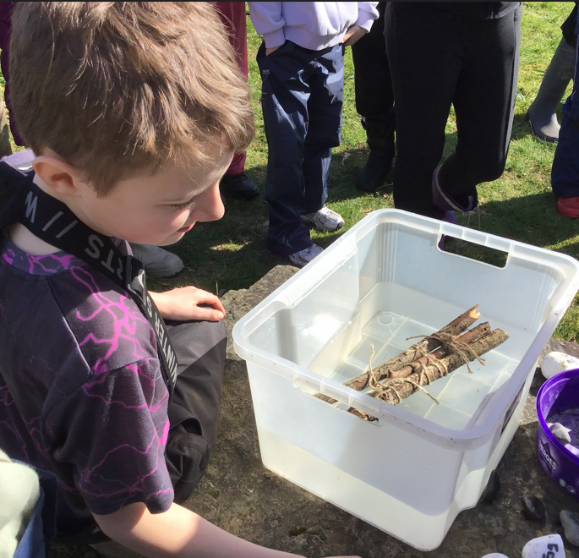
Forest School 18th March 2026
Class 2 and 3 had an even warmer day than Class 1, it was glorious! Their task was to design and build a small raft. The raft had to be able to float in the tub, but it also had to be stable enough to carry stones which had each been weighed and the weight recorded on each stone. The raft which floated and carried the most weight won. There were lots of different designs, the children used their problem solving skills to work out how to make sure that their raft could carry some of the stones. They also used their maths knowledge to add up the different weights of the stones. They also had a snacks and a drink, Class 3 had a few games of capture the flag before returning to school.

