Slide 1
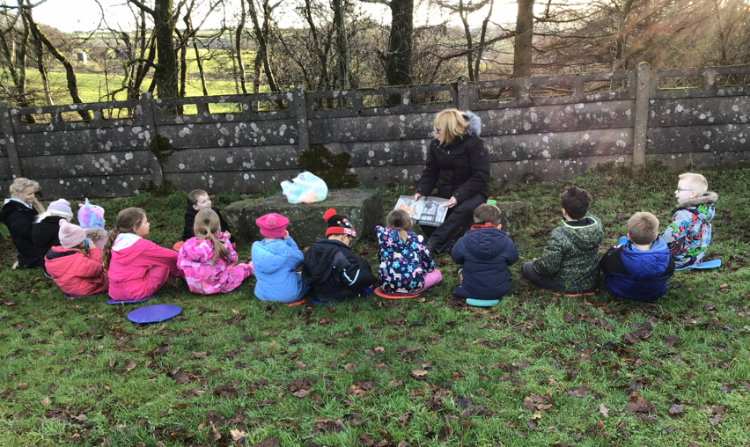
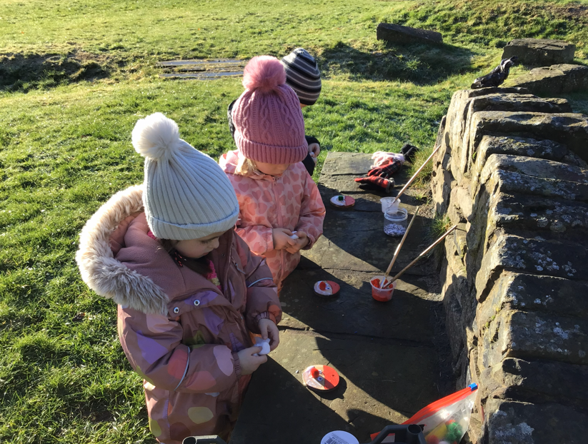
Class 1 Forest School Visits
Class 1 had a frosty start to their session. They explored our new forest school area and learnt the new boundaries. The children made Father Christmas tree cookie decorations using paint, glue, cotton balls and pom poms. They then enjoyed hot chocolate and a biscuit to help them warm up.

Slide 2
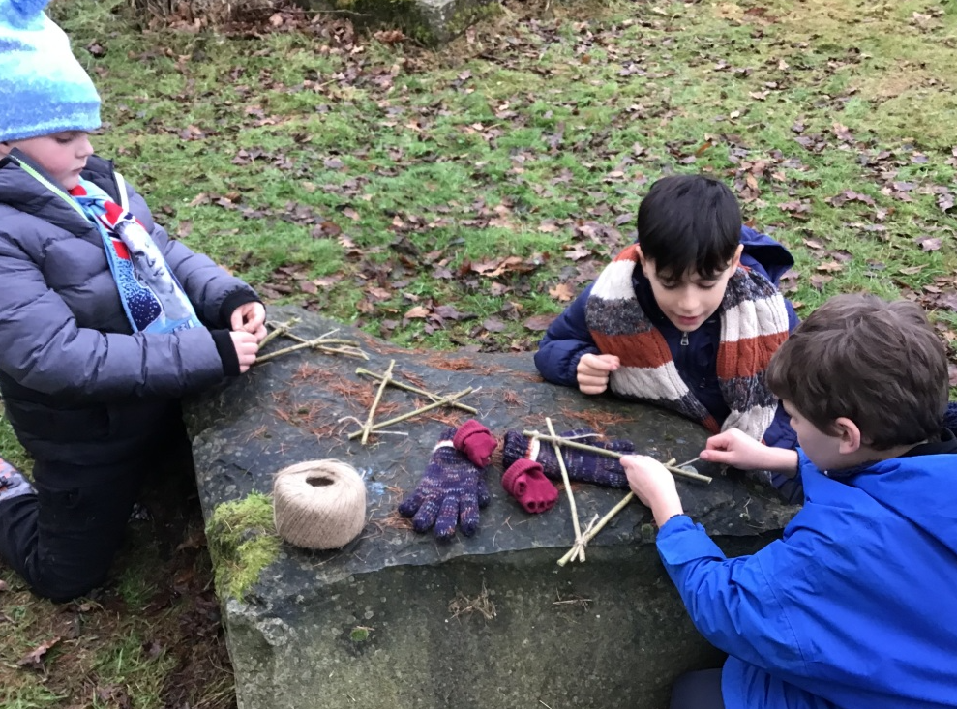
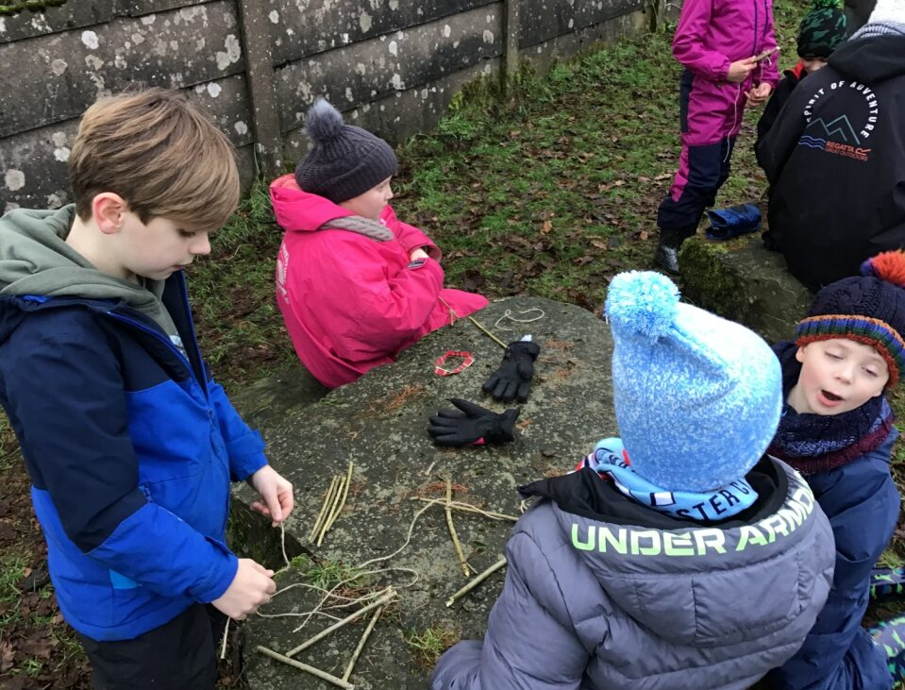
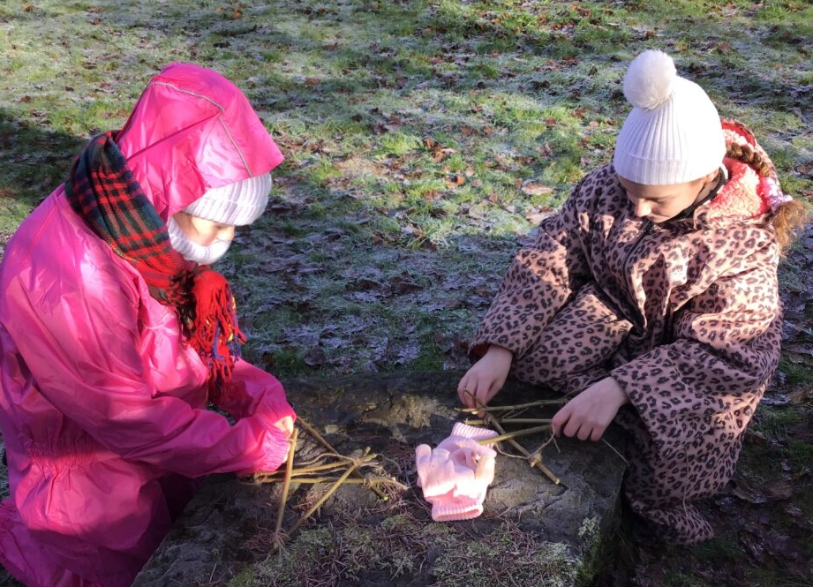
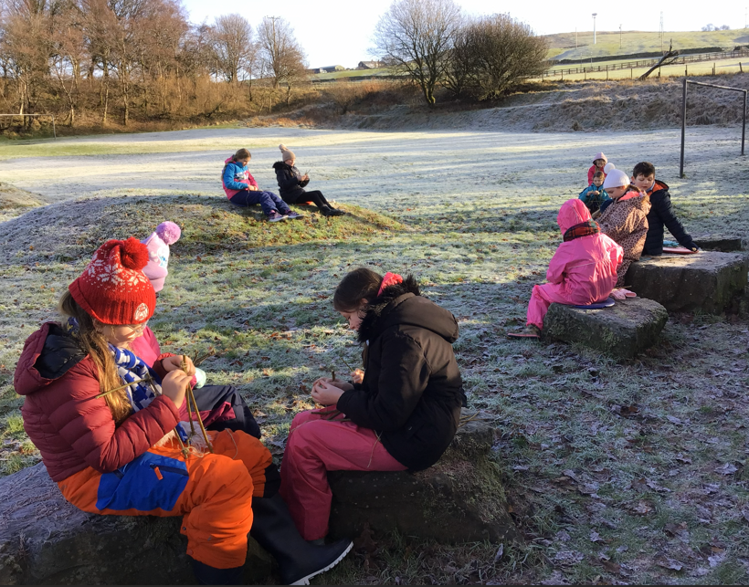
Class 2 Forest School Visit
Most of the frost had disappeared by the time that Class 2 arrived at Forest School in the afternoon. They were the last group to explore the new site, and they enjoyed sliding down the grass bank (this was a big hit with all groups!) Class 2 had to create a willow tree and decorate it. They learnt to tie a basic knot and then had their hot drink and snack before returning to school.
Class 3 Forest School Visit
It was super frosty for Class 3’s session. They also explored and found the new boundaries, both physical and imaginary. Their activity was to make a willow star decoration. This tested their knot-tying skills and also their resilience. The children enjoyed warming up with hot chocolate and biscuits.

