Slide 1
SATs 2020
Week beginning 11th May 2020

Slide 2
Timetable for the week
Monday 11th | Tuesday 12th | Wednesday 13th | Thursday 14th | Friday 15th
English grammar, punctuation and spelling paper 1 | English reading | Mathematics paper 1 - arithmetic | Mathematics paper 3 - reasoning
English grammar, punctuation and spelling paper 2 |  | Mathematics paper 2 - reasoning

Slide 3
Scaled Scores
What is meant by ‘scaled scores’?
100 will always represent the ‘national standard’. A child who achieves the ‘national standard’ (a score of 100) will be judged to have demonstrated sufficient knowledge in the areas assessed by the tests.
Each pupil’s raw test score will therefore be converted into a score on the scale, either at, above or below 100.
The scale will have a lower end point of 85 and an upper end point of 120.
Each pupil will receive:
A raw score (number of raw marks awarded).
A scaled score in each tested subject.
Confirmation of whether or not they attained the national standard.

Slide 4
A child awarded a scaled score of 100 is judged to have met the ‘national standard’ in the area judged by the test.
A child awarded a scaled score of more than 110 is judged to have achieved a high score.
A child awarded a scaled score of less than 100 is judged to have not yet met the national standard and performed below expectation for their age.
A score of 98 or 99 will be judged as a ‘near miss’.
A score below 85 will be classified as a ‘no score’
There won’t be any separate tests for the most able children. All children will take the same test.

Slide 5
Breakfast Club
On the morning of each day of the SATs, we will be running a breakfast club. Children will be welcomed into school at 8.20 so that they can socialise and have breakfast before the tests. Games will be provided and there may be chance to do some yoga.

Slide 6
Grammar, punctuation and Spelling
Paper 1 :
This paper has questions about grammar, punctuation and spelling patterns.
It lasts for 45minutes and there are a possible of 50 marks.
Paper 2:
This paper is the spelling test. Children will be expected to spell 20 words, applying the spelling patterns that they have learnt across Key Stage 2.
The total raw score that the children achieve will be out of 70.

Slide 7
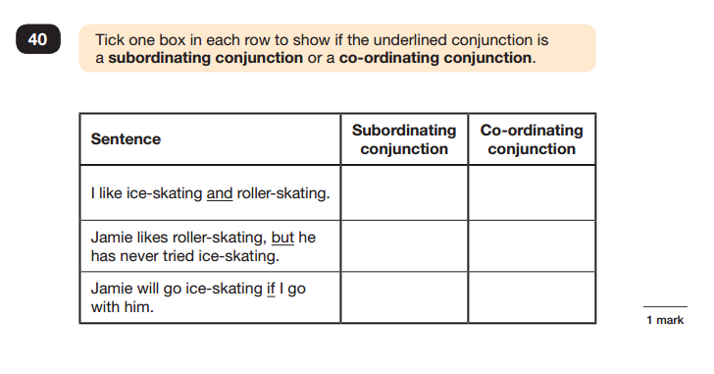
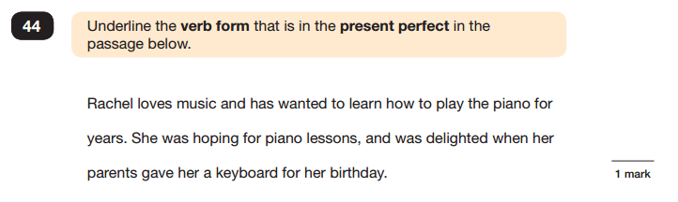
Sample Questions

Slide 8
GPaS
How you can help at home
Encourage your children to ensure that they use capital letters and full stops every time they write.
Visit spag.com regularly for practice tests.
Revise the spelling patterns that are in the CGP homework books.
Continue to encourage your child to practise their weekly spellings.

Slide 9
Reading
Paper 1 :
This paper tests the children’s comprehension skills and reading.
It lasts for 1 hour.
There are 3 texts that the children are expected to read and they will have to answer questions on each.
There are a possible 50 marks on the reading paper.

Slide 10
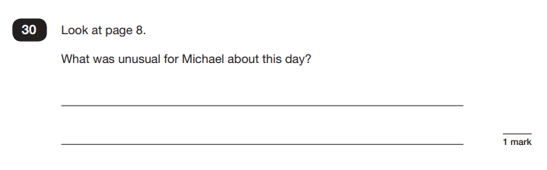
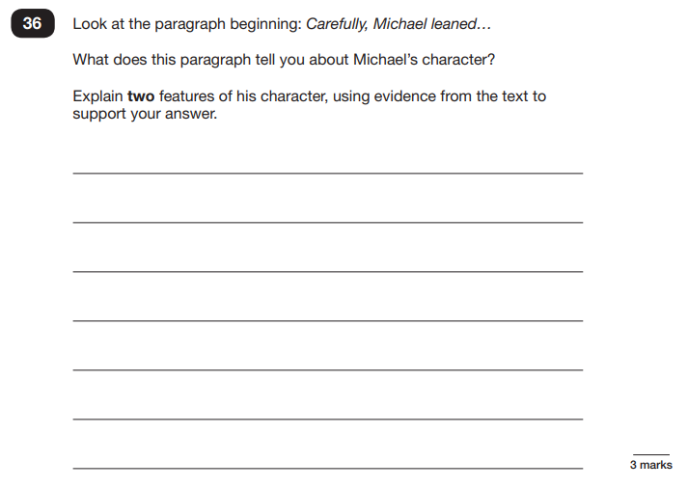
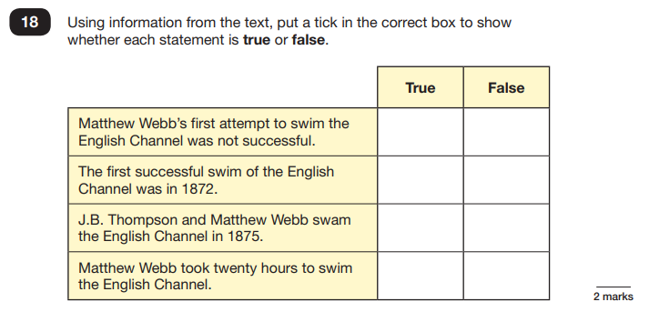
Sample Questions

Slide 11
Reading
How you can help at home
Encourage your children to read at least 3 times a week every week.
Ask the children questions about the text that they have read using the sheet that was provided with the targets. Make sure they look back at the text to find their answer.
Focus mainly on find and retrieve and inference questions as this is what the majority of the test is based on.
Check the definitions of unfamiliar words and explore the context they should be used in.

Slide 12
Maths
Paper 1 - Arithmetic:
This paper tests the children’s arithmetic skills.
There are no worded problems: the whole test is based around calculations.
It lasts for 30 minutes.
There are a possible 40 marks on the arithmetic paper.

Slide 13
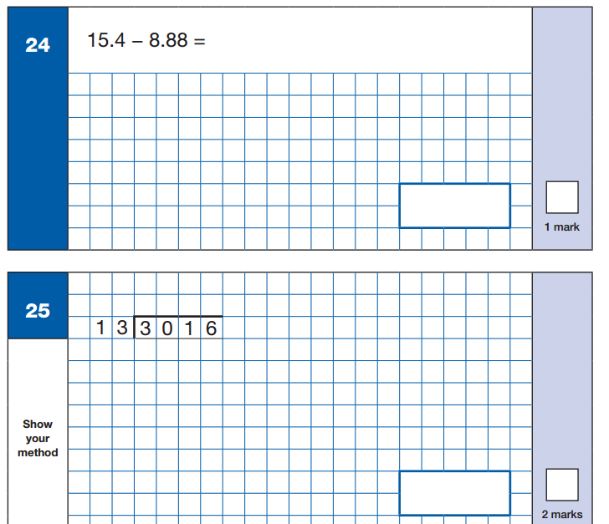
Sample Questions

Slide 14
Maths
Paper 2 and 3 - reasoning :
This paper tests the children’s problem solving through worded problems.
Each test lasts for 40 minutes.
There are a possible 35 marks on each reasoning paper.
Altogether for maths, the children have a possible 110 marks that can be scored.

Slide 15

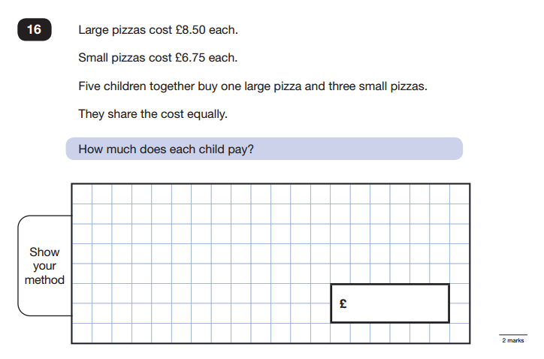
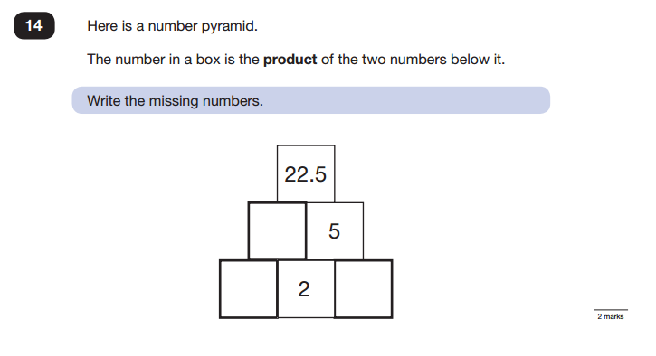

Slide 16
Mathematics
How you can help at home
Practice the different calculation skills with your children regularly at home.
Encourage your child to practise their timestables on TTRockstars.
Discuss the meaning of different words within mathematics that could be used within the worded problems.

Slide 17
Easter homework
Through experience, there is a trend that children forget a lot of learning over the 2 week holiday. Therefore, we will be sending out homework over the spring break called ‘10 for 10’.
There will be short activities to complete that should only take 10minutes. These will be for each subject that will last for 10 days.
Please encourage your child to complete these as much as possible.
Please let us know if there is something your child has struggled with during their homework tasks.

Slide 18

Stress
Please encourage your child to try their best and continue to help them as home as much as possible.
Make sure they come to school every day and work their hardest.
However, please try not let them stress too much about these tests.

Slide 19


