Slide 1


Exploring identity and gaming online

Slide 2
















What uses the internet?

Slide 3

Have you ever…

Slide 4
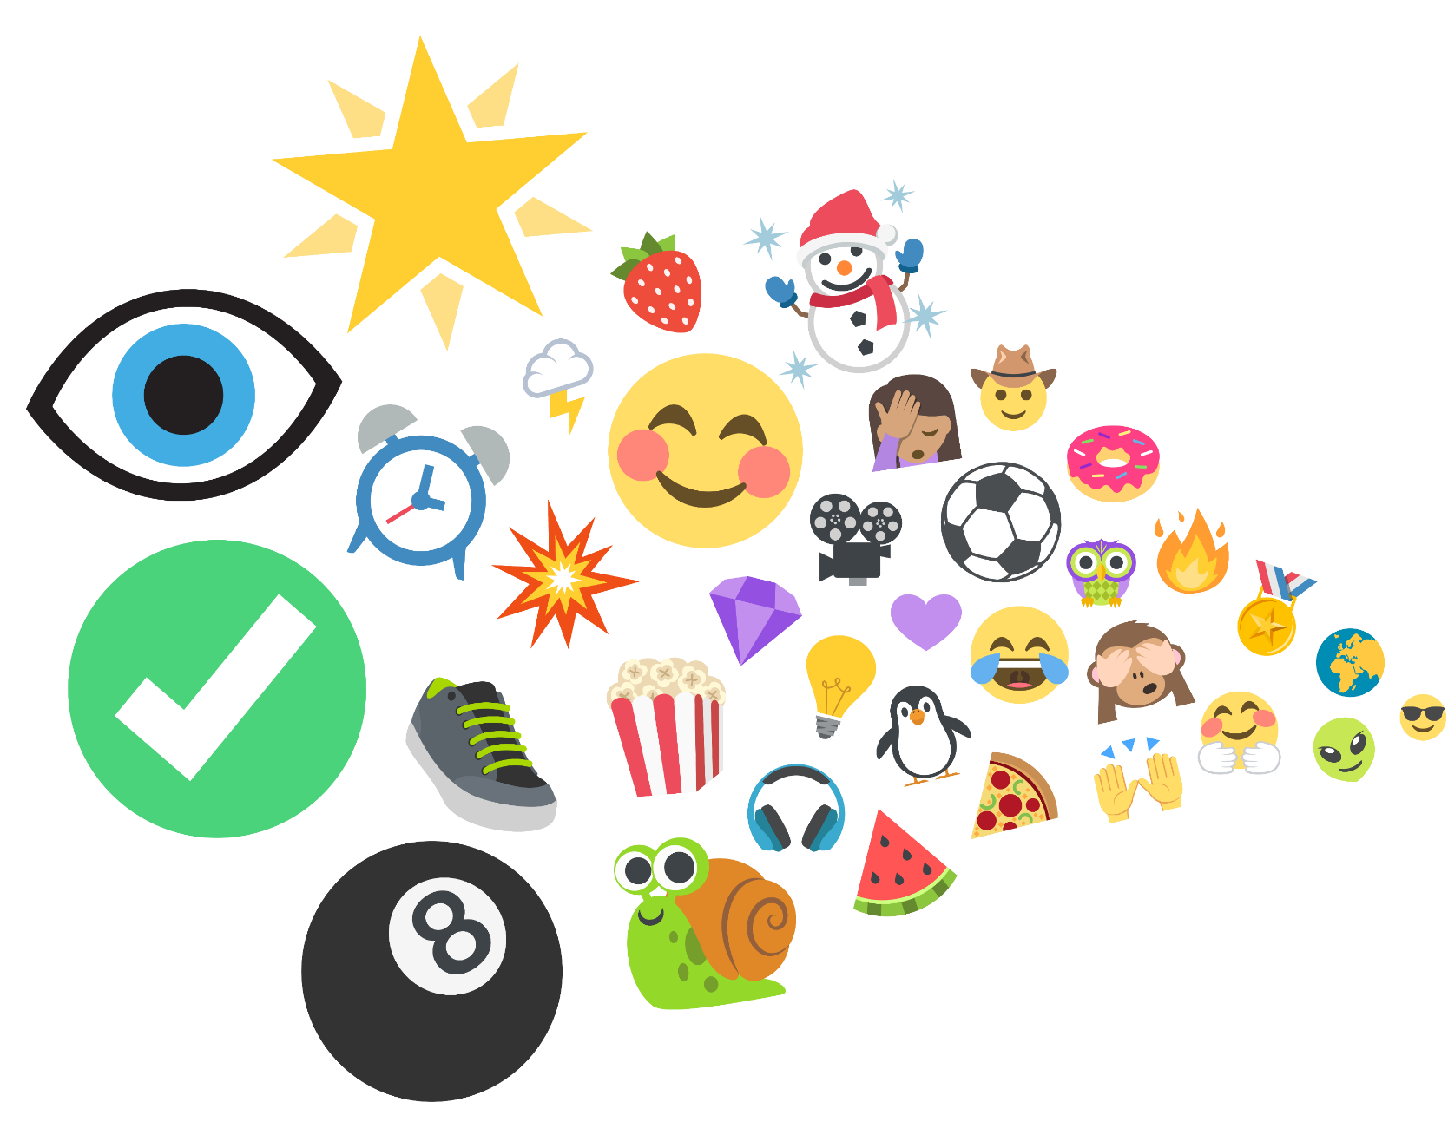
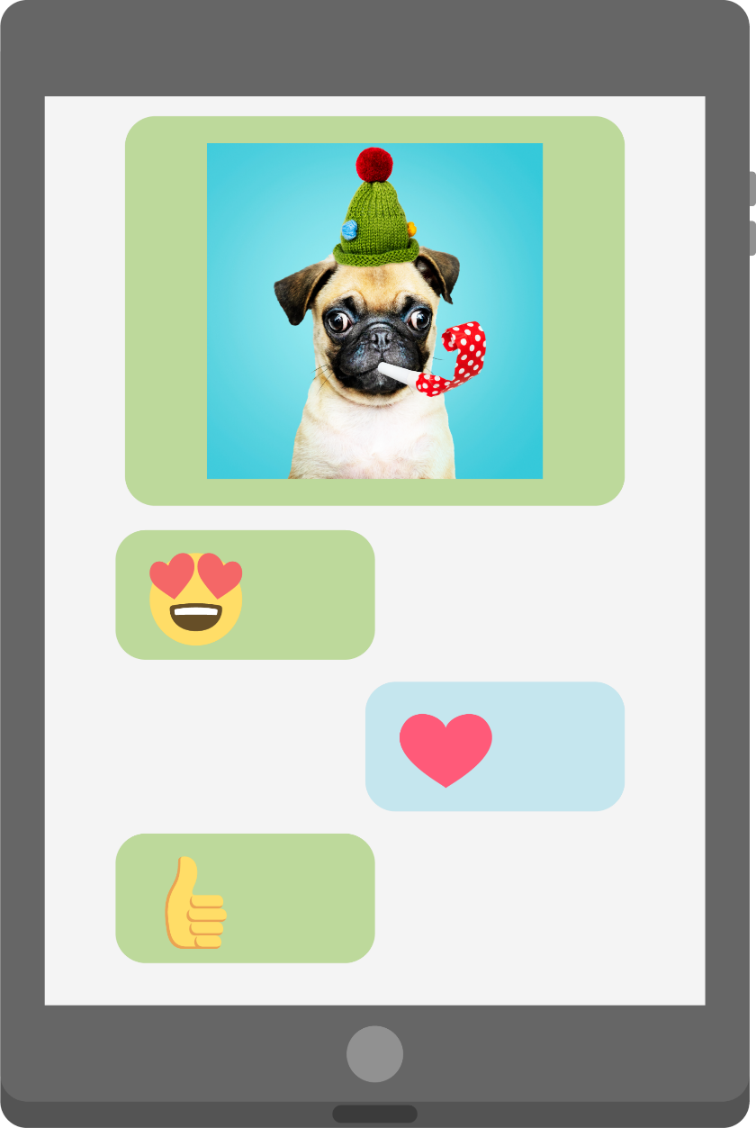
…seen or used an emoji?
Notes:
Shutterestock – tablet
Freepik – dog photo
Emojis from-
https://www.joypixels.com/emoji#all

Slide 5
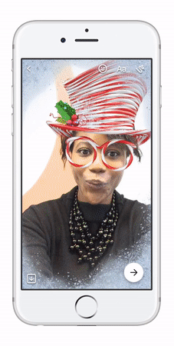
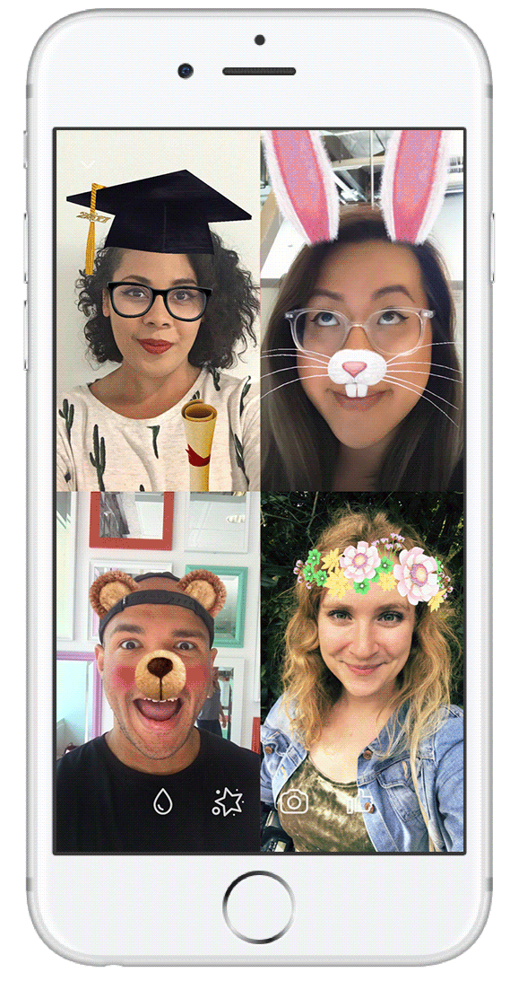
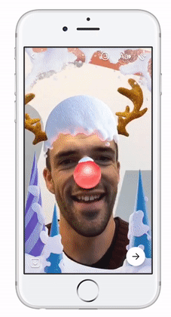
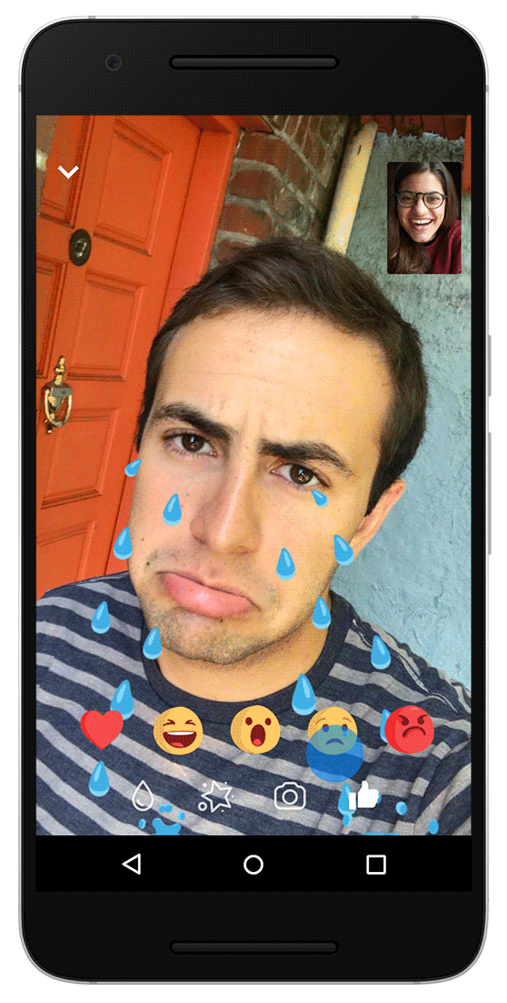
…used a filter online?
Notes:
© Facebook

Slide 6
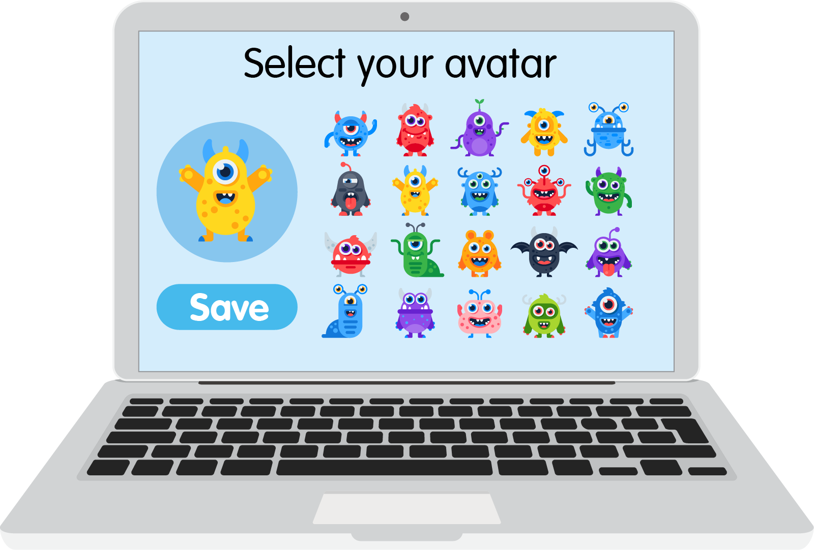
… created or chosen an avatar or character?

Slide 7

Username | Online
Gamer_girl467 | Yes
Jo.pizzaboss.73- | Yes
sleepy_meerkat | No
_Flying.fox.55 | Yes
mega.Millie | No
Invisible_penguin23 | No
xX-PLY2WIN-Xx | No
lucky-dimond.01 | No
…chosen a username?

Slide 8
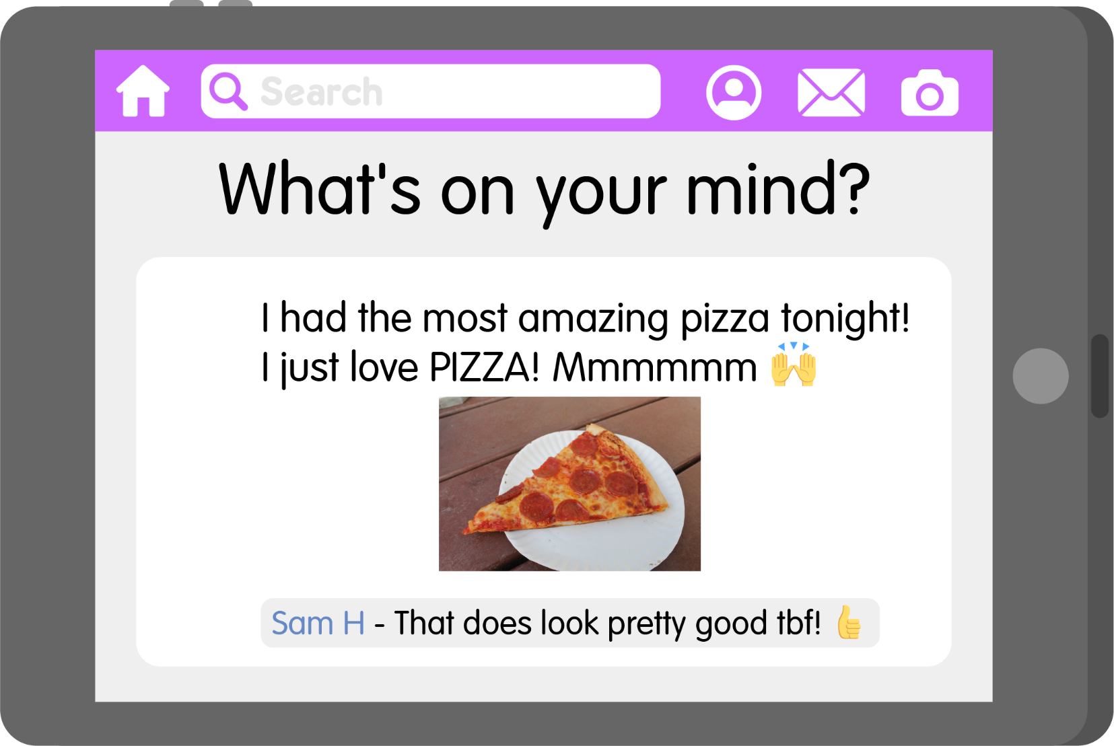
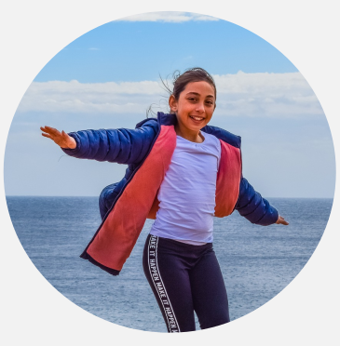
… shared something online about yourself or the things you like to do?

Slide 9




People all over the world use the internet.
So there are lots of different identities online.
58% of people go online!

Slide 10
















What is your identity?
What makes you…
YOU?

Slide 11


Slide 12

This is me!
A poem about online identity

Slide 13


The internet’s a super place,
To play, to learn, to chat.
A space for us to be ourselves,
So let’s remember that.

Slide 14

Need a book? Well search no more,
Pop one on your device.
Sit down, relax and snuggle up,
Doesn’t that sound nice!

Slide 15


Feeling glum? A little tired?
To take away your gloom…
Just listen to your favourite tunes,
And bop around the room!

Slide 16



Can gorillas doodle?
A question’s buzzing in your head,
Can gorillas doodle?
Oh wow, it seems the answer’s yes,
You found out thanks to Google!

Slide 17
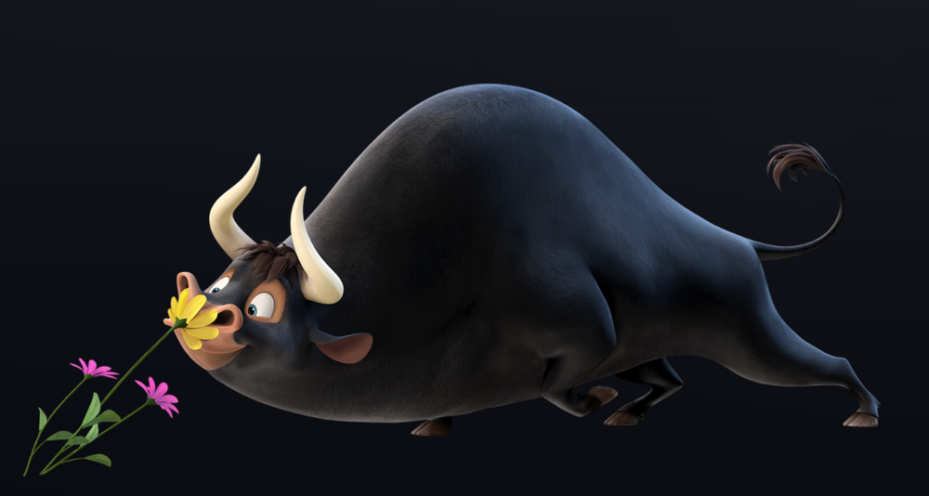
You’re off on hols, the drive is long,
To pass away the hours,
You watch a film about a bull,
Who loved to smell the flowers.
© 2017. 20th Century Fox

Slide 18

Your cousins live across the world,
A thousand miles away.
But thanks to WiFi, face to face,
You see them every day!

Slide 19


Which super power do you have?
Fly, hide, stretch or whizz?
There’s just one way to find it out,
Take an online quiz!

Slide 20


It’s your birthday, lucky you!
Your cake is just sublime.
You take a pic to show your gran,
And share with her online.

Slide 21



You love a funny video,
Of pandas, cats or puppies.
And a football-loving horse called Ace
Who’s great at keepy-uppies!

Slide 22


You crave adventure, games and fun,
You play with friends online.
You build your castles and your lands,
And have an amazing time!

Slide 23

But wait, there’s more that you can do,
Buy tickets, gifts, or food.
New clothes are a click away,
To look the awesome dude!

Slide 24

It’s great to share your favourite things,
With friends across the nation.
But keep offline, and just for you,
Your personal information.

Slide 25



The safety tools are always there,
To keep things running well.
Block, report or flag it up,
It’s important that you tell.

Slide 26

Sometimes people can be mean,
Remember, don’t join in.
Be yourself and keep in mind,
That kindness always wins.

Slide 27

If you’re online and feeling sad,
Worried, or upset,
Tell a grown-up straight away…
It’s the best help you can get!

Slide 28
There’s just one you and you are FAB,
I think that you’ll agree.
Express yourself and make some noise,
Jump up, shout…

Slide 29


Slide 30

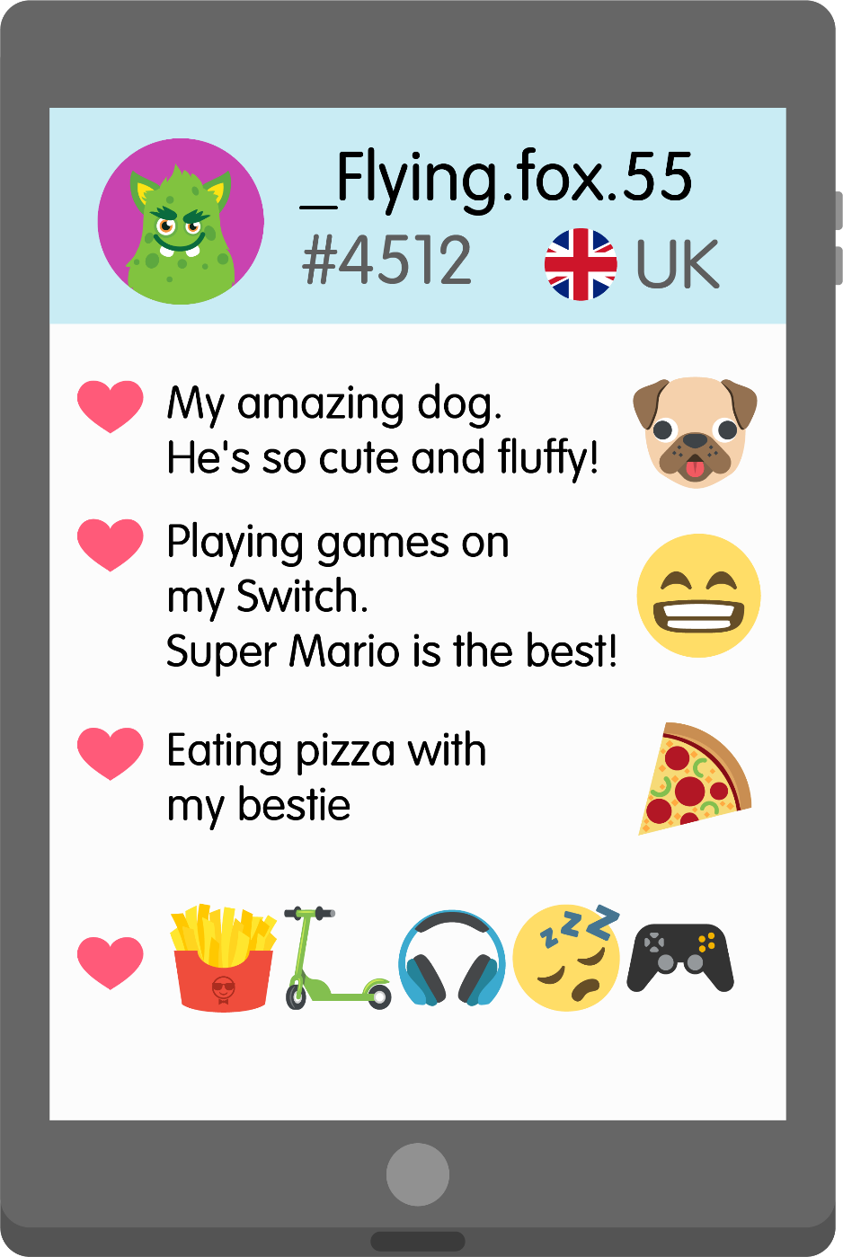

Online identity detectives
Sally Johnson
Just got home from Hoole CE Primary School – what a day!
It was my 9th birthday yesterday – I got loads of cool presents!
Party at mine on Saturday (13 Hoole Street) at 2pm.

Slide 31
Online identity detectives

Slide 32
Competition Time!
Create a poster explaining how to stay safe and happy when gaming online.
The prize will be a £10 gift card.
Deadline is next Monday.
Please bring entries to me in TGV or hand in at the office.

