Slide 1

Welcome to our Writing Workshop
Writing in the Early Years!
Hoole CE Primary School

Slide 2
What comes before writing?
We are seeing more and more children getting to school with underdeveloped fine and gross motor skills; a prime area of learning. This could be due to the increase of children of preschool age using iPads etc. at home. The ability to write is a complex one, not only do children need to have the confidence to pick up a pencil and make marks on paper, they also need to be developmentally ready to write with strong core and hand muscles. The hand is a really complex piece of machinery and is made up of lots of joints and muscle groups that interconnect and work together to provide maximum dexterity.

Slide 3
How do muscles develop?
Children’s arms and hands contain a series of pivotal joints which develop from biggest to smallest (shoulder, elbow, wrist, fingers). Once the pivots have worked their way down to the wrist, the journey doesn’t stop there, though for many children it becomes far trickier and they often face difficulties. The end of the pivot journey is when the mark making ends at the smallest set of pivots, right at the end of the fingers. If children can hold their mark making tool there, then they will have the fullest, most dextrous range of movement that their bodies can provide and be ready to write for life. This is fine motor control. However, it is important to remember that a child cannot master fine motor activities until gross motor skills are developed.

Slide 4
What do we do in school at Hoole to develop gross motor skills?
Outdoor learning environment
PE Lessons
Climbing
Range of equipment available throughout the day
Targeted interventions

Slide 5

What can you do to support gross motor development at home?

Slide 6
What can be done at home to improve gross motor skills?
Go to various parks – monkey bars
Gymnastics and trampolining
Bikes and trikes
Dancing
Obstacle courses
Walks at the beach / forest
Painting with rollers
Brushing and mopping with large brooms and mops

Slide 7
What do we do in school at Hoole to develop fine motor skills?
Dough Disco! - https://www.youtube.com/watch?v=i-IfzeG1aC4
Designated area with various activities set up.
Name writing
Range of writing equipment
Scissors

Slide 8
What can you do to support fine motor development at home?

Slide 9
What can be done to improve fine motor skills at home?
Playdough and clay
Threading
Cooking
Woodwork
Weaving
Sewing
Painting and finger painting
Sand and water play
Building
Transient art
Collaging
Building up strength in fingers - https://nancykopman.com/songs-that-strengthen-little-fingers-get-a-digit-al-workout-while-you-sing/

Slide 10
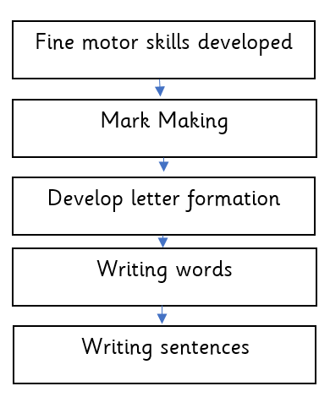
Stages of writing
Children will begin with mark making and develop to pictures with meaning before finally beginning letter formation developed alongside the Letters and Sounds phonics program.

Slide 11
Mark Making
Once the muscles are fulling developed we can move onto mark making with pencils. The children will develop their own grip and it is important not to constantly ‘correct’ it but to guide children carefully to feel more comfortable holding a pencil.
Resources we provide for mark making are:
Chalks
Paint brushes
Mops and long handled brushes
Sand
Water sprays
Gloop in trays
Paper and pens
Whiteboards and pens
Paper on the wall inside and outside

Slide 12
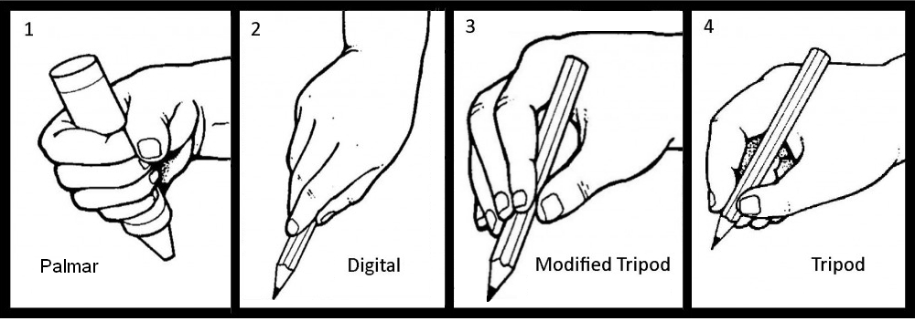
Holding a pencil

Slide 13
Writing technique
It is important for children to learn the correct way to form a letter from as early as they start writing so that habits don’t become and issue later on. When we see children writing we try to help them by guiding their letter formation.
We use sound mats that children can access which contain the sounds that children have learnt through our phonics scheme.
We also practise letter formation on white boards during our phonics sessions quickly and in a fun active way during a game for example find something in the box and write the letter it starts with.

Slide 14
Writing words and sentences – How do we support the development of writing in school at Hoole?
At school we like to make writing or attempts to write meaningful and purposeful so that children enjoy it and see the reason to write. We can do this by facilitating their play, when children are engaged already then it is easy to give a reason to write for example building a Lego mansion and then labelling the parts with post it notes so that others can see what parts are what. Ways we can encourage writing during play are by:
Writing message to their friends
Labelling their construction work
Writing shopping lists in the home corner
Writing recipes
Writing song lyrics
Labelling art work
Writing a phone number
Secret codes
Writing cards

Slide 15
Mark Making at home
It is ideal to have resources available for children to mark make at home as and when they wish to, things they can access themselves for example:
Paints
Chalks and chalk boards
Pens and pencils
Water mats
iPad drawing
Sand with paint brushes
Post it notes
Old cards

Slide 16
Writing at home
You can encourage your children to write at home for a purpose or for fun in the following ways?
Writing message to their friends
Labelling their construction work Writing song lyrics
Labelling art work
Writing thank you cards to others
Writing birthday cards and invitations
Helping you write a shopping list

Slide 17
The Early Learning Goal – Writing
By the end of Reception, it is expected that MOST children will…
… use their phonic knowledge to write words in ways which match their spoken sounds. They also write some irregular common words. They write simple sentences which can be read by themselves and others. Some words are spelt correctly and others are phonetically plausible.

Slide 18
Thank you for your time. If you have any questions, please speak to a member of the Early Years Team ☺

