Slide 1


Slide 2

How would you solve the following calculations?
400 + 800 =
48 + 19 =
321 + 636 =

Slide 3
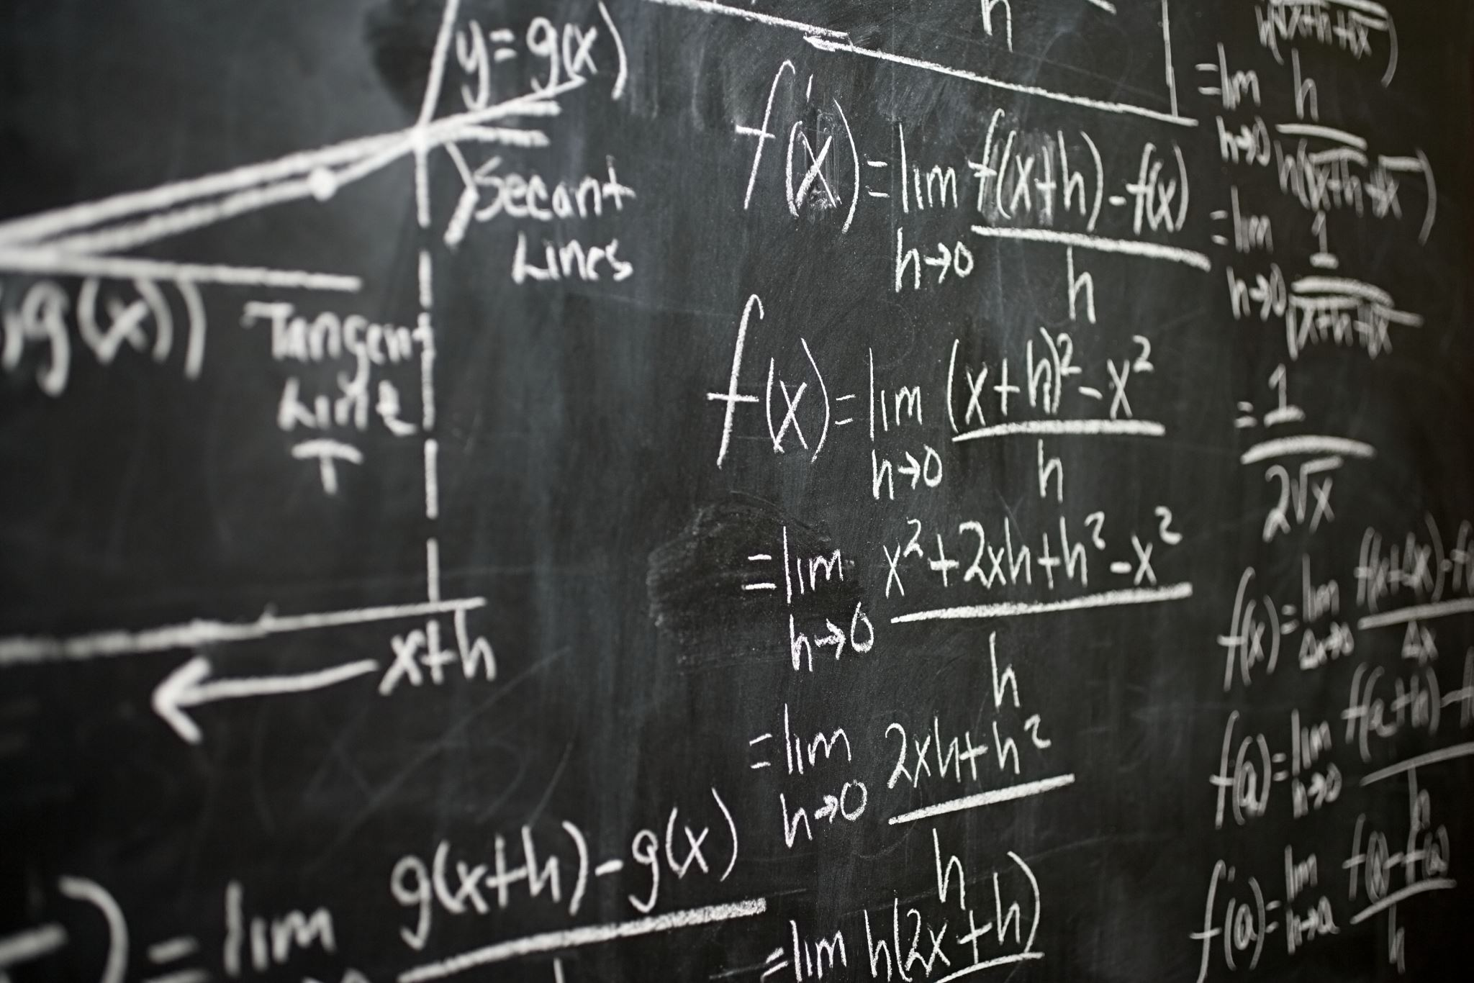
Mental Methods

Slide 4
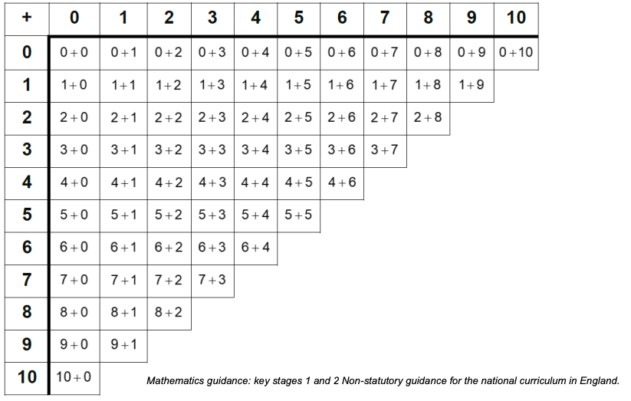
66 addition facts within 10

Slide 5
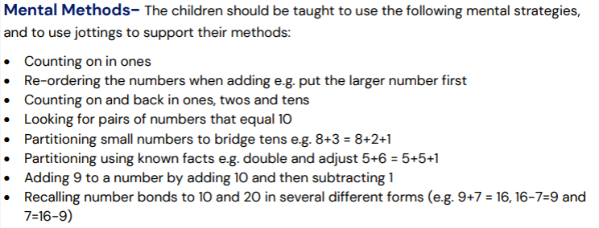
Year 1

Slide 6
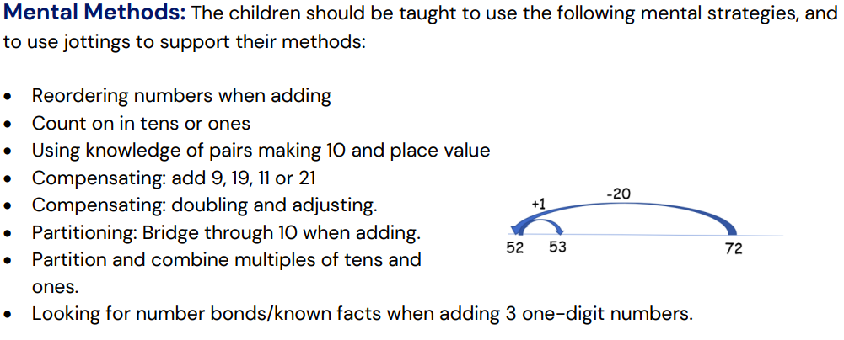
Year 2

Slide 7
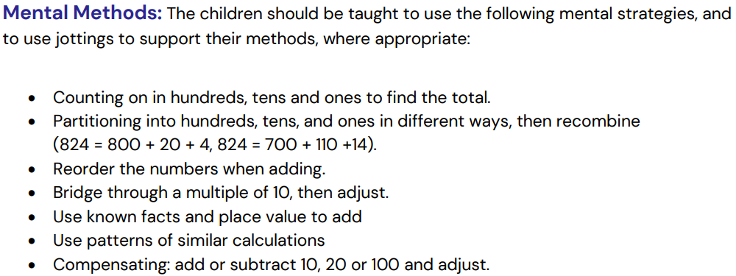
Year 3

Slide 8
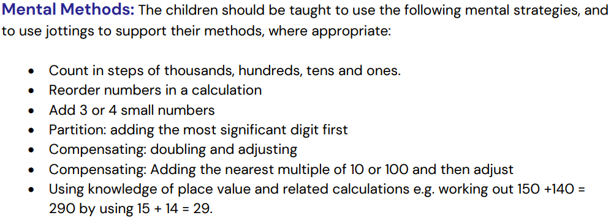
Year 4

Slide 9
Written Methods

Slide 10
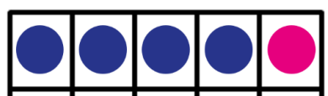
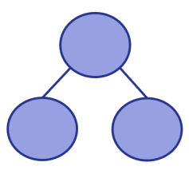
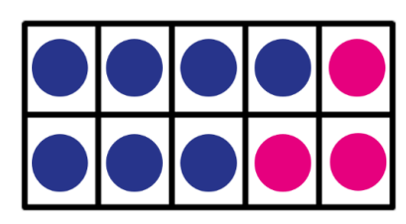
Reception
In Reception we look at:
Number bonds within 5
Some number bonds to 10

Slide 11
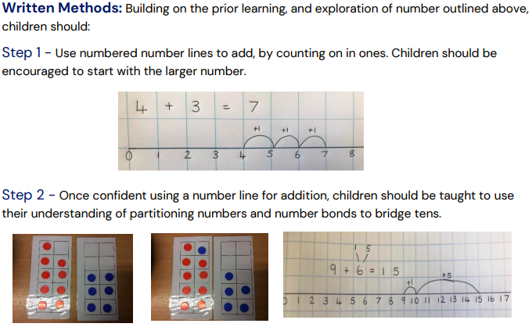
Year 1

Slide 12
Your turn!
Use a numbered number line to add, by counting on in ones.
11 + 7 =
Use a number line to bridge the 10 and solve the calculation.
8 + 6 =

Slide 13
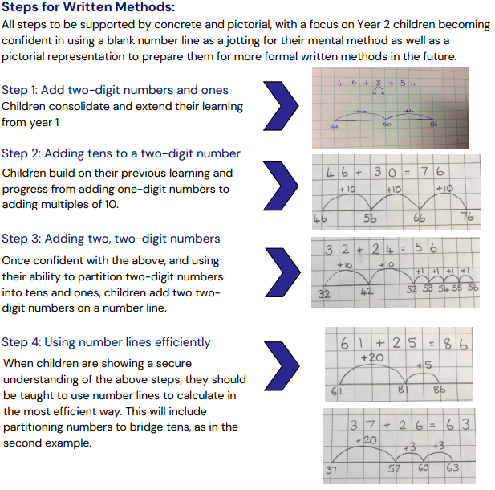
Year 2

Slide 14
Your turn!
Use a numbered number line to add a two-digit number and ones.
23 + 6 =
Use a number line to add tens to a two-digit number.
18 + 20 =

Slide 15
Your turn!
Use a numbered number line to add 2 two-digit numbers.
33 + 16 =
Use number lines efficiently, selecting the most efficient method to solve the calculation or problem.
Miss Carter has 45p in her purse. She finds 27p in the boot of her car. How much money does she have in total?

Slide 16
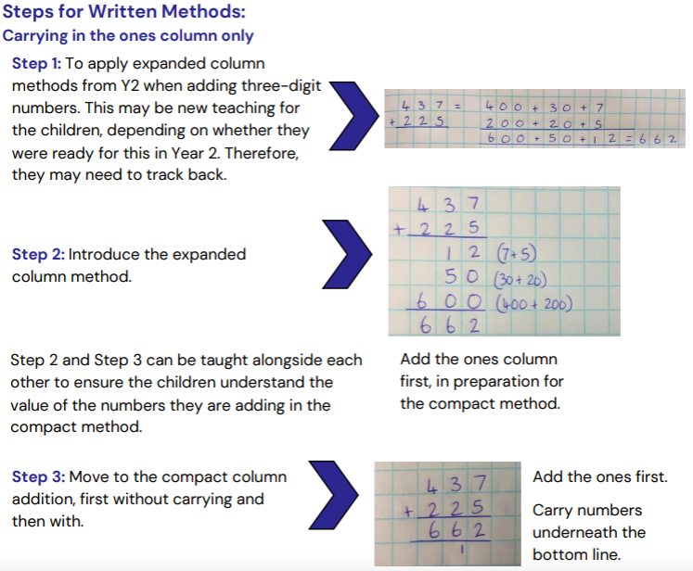
Year 3

Slide 17
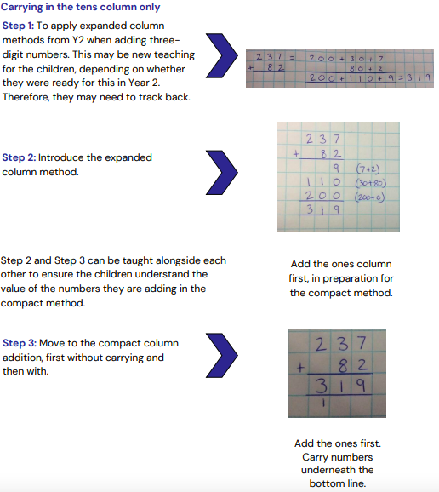
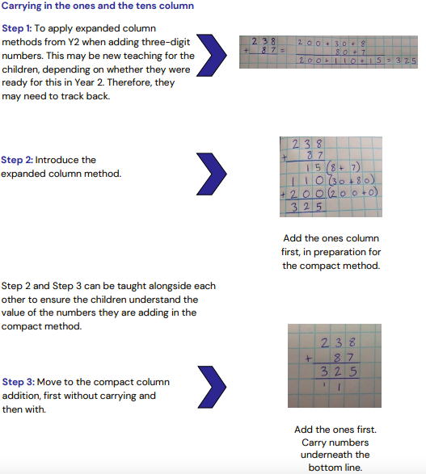

Slide 18
Your turn!
Exchanging in the ones
343 + 128 =
Exchanging in the tens
247 + 381 =
Exchanging in the tens and ones
456 + 275 =

Slide 19
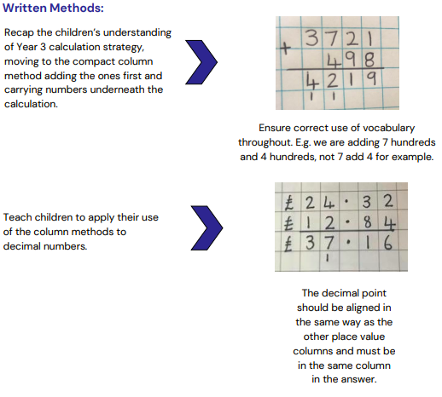
Year 4

Slide 20
Your turn!
Spot the mistake:

Slide 21
Any questions?

