Slide 1
Religion: Islam
Ramadan

Slide 2
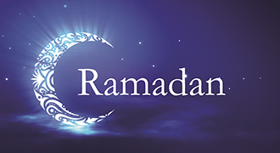
What is Ramadan
What is Ramadan?
Ramadan is a celebration for Muslims which was started by Muhammad (peace be upon him).
Ramadan is one of the five pillars of Islam, along with Shahada, Salah, Zakat and Hajj.
Notes:
NOTE: To change images on this slide, select a picture and delete it. Then click the Insert Picture icon in the placeholder to insert your own image.

Slide 3
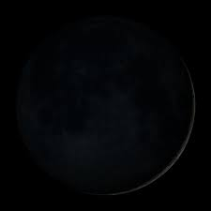
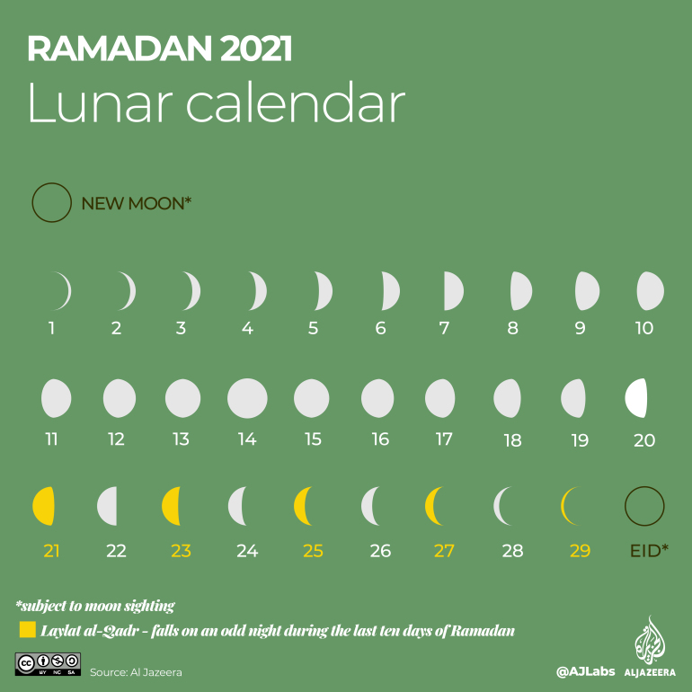
Ramadan starts with a sighting of a new moon and ends with a crescent new moon. Ramadan usually lasts for 29 or 30 days.
This is a new moon.
Notes:
NOTE: To change images on this slide, select a picture and delete it. Then click the Insert Picture icon in the placeholder to insert your own image.

Slide 4
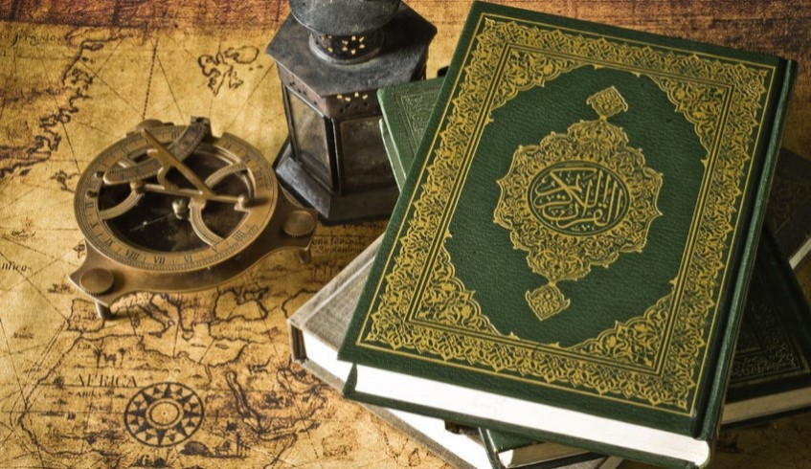
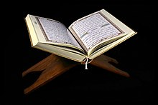
The Quran – holy book
The Quran is a Holy book for Muslims to read. The Quran is written in Arabic.

Slide 5

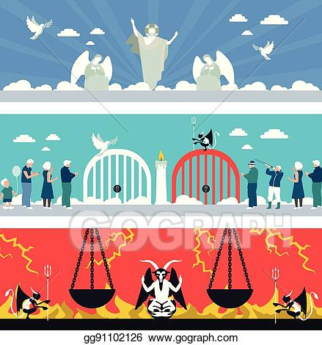
All about Ramadan
Ramadan is a time of contemplation and a time to strengthen ourselves but also a time when the verse’s of the Qur’an were revealed by Muhammad (peace be upon him).
Muslims believe that the gates of heaven (Jannah) are open and the gates of hell (Jahanam) are locked for the Duration of Ramadan.

Slide 6
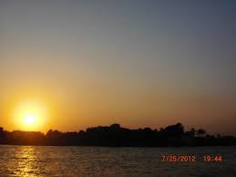
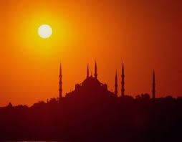
Fasting
Muslims are expected to be fasting from sunrise to sunset and shouldn’t be eating or drinking.

Slide 7
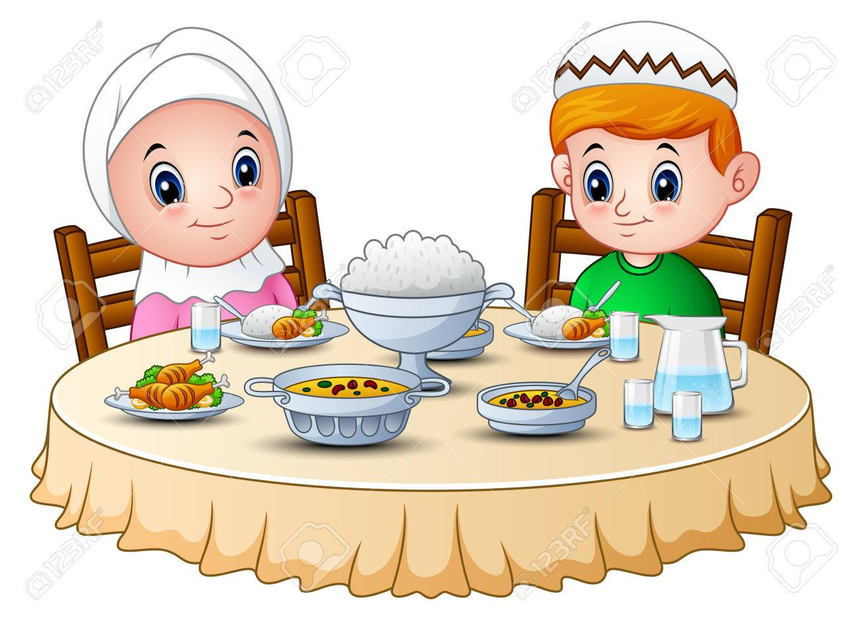
Breaking Fast
When a Muslim breaks their fast, they eat a date and some water, but also they have to recite the prayer (dua) when breaking fast.

Slide 8
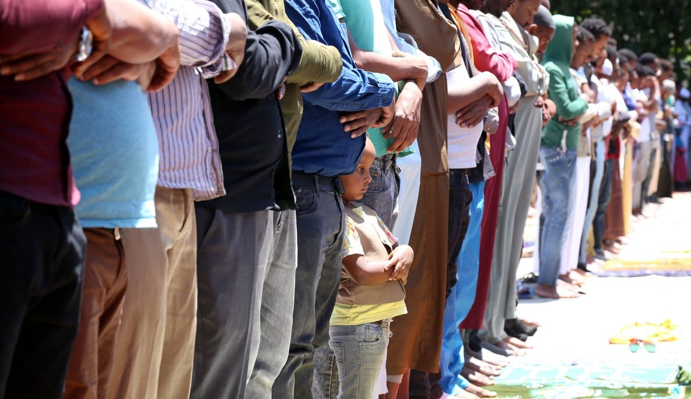
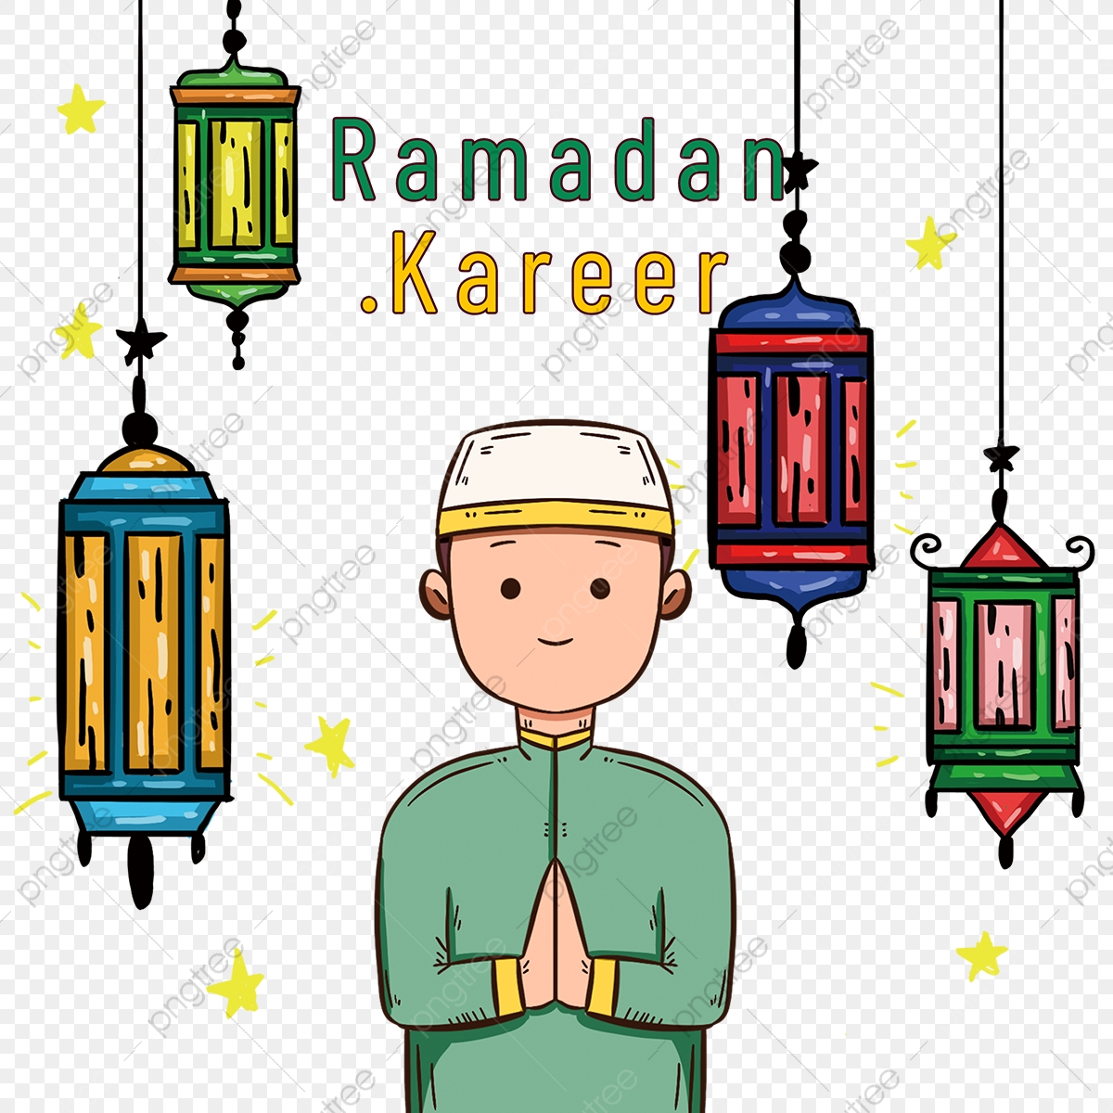
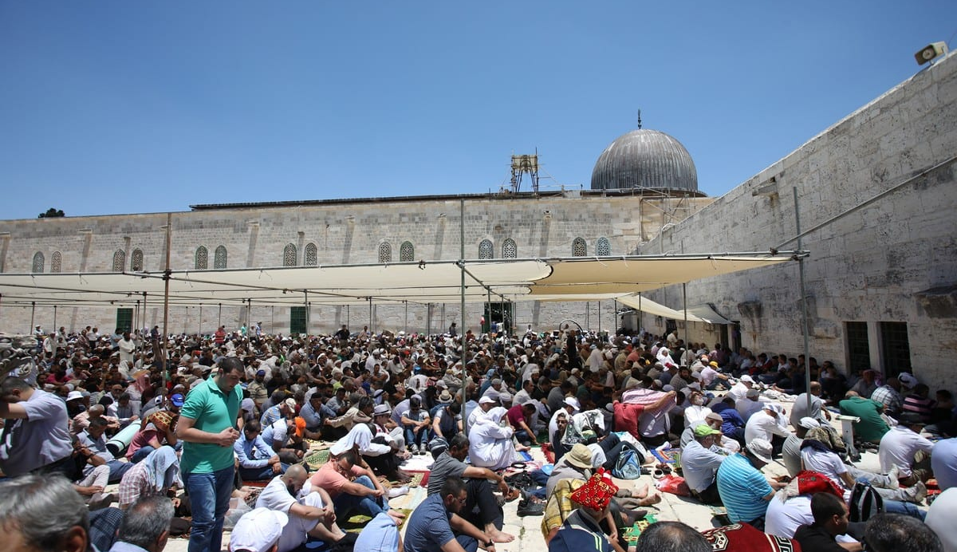
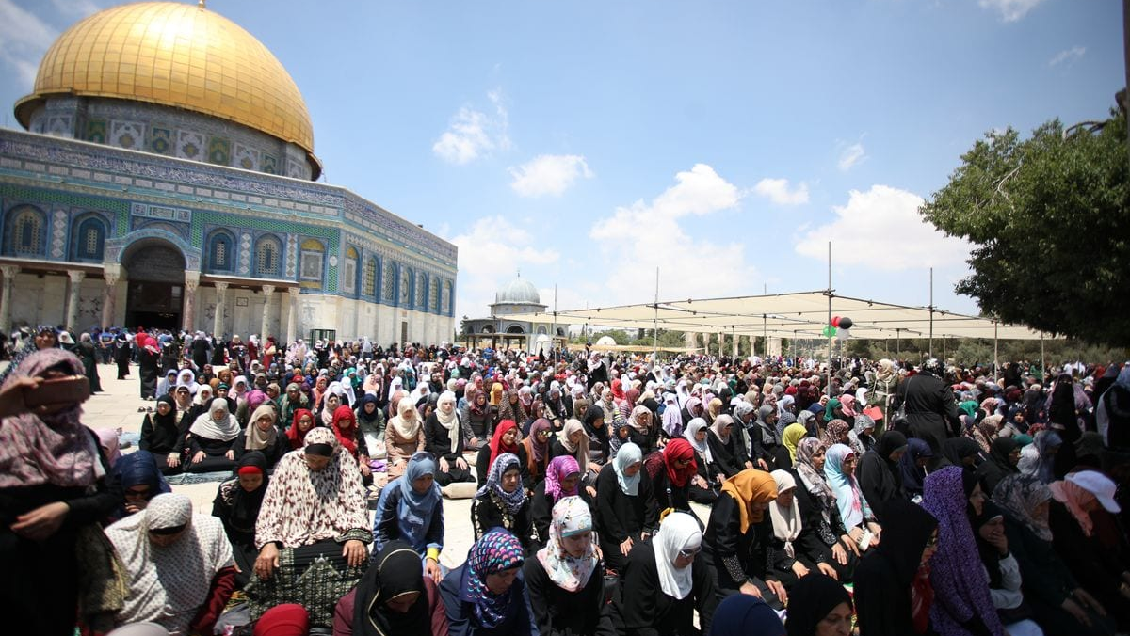
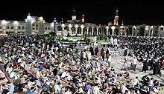
Muslims are obliged to fast for 29 or 30 days.
Notes:
NOTE: To change images on this slide, select a picture and delete it. Then click the Insert Picture icon in the placeholder to insert your own image.

Slide 9
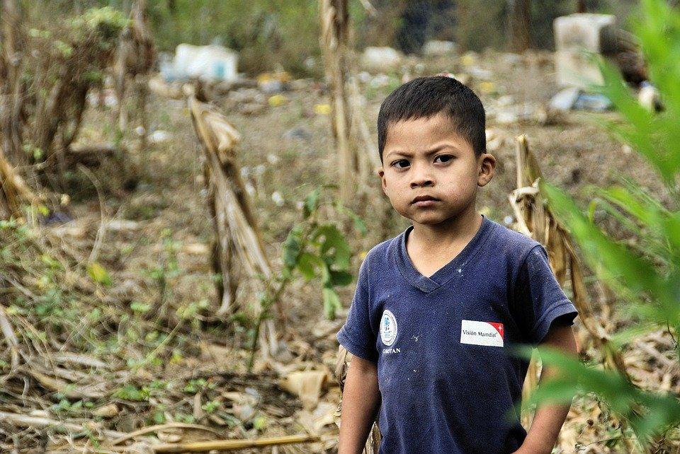
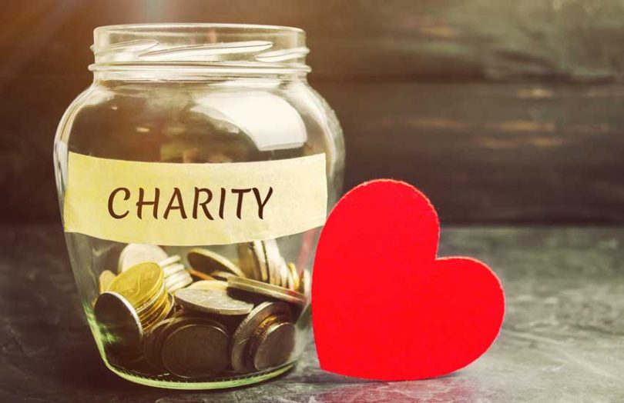
Breaking fast in different ways and what fasting teaches us
Fasting is supposed to teach Muslims that patience and spiritual things. Also Ramadan is a time to talk about how other people aren’t surviving in their country that’s why Muslims do charity to help others because it teaches us to be helpful. It teaches us to not be selfish and think about others.
What will you do to help?

Slide 10
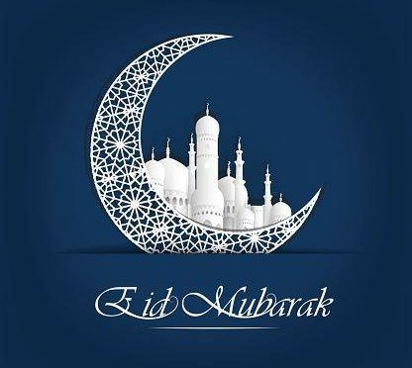

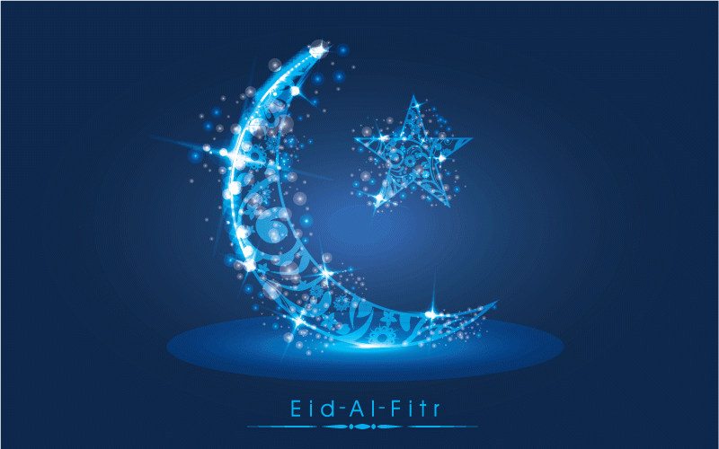
Eid Mubarak

Slide 11
Why are the last 10 days of Ramadan important?
The ten days are important for Muslims because during the Qur’an was revealed by Muhammad( peace be upon him) in these 10 days. Also Muslims give £2 to Charity each day and you will a rewarded a thousand times for each £2 given.
Some Muslims will give the money to the Masjid and they will give it to the charity.

