Slide 1
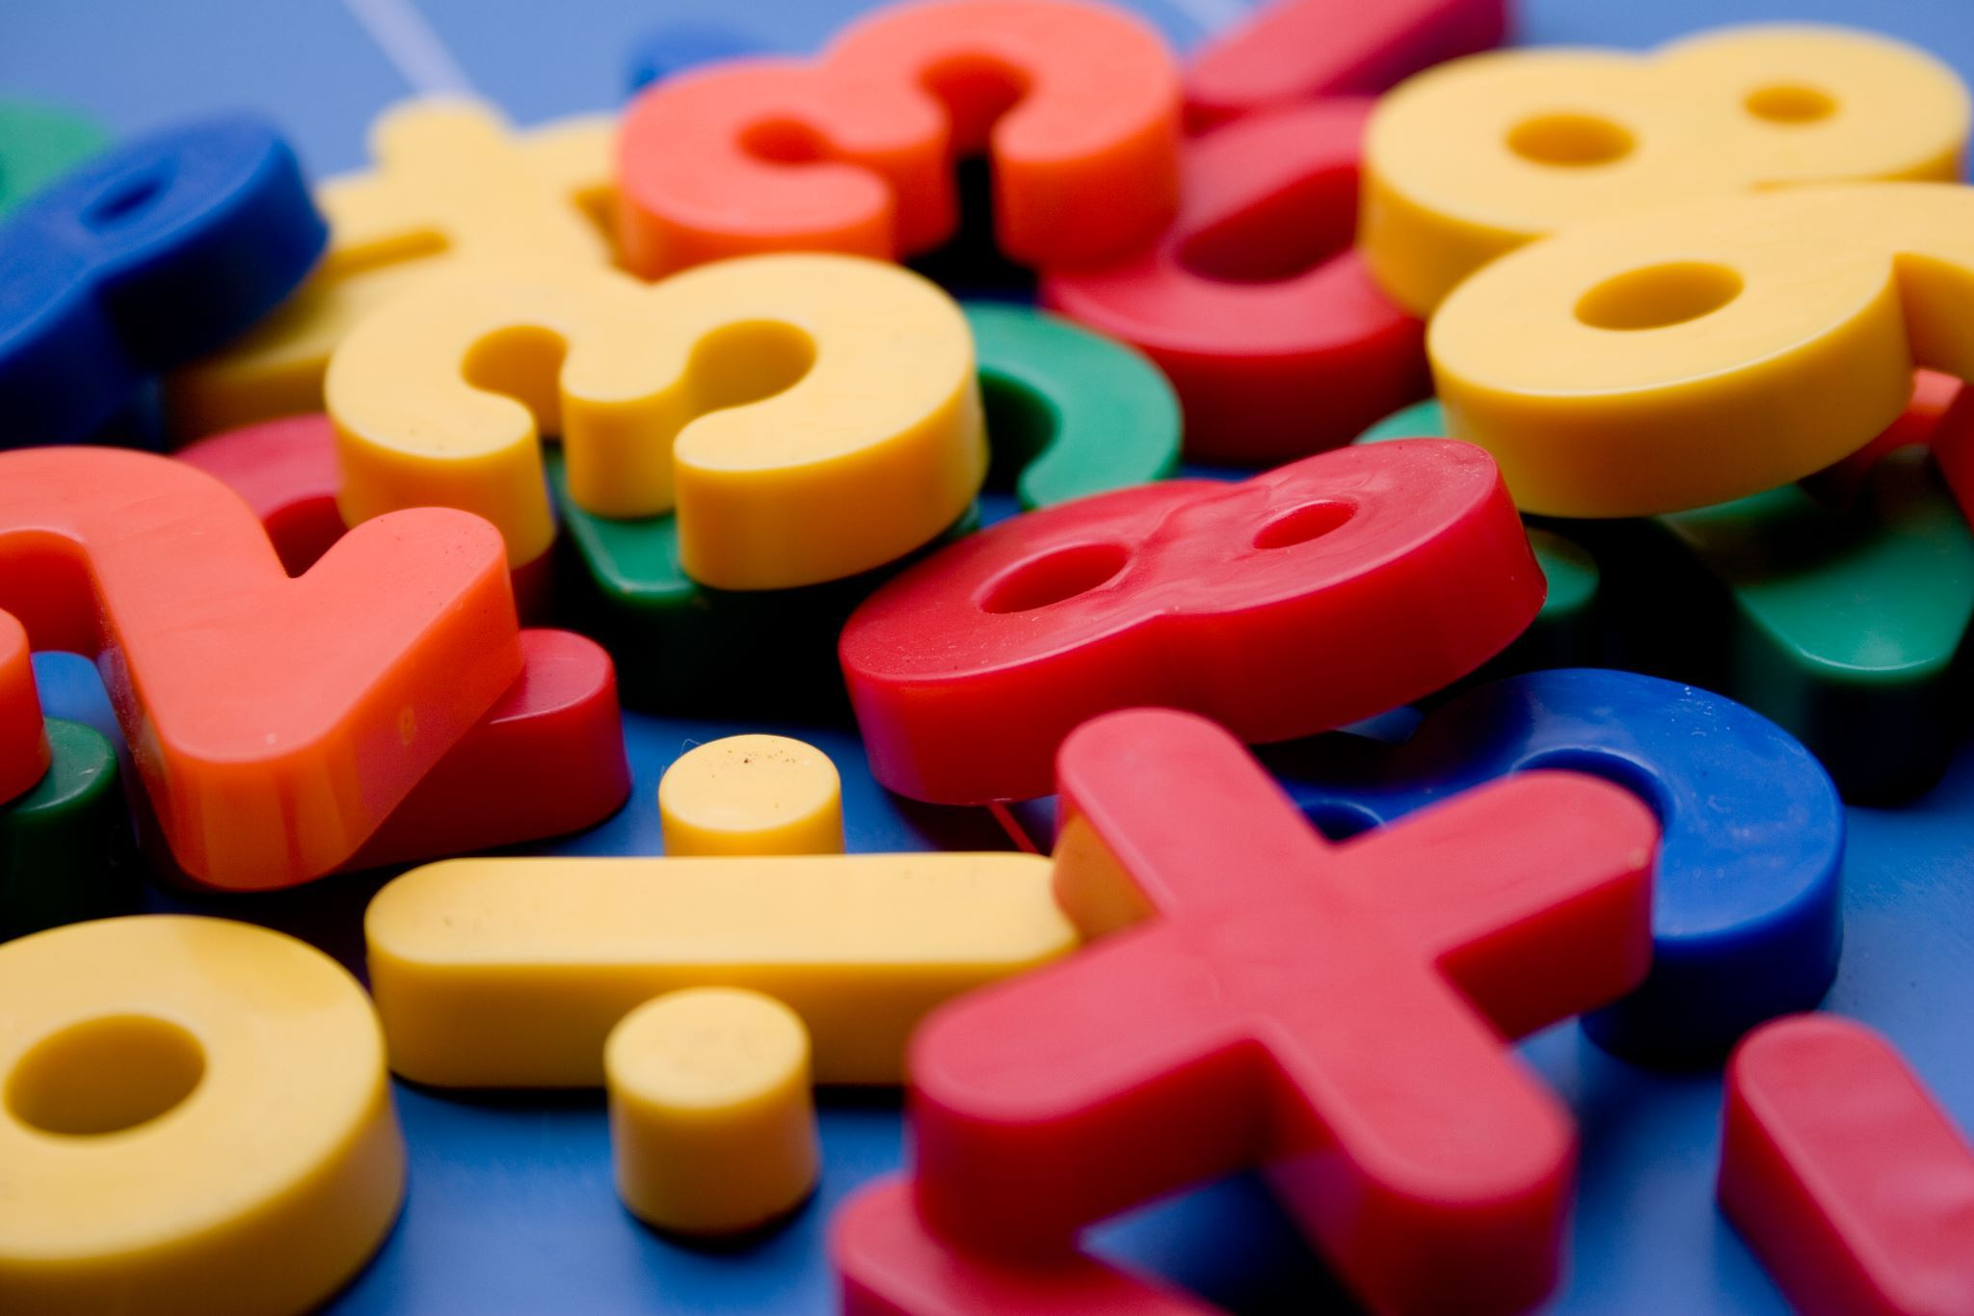
Multiplication Tables Workshop
Year 4

Slide 2
Why times tables matter
They are very important in the mathematics curriculum.
  Written multiplication and division
  Fractions
  Percentages
  Problem solving
Expected recall by the end of Year 4 (Multiplication Tables Check).
Times tables are about rapid recall, not endlessly completing worksheets.

Slide 3

How do children learn their times tables?
Concrete
We begin by exploring times tables with practical equipment. The children need to first of all understand what groups are.
Example: 3 groups of 4
Notes:
Ask the parents to make different groups of.
Example: 2 groups of 3. 5 groups of 9.
This could be done with anything at home. Lego, toys, counters, sweets etc.

Slide 4

How do children learn their times tables?
Concrete
Children then progress to creating arrays with practical equipment.
Example: 3 x 4 =
Notes:
Now get the parents to make arrays for differnt multiplications with practical equipment.

Slide 5
How do children learn their times tables?
Pictorial
Once the children have grasped these to aspects with practical equipment. We begin to draw the representations.
Notes:
Can you show 5 x 3 as an array and as groups?

Slide 6
How do children learn their times tables?
Abstract
We then move on to the children looking at the abstract part of maths. This is when they just use the numbers. We build this first by relating back to the concrete and pictorial.
3 x 4 = 3 groups of 4

Slide 7
When do the children learn times tables?
Year 1 | Count in multiples of 2, 5 and 10. Begin learning doubles and halves
Year 2 | Recall and use the 2, 5 and 10 times tables and related division facts.
Year 3 | Recall and use the 3, 4 and 8 times tables and related division facts.
Year 4 | Learn the 6, 7, 9, 11 and 12 times tables. By the end of Year 4, children should know all multiplication facts up to 12 × 12
Year 5 | Consolidate and rapidly recall all times tables up to 12 × 12.
Year 6 | Continue to use and apply all times tables up to 12 × 12 fluently

Slide 8
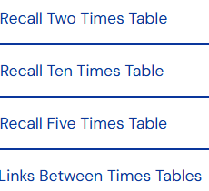
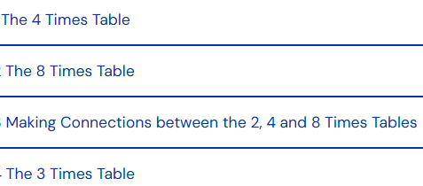
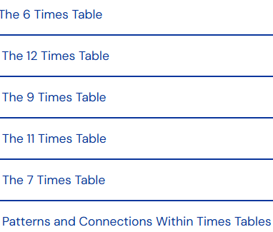
What order do they learn them?
Year 2
Year 3
Year 4

Slide 9
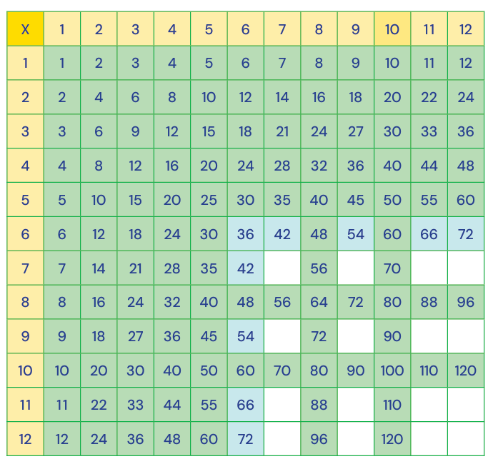
Year 4
By the time the children begin to learn their 6 times tables in Year 4, they already know most of them from their learning in Year 2 and 3.

Slide 10
Important message
It is important that children understand times tables and patterns in times tables before learning them by rote.

Slide 11
Strategies to help to learn
Arrays
Commutativity
Fact families
Known facts

Slide 12
Commutativity
The order that the numbers are written in do not change the result.
Example.
3 x 4 = 12 4 x 3 = 12
Notes:
Explain to the parents that we allow the childre to explore arrays to show this untilt he children figure it out themselves.
Ask parents to make an array and then turn it to show commutivity

Slide 13
Fact Families
Once children have understood the commutative law (that times tables can be done in any order and get the same result), we then move on to learning about fact families.

Slide 14
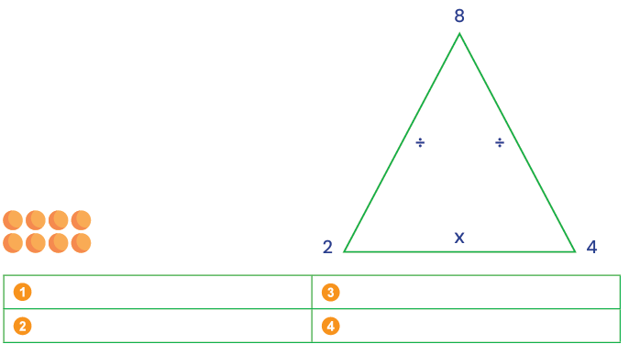
Fact Families

Slide 15
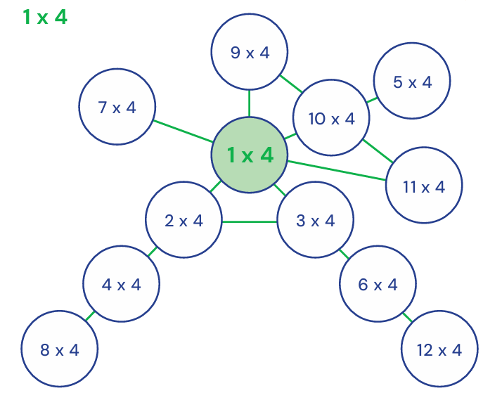
Known Facts

Slide 16
Tricks and patterns
2 Times Table
All answers are even numbers.
Just double the number.
2 × 7 = 14 (double 7)
5 Times Table
Answers always end in 5 or 0.
Count in fives:5, 10, 15, 20, 25...
Odd × 5 ends in 5.
Even × 5 ends in 0.
10 Times Table
Add a 0 to the end.
10 × 8 = 80
11 Times Table
For 11 × 1 to 11 × 9, the digits repeat:
11 × 3 = 33
11 × 7 = 77
4 Times Table
Double and double again.
4 × 6 (double 6 = 12 and double 12 = 24)
They are double the two times tables.

Slide 17
Tricks and patterns
8 Times Table
Double three times.
8 × 4 (4 → 8 → 16 → 32)
They are double the 4 times tables.
9 Times Table
Finger Trick - Hold out 10 fingers.
For 9 × 4: Fold down the 4th finger.
3 fingers before it and 6 after it.
Answer = 36
The digits add to 9: (9 × 3 = 27 → 2 + 7 = 9)
Tens Go Up, Ones Go Down
09 18 27 36 45 etc
7 Times Table
No special trick, but use known facts:
7 × 8 = 56
Think: 5 × 8 = 40 and 2 × 8 = 16
40 + 16 = 56
12 Times Table
Double the 6s
10 times table + 2 times table
12 × 7(10 × 7) + (2 × 7)
70 + 14 = 84

Slide 18
The tricky 6
6 × 7 = 42
7 × 8 = 56
8 × 8 = 64
7 × 9 = 63
8 × 9 = 72
6 × 8 = 48

Slide 19
Top Takeaways
Allow children to explore times tables before learning by rote.
Do not introduce new times tables until they have been taught in school.
Try to not make learning of times tables stressful.
Play games and have fun learning them.
Practise regular and often. Do 5 minutes practise every day over 30 minutes on one day.

Slide 20
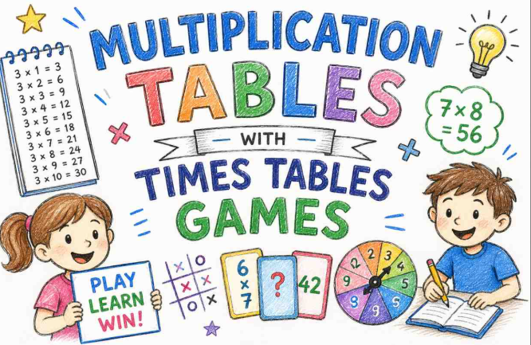
Let's get the children in and have some fun learning times tables

Slide 21
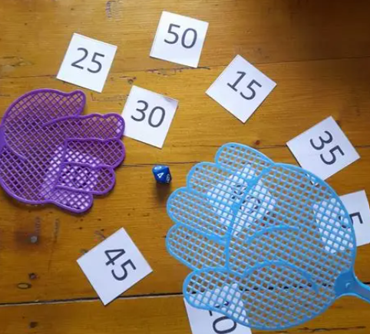
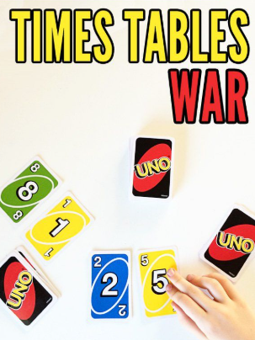
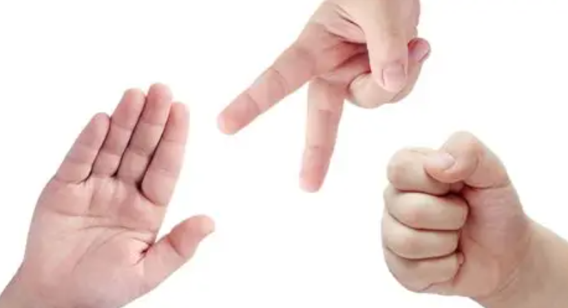
Games
Times tables splat
Patterns -raise arms, fizz/buzz
Rock Paper Scissors

Slide 22
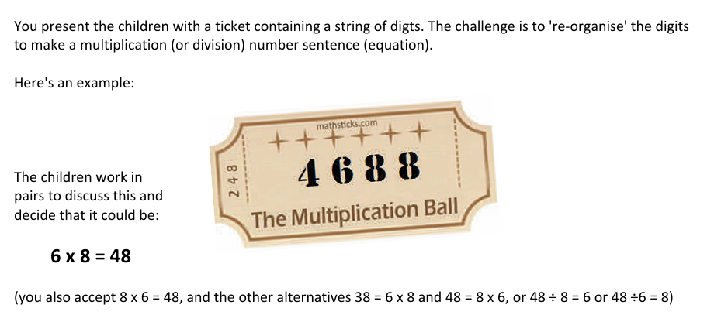
Ticket Times Tables

Slide 23

Songs on YouTube
https://www.youtube.com/watch?v=e7rYbk9PNuM&t=50s

Slide 24
Have a try at the times tables check
At the end of Year 4, all children sit the times tables check. We thought it would be nice for you to experience what it may look like.

Slide 25

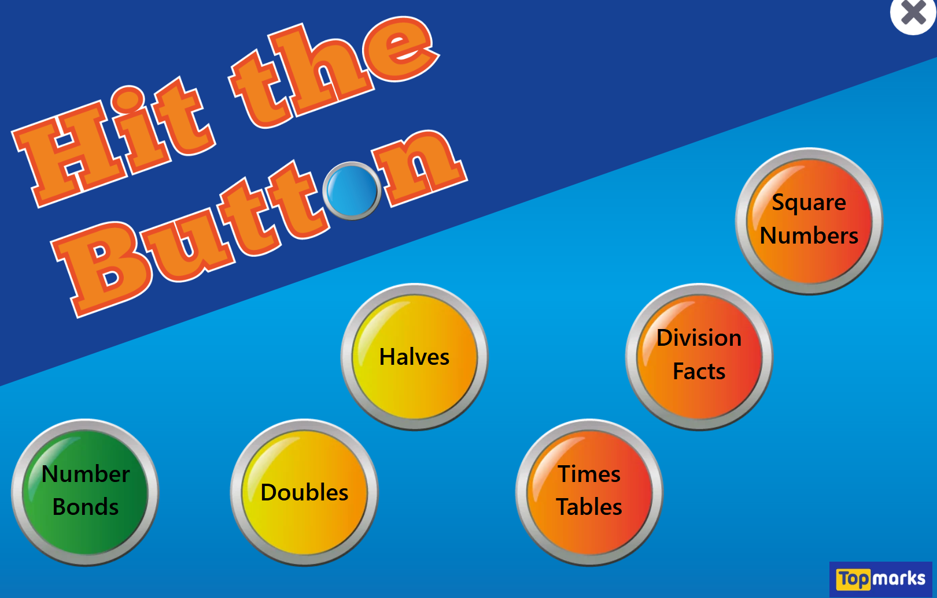
Useful websites
Times Tables Rock Stars
https://ttrockstars.com/
Hit the button
https://www.topmarks.co.uk/maths-games/hit-the-button

Slide 26

Questions

Slide 27

Thank you for coming!
We will hopefully see you at our times tables musical later in the year!

