Slide 1
SATs information evening
Miss Buckley and Mrs Millington

Slide 2
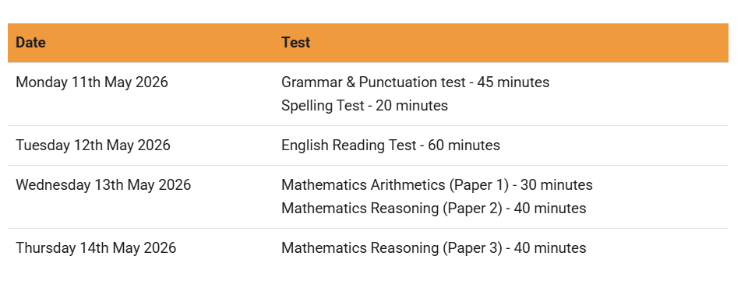
Timetable 2026

Slide 3
Easter revision packs
These will be sent out at the end of the term.
You will receive a maths booklet, an arithmetic paper, reading questions, a grammar paper and a fun Easter revision booklet.
There is no expectation of how much of this is completed.
Children who completed it last year said that they felt more confident going into the tests because they did small amounts over the Easter break.
These children returned back to school after the break with increased confidence.
Please do not complete any extra work that will cause any unnecessary stress.

Slide 4
Start of the day
We will be running a Breakfast Club each morning, in Eurostar, from 8.15 – 8.45am. Please encourage your child to attend as it is a chance for them to chat to their friends and relax a little before each test starts. Children should sign in at the school office each morning.
Sausage, bacon or a vegetarian alternative will be available to order on School Spider nearer the time. The option they choose will be provided all week. They cannot choose a different option each day.
If your child is not attending the Breakfast Club, please make sure that they arrive at school no later than 8.50am.

Slide 5
How can you help?
Ensure your child gets an early night before each test.
Work through the revision materials provided over the Easter Break as much as you can.
Remind your child that their best is good enough.
Encourage them to ask us if there is anything they want to revise before the tests. Please encourage them to let us know so that we can help.

Slide 6
Spelling, Punctuation and Grammar: Monday 11th May
Spelling, Punctuation and Grammar consists of two papers.
Paper 1 focuses on all three elements (spelling, punctuation and grammar). The paper lasts for 45 minutes.
Paper 2 consists of a spelling test only. It should take approximately 15 minutes, although this is not a set amount of time (pupils should be given as much time as they need to complete the test).

Slide 7
Spelling, Punctuation and Grammar: Paper 1
The children will have been working hard on developing and securing their knowledge of the technical vocabulary needed in this test.
This test focuses on:
Grammatical terms/ word classes;
Functions of sentences;
Combining words, phrases and clauses;
Verb forms, tenses and consistency;
Punctuation;
Vocabulary;
Standard English and formality.
This test requires a range of answer types but does not require longer formal answers.
Notes:
The question types include:
Circling
Drawing lines to connect
Multiple choice questions (including ticking tables)
One-word answers
Short answer questions

Slide 8
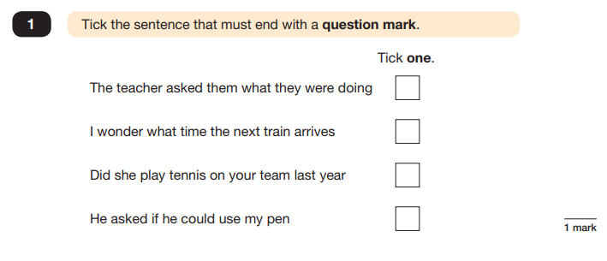
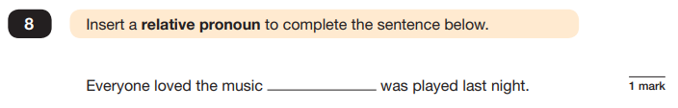
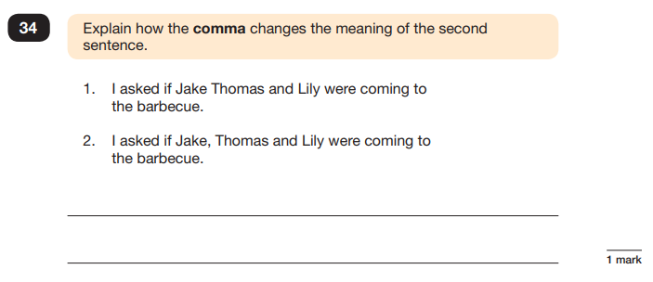
Spelling, Punctuation and Grammar: Paper 1
Example questions:
that
✔
e.g. The first sentence is about two people and the second sentence is about three people.
Notes:
For questions 8 and 34, there are various correct answers.

Slide 9
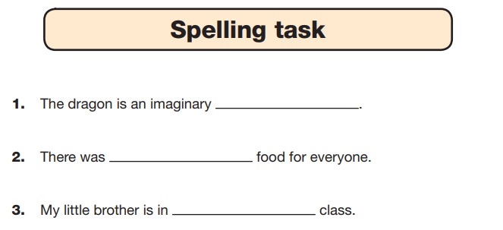
Spelling, Punctuation and Grammar: Paper 2
Paper 2 is a shorter paper that focuses solely on spellings.
Example questions:
Notes:
There is a spelling script that accompanies this. Example:
The word is creature. The dragon is an imaginary creature. The word is creature.

Slide 10
How can you help?
Give the children time to practise on SPAG.com (all logins have been stuck in reading records)
Remind children about full stops and capital letters.
Complete grammar pack sent home over Easter. Refer to the glossary sent home to help with this.
Ask children to teach you what the different terms are.
www.spag.com - we will send out login details next half term.

Slide 11
Reading: Tuesday 12th May
There is one reading test that lasts for 60 minutes.
The test is designed to measure if the children’s comprehension of age-appropriate reading material meets the national standard. There are three different set texts for children to read. These could be any combination of non-fiction, fiction and/ or poetry.
The test covers the following areas (known as Content Domains):
Give/ explain the meaning of words in context;
Retrieve and record information/ identify key details from fiction and non-fiction;
Summarise main ideas from more than one paragraph;
Make inferences from the text/ explain and justify inferences with evidence from the text;
Predict what might happen from details stated and implied;
Identify/ explain how information/ narrative content is related and contributes to meaning as a whole;
Identify/ explain how meaning is enhanced through choice of words and phrases;
Make comparisons within the text.

Slide 12
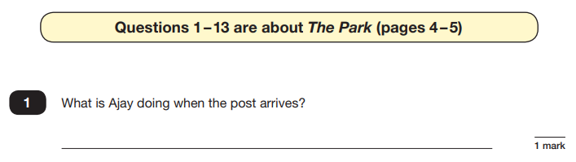
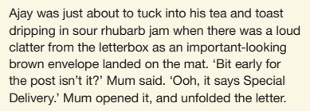
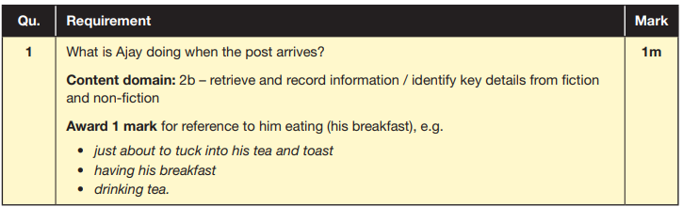
Reading
The reading SATs paper requires a range of answer styles.
Example questions:
Notes:
Question styles include:
Multiple choice questions
One-word answers
Short answer questions
Multiple mark (long answer) questions

Slide 13
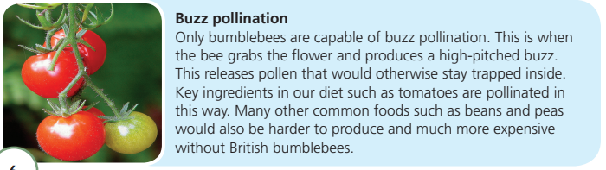
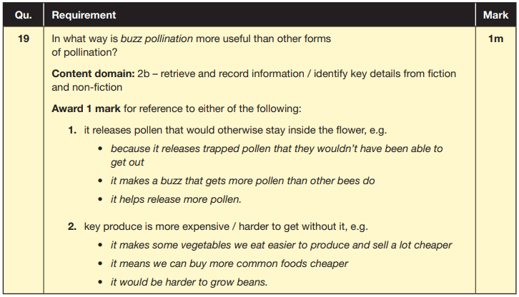
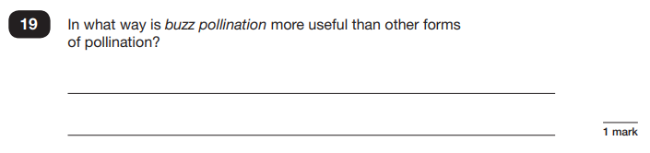
Reading
Example questions:
Based on text 2: Fact Sheet: About Bumblebees

Slide 14
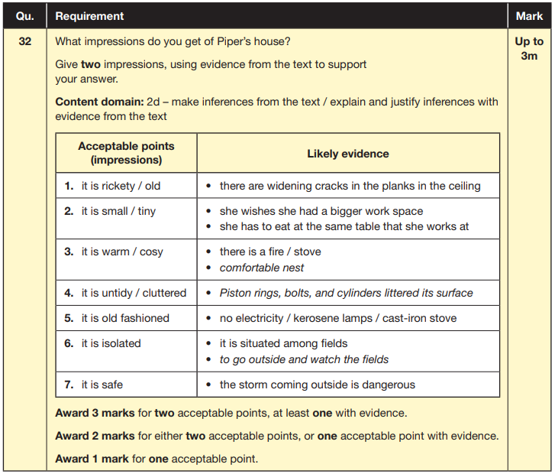
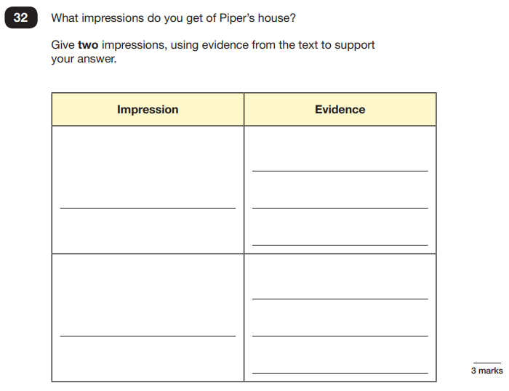
Reading
Example questions:
Based on text 3: Music Box
Notes:
This question is based on the whole text (2 pages).

Slide 15
Reading
Since the current testing formation for the SATs began in 2016, there has been a tendency for three types of questions to be the most popular.
In the 2023 Reading SATs paper,
12% of marks could be gained from answering questions involving giving and explaining the meaning of words in context;
42% of marks could be gained from answering questions involving retrieving and recording information or identifying key details from a text;
36% of marks could be gained from answering questions involving making inferences from a text and justifying inferences with text evidence.
Notes:
Example questions to ask at home:
What does this word mean?
Which word in this paragraph is the closest in meaning to…?
What [character] doing when [event] happened?
True or false questions about a paragraph/ text.
Why do you [character] did [event]? Can you think of another reason?

Slide 16
How can you help?
Encourage your child to read as often as possible.
Discuss the meaning of words they may come across or are unsure of.
Try to figure out the meaning together before telling them an answer.
Ask questions such as: How is this character feeling? What impression do you get of this character? What is the word closest in meaning to?

Slide 17
Maths: Wednesday 13th May and Thursday 14th May
The maths assessments consist of three tests.
Paper 1: Arithmetic (30 minutes) – Wednesday 13th May
Paper 2: Reasoning (40 minutes) – Wednesday 13th May
Paper 3: Reasoning (40 minutes) – Thursday 14th May

Slide 18
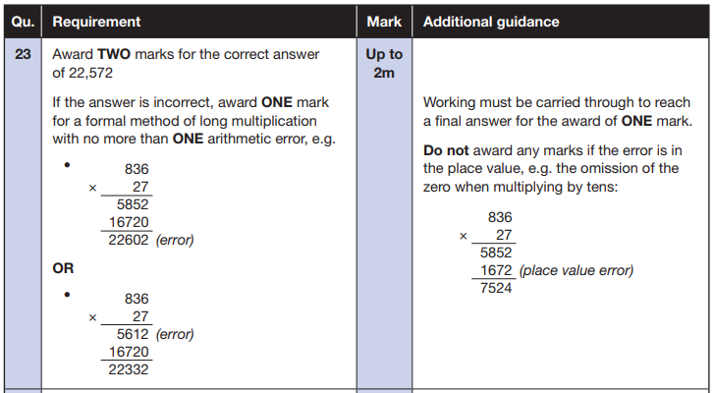
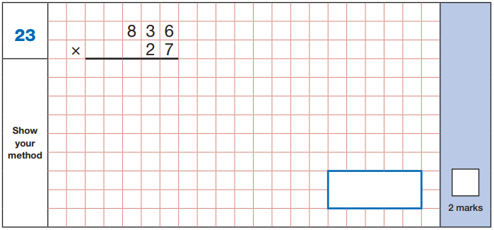
Maths Paper 1 (Arithmetic)
The maths arithmetic paper has a total of 40 marks.
The test covers the four operations (addition, subtraction, multiplication, division, including order of operations requiring BODMAS), percentages of amounts and calculating with decimals and fractions.
Example question:
Notes:
Identify that there are some questions that have 2 marks and some that have 1. If the answer to this question is wrong, children could still get a mark for a correct method containing an error.

Slide 19
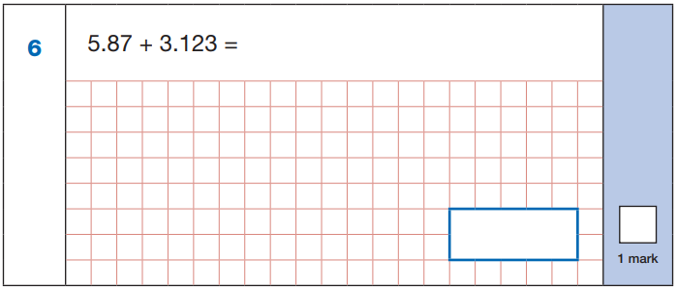
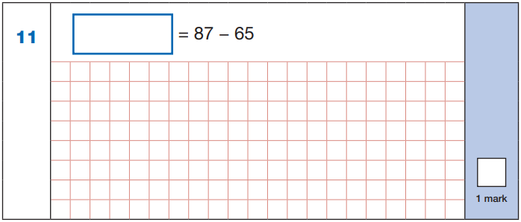

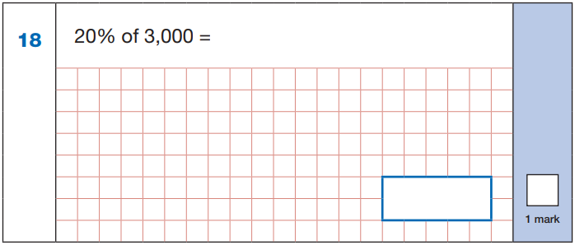
Maths Paper 1 (Arithmetic)
Example questions:
22
5.87
+ 3.123
8.993
87
- 65
22
8.993
60 ÷ (30 - 24)
60 ÷ 6 = 10
10% of 3,000 = 300
20% of 3,000 = 600
10
600
Notes:
These are examples of how children could solve the calculations. There are some that could/ should be solved mentally as it is far quicker that way (40 marks in 30 minutes does not allow for 1 minute + per mark).
Answers should always be given in their simplest form unless stated otherwise (e.g. for question 11, 20 + 2 would not be accepted as a correct answer).

Slide 20
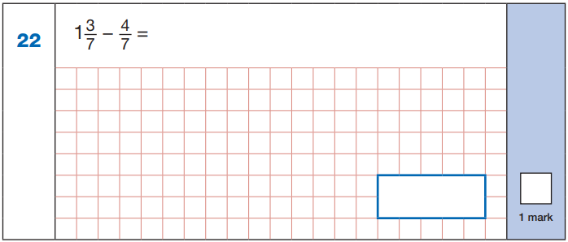
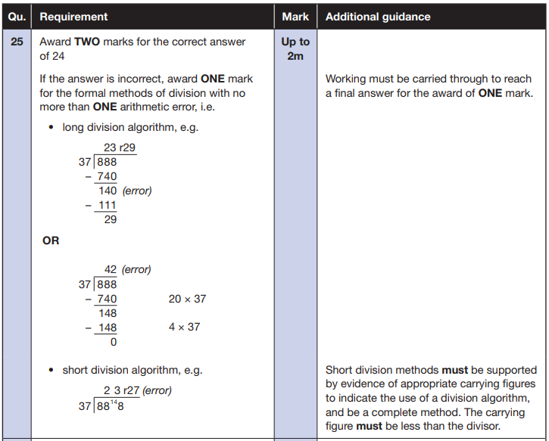


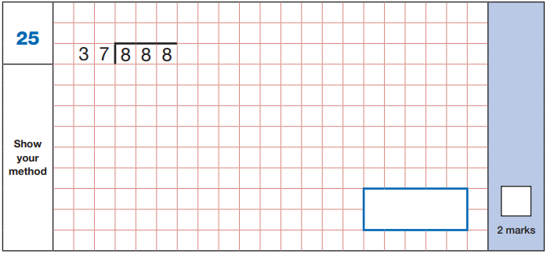
Maths Paper 1 (Arithmetic)
Example questions:

Slide 21
How can you help?
Complete the arithmetic questions in the pack sent home at easter.
Continue to keep times tables fresh in their minds.
Ask your children which questions they feel least confident with and go over these together.
SATS - Key Stage 2 Arithmetic - Compact Version (mathsbot.com)

Slide 22
Maths Papers 2 and 3 (Reasoning)
Paper 2 will take place on Wednesday 14th May and paper 3 will take place on Thursday 15th May. These tests have a total of 35 marks each.
These papers require children to demonstrate their mathematical knowledge and skills, as well as their ability to solve problems and their mathematical reasoning. They cover a wide range of mathematical topics from key stage 2 including,
Number and place value (including Roman numerals);
The four operations;
Geometry (properties of shape, position and direction);
Statistics;
Measurement (length, perimeter, mass, volume, time, money);
Algebra;
Ratio and proportion;
Fractions, decimals and percentages.
Notes:
In general, the questions get progressively harder throughout the paper. As this is the case, it is not unusual for children to be unable to complete the entire paper in the given time. Maths Paper 1 (Arithmetic)

Slide 23
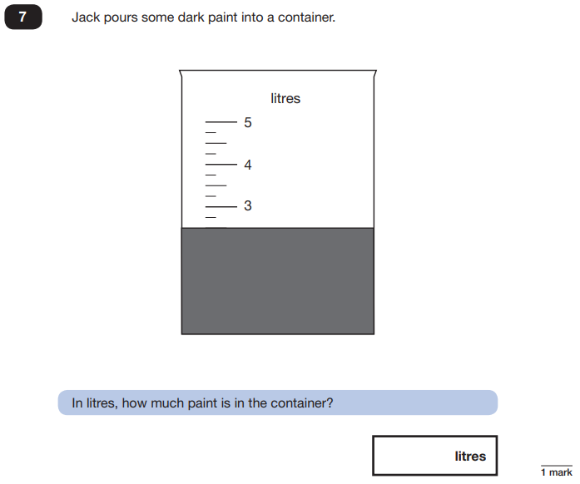
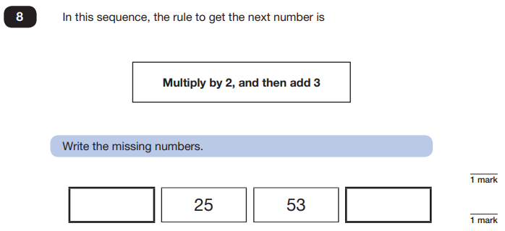
Maths Papers 2 (Reasoning)
Example questions:
11
109
2.5 or 2 ½

Slide 24
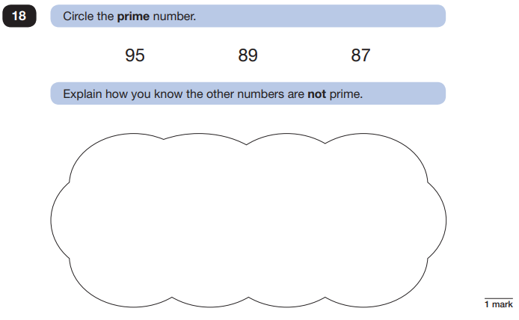
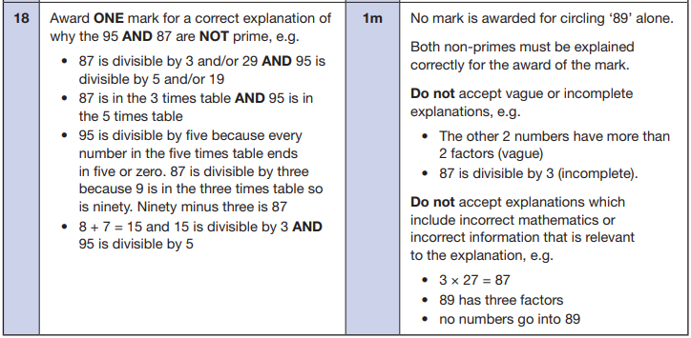
Maths Papers 2 (Reasoning)
Example question:
Notes:
This question is an example where pupils will need to justify their answer.

Slide 25
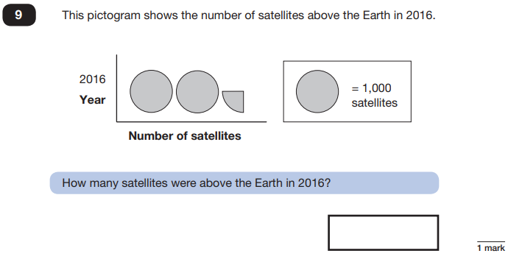
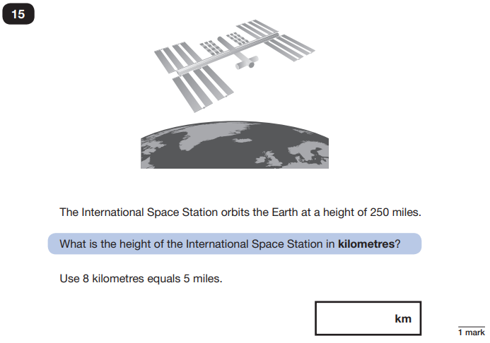
Maths Papers 3 (Reasoning)
Example questions:
2,250
400
Notes:
Question 9: Pictograms are part of the Year 3/ 4 curriculum.
Question 15: This show that children will need to know how to convert but they do not need to remember the conversion fact.

Slide 26
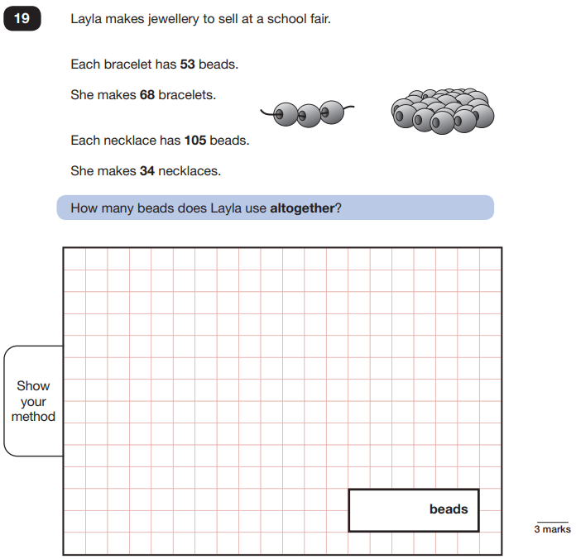
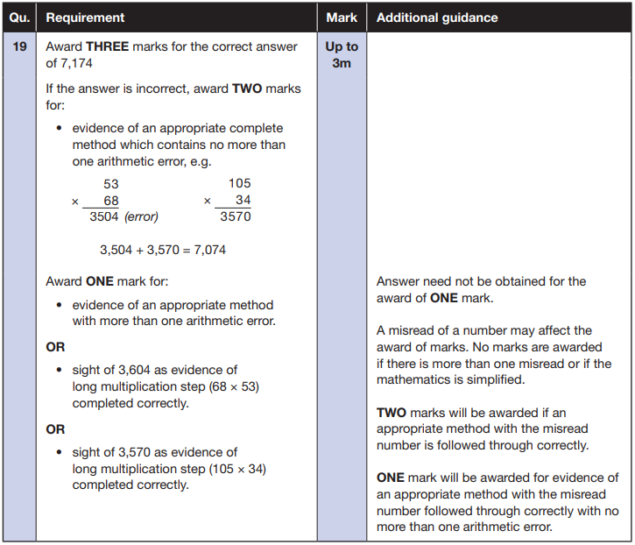
Maths Papers 3 (Reasoning)
Example question:
Notes:
Note that this is a three mark question.

Slide 27
Things to remember about SATs
SATs focus on what children know about Maths and English.
They will not reflect how talented they are at science, geography, art, PE…, and they certainly won’t highlight all of their amazing personal characteristics.
SATs don’t tell the whole story.
Their results will say if they did or did not meet a certain standard but not necessarily by what margin. These thresholds change each year according to the overall national performance, so what was classed as ‘meeting the expected standard’ this year might not be the same as last year.

Slide 28
Questions from parents last year
Do the children get their results and if so, how do they get them?
Results are given to parents on the end of year reports. You can then share these with your child. We will not tell them their results in school.
What are the test conditions and where do the children sit them?
The children sit the tests in the hall. They are separated by dividers. The children must be silent from the moment the tests enter the hall until the moment the tests leave the hall.
What happens if a child is overwhelmed by the test conditions?
There is an option to sit the test in a smaller room if we feel this will help the child to feel more calm.

Slide 29
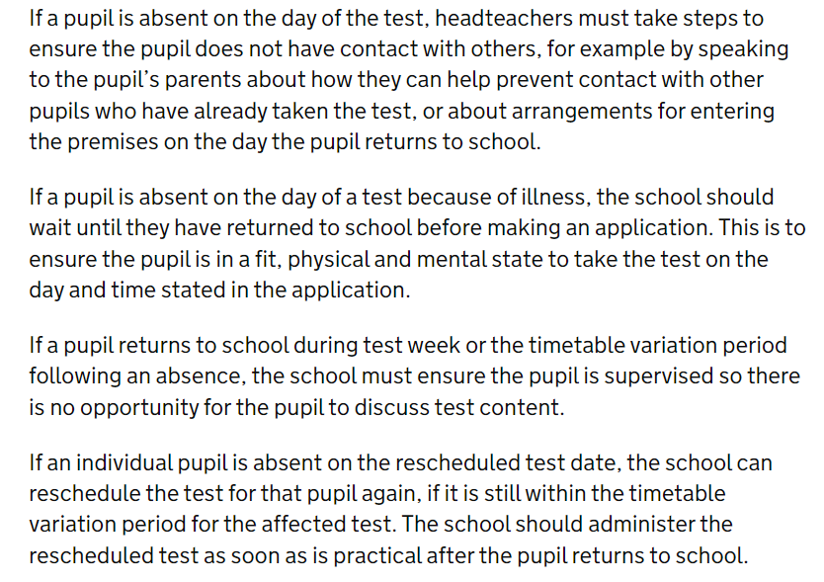
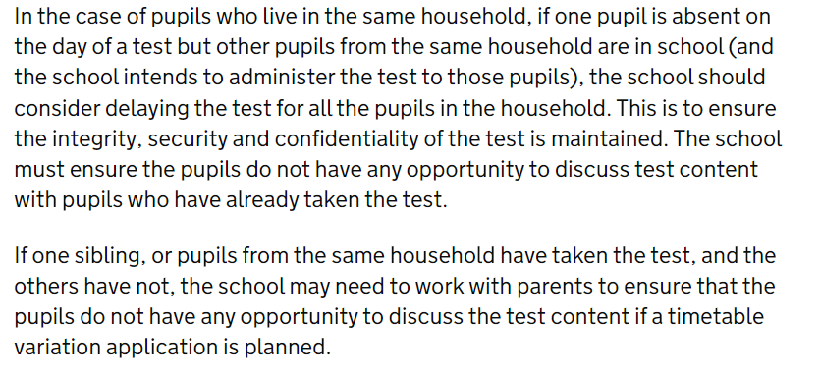
Questions from parents last year
What happens if a child is ill during the testing week?
The information below has been taken from the Gov.uk website.

