Slide 1
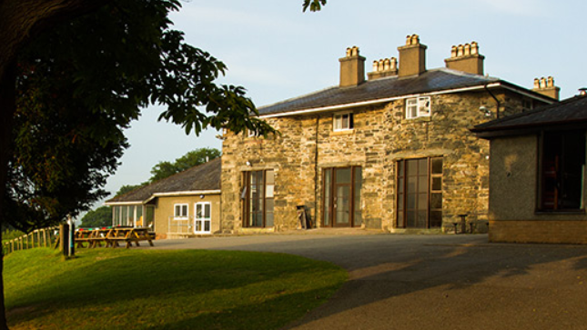
YEAR 6 RESIDENTIAL
Glan Llyn

Slide 2

DATES
WEDNESDAY 17TH SEPTEMBER –FRIDAY 19TH SEPTEMBER
DEPARTURE: 9.30
ARRIVAL AT THE CENTRE: AROUND 11
ARRIVAL BACK AT SCHOOL ON FRIDAY: BEFORE THE END OF THE DAY.
PLEASE ENSURE THERE IS SOMEONE TO COLLECT.

Slide 3
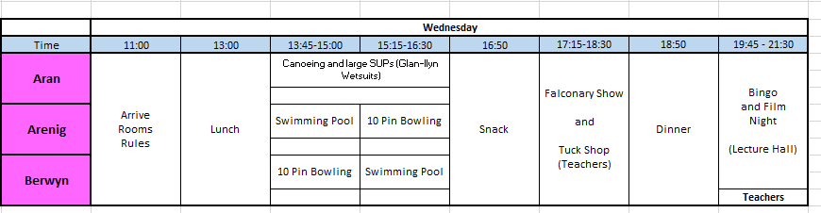
ITINERARY - SAMPLE

Slide 4
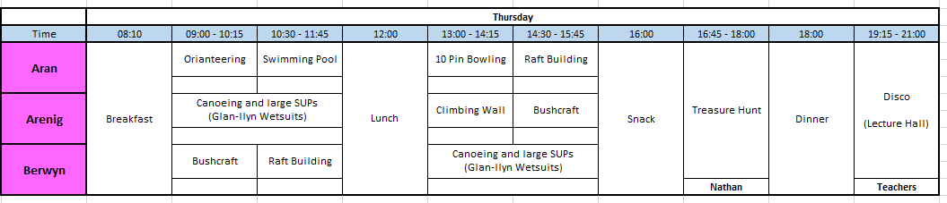
ITINERARY- SAMPLE

Slide 5
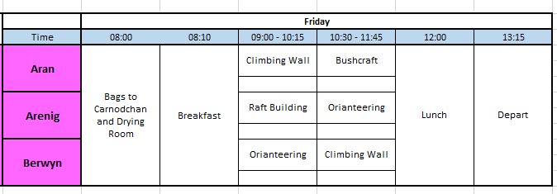
ITINERARY - SAMPLE

Slide 6
ROOM AND GROUP ALLOCATION
The children will write 4 children who they want to be with.
We will make sure they are with at least one of those people in their rooms and in their activity groups.
They will find out which group they are in when they get there.
Room sizes vary from 4 – 10 children. Boys and girls will be kept separate.
We will be split into 3 main activity groups.
Each group will have 2 staff members and at least one instructor depending upon the risk of the activity.

Slide 7
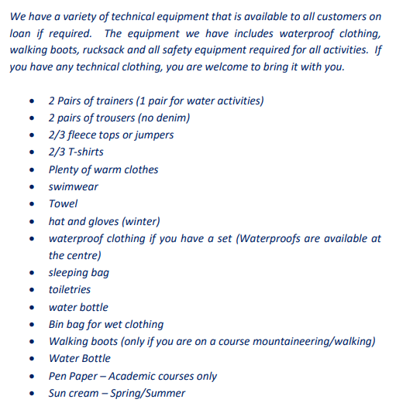
KIT LIST

Slide 8
The children will have the chance to visit the tuck shop.
Should you wish to, send £5 in a named envelope.
Your child will be responsible for keeping this safe as we are unable to take responsibility and will not have cash to replace lost money.
Medication – please give it to Mrs Millington or Miss Buckley on Wednesday morning.
Please do not bring:
Mobile phones or any devices.
Anything that is valuable (jewellery, special clothes).
WHAT ELSE TO BRING?

Slide 9

The centre will serve four meals a day (Breakfast, lunch, tea and supper) with a separate menu for vegetarians.
Should your child have any special dietary requirements, please note this on the health certificate so they can provide appropriate food.

Slide 10
NIGHT TIME
Staff will be available all night for children if they need us.
Centre staff are also available 24 hours a day.
Please let us know if your children will need any specific strategies that may help them to settle if they become upset.

Slide 11

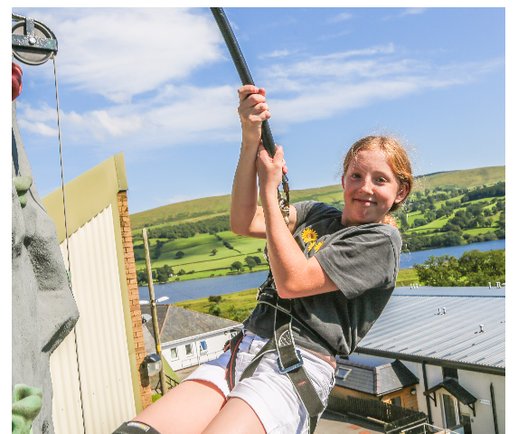
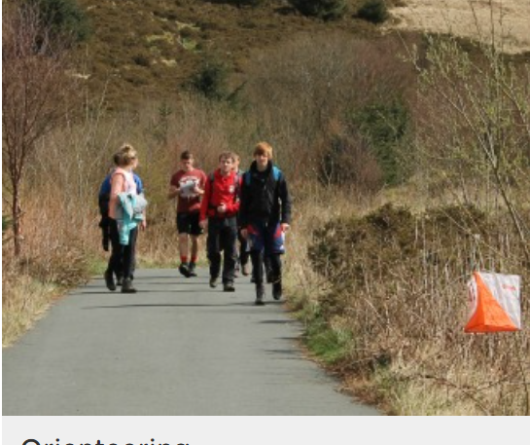
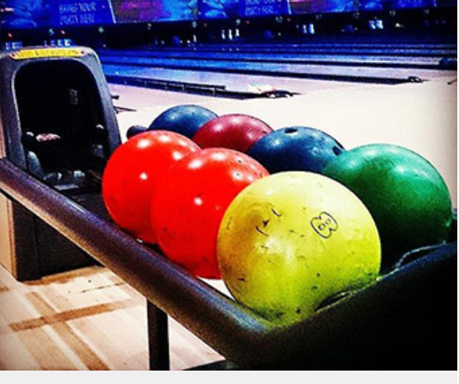
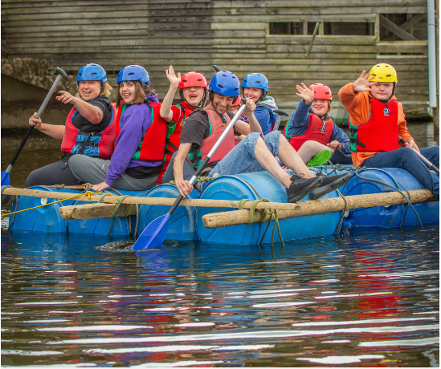


Slide 12
QUESTIONS FROM THE MEETING
Do we need to pack pillows?
  No the centre will provide pillows
Do they need more than one towel?
  The centre says that one towel will be enough. Each room has its own showering facility. If you want to pack an extra towel for swimming, you may do so.
Do we need to send them with their school jumpers?
  No. Please send the children in clothes that are suitable for the activities.
Can we call the children?
  The children will need to leave their mobile phones at home. We will only contact you if we need to. If you have any concerns, please contact admin and they will inform us of any information that needs to be passed on.
When will they arrive?
  We are aiming to get to the centre for 11am. We will let school know when we get there. We will aim to leave the centre at 1:30pm on Friday. We are expecting to arrive at around 3:00pm but will keep school updated with our ETA. Please ensure that you collect your children. They will be released from the usual school gate.
  Where do the children who go to Breakfast Club go?
  To Breakfast Club as normal. They can wheel their cases down as they come to class.

