Slide 1
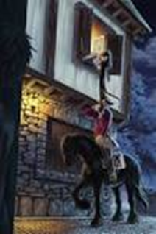
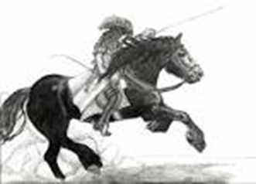
Highwayman Halted
13th January 1732 By Colin Creevy
Shocking and breath-taking events have happened over the last three days in the village of Sherlock. A local highwayman and his girl Bess, the Landlord’s daughter, were both killed tragically by a musket. Attempting attention The Highwayman arrived by horse in a coat of claret velvet and a bunch of lace at his throat. He attempted to attract his love’s attention by whipping the window and whistling a tune. When this worked he told Bess he would come back. Witnessed The Highwayman and Bess were seen together by a witness (who prefers not to report him name) that was there when he heard the Highwayman say he would return with stolen gold the next night. The on-looker was determined he heard the robber announce he was | “after a prize tonight”. Ruthless Redcoats It is believed that the witness had told King George’s men – the Redcoats – about the Highwayman and his girl Bess as the next night, the Redcoats arrived at the old inn marching menacingly. Without and manners and displaying boisterous behaviour, they drank the Landlord’s ale and disappeared upstairs where they found Bess in her room. They gagged her and bound her to her narrow bed with a musket at her side. They mocked her and used her as bait, which led her to making her big decision. When she heard the Highwayman on the Highway, Bess decided to take her own life by pulling the trigger on the musket to warn her love. The Highwayman heard the musket and retreated immediately leaving the soldiers furious. | Then, the Highwayman spurred back, realising it was Bess. The Redcoats shot him down as he was racing back down the road to the village to seek revenge for Bess’ death. Ghostly form? It is now reported that every night the ghostly images of the Highwayman can still be seen riding into the village of Sherlock on his horse arriving at the old inn where Bess is at her window looking out into the night.
The Highwayman talking to Bess.
The Highwayman come back for revenge of Bess’ death.

