Slide 1
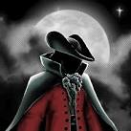
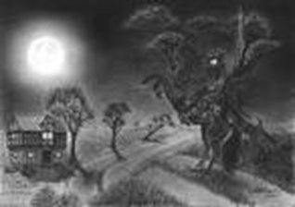
Heroic Highwayman
Friday 13th December 1765 Robber’s antics thwarted by local soldiers By John Gregory
Shocking and strange events struck the small village of Goostrey putting the villagers in an anxious state. Yesterday, Bess the landlord’s daughter and a local highwayman, both fell into the trap of king George’s men(the Redcoats)neither of the survived the tragic incident. Bess had been helping the highwayman with his devious thieving. The Arrival of the Highwayman According to our witness(who has asked to remain anonymous)the highwayman came on Friday he easily identified him from his night dark house splattered with mud and his rapier swinging from his leather belt he tried knocked but he must of known her as he whistled a tune. The Promise According to our eye-witness over-heard The Highwayman say:” I’m after a prize tonight” and promised to return. | Our on-looker recalled him sounding familiar, while he was tending to the horses he heard the same voice, so Bess and the highwayman could have been contacting for ages. Ruthless Red Coats Because of her negotiations with the highwayman, the witness was forced to take further action and tell King George's men to settle the unbelievable happenings, but they came unpleasantly drinking the lords ale without spending a penny. They stomped up-stairs chaining Bess to the foot of a bed mocking her and laughing at their jests. Bess These unfortunate events lead to the trigger of the musket. when the highwayman rode up to the old inn (The Black Raven)Bess pulled back the trigger of a musket warning her love. However, message soon travelled to his ears, like poison to his heart. He charged back | stampeded back in his anger and grief, seeking revenge of the woman he loved. taken over by anger, he charged as an easy target and was shot down in his grief. Haunted Highwayman Villagers thought that these paining occurrences were over… However, we have been in touch with some of the villagers and have reported that ghostly figures have been spied retelling the tragic events.

