Slide 1
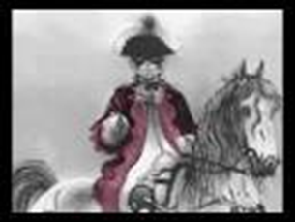
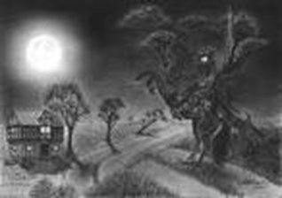
The Highwayman
A Highwayman caught thieving in a village. 20 August 1769 By Donald Grump | The Highwayman | The old inn
Shocking Events A shocking tragedy has occurred Over the last three days and nights, involving a Highwayman and his girlfriend, a landlords daughter, called Bess. This event happened in the village of sweets in an old inn. Bess and a Highwayman ended up on the wrong side of a musket as The Highwayman, who rode a black horse, went robbing people for money. This happened Friday to Sunday on a cold winter night. The Highwayman’s Arrival The Highwayman came clattering and clashing over the cobbles in to the courtyard on his horse. He was wearing boots up to the thigh and a bright, red, velvet coat as he held his rapier high in the air. He tried to grab Besse’s attention by first tapping on the window with his whip then he tried whistling a tune until Bess appeared. | Terrible Thieving According to an eye witness -who was an ostler in the village- proclaimed that The Highwayman was boasting that he was going out thieving this quote was followed by a kiss. He then whispered in her ear “I will be back by moonlight, wait for me by moonlight.” King Georges Men It was a Saturday evening and suddenly King men (also known as the Red coats) busted through the door boisterously as they supped the landlord’s ale. They rampaged up the stairs to Bess and tied her to the bed and gagged her and also mocked her. They all waited for the Highwayman until Bess had to make a terrible decision with the musket. | The Big Bang Tlot tlot, they heard the hooves of The Highwayman’s horse riding over the cobbles. Bess needed to warn him so she pulled the trigger BANG! The Highwayman fled to the west. But then The Highwayman found out it was Bess who had died and he rode back furiously BANG, The Highwayman was left on the ground. Ghostly Form Villagers report that every full moon, you can still see ghostly images on his horse and Bess plaiting a dark red love knot in her long black hair.

