Slide 1
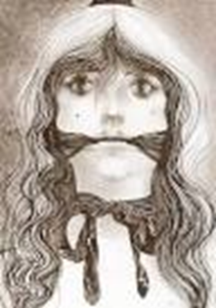
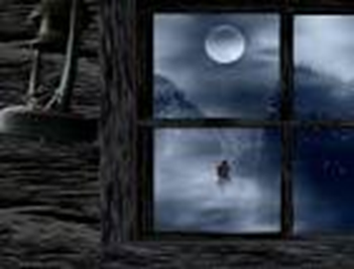
Hunted Highwayman
17th January 1763 Thieving stopped for the highwayman. By Colin Creevy | Bess, being gagged. | Ghost of the in love.
Unbelievable happenings have occurred in the village of Godricks Hollows, have taken place – a tragic love story which ended with a bang, leaving disbelieving villagers to wonder. It took place in the last 3 days. Although they have recently appeared in ghostly form – always in the dead of night. The Highwayman came galloping up to the old Dartmoor pub (with a lace at his throat, a musket and French cocked hat, and a jet black horse) He was striking at the window with his whip, waiting for a welcome. Instead he whistled a tune which would be enough to lure anyone close. Bess , who was sir Hollingshead (the Landlords daughter) Instantly fell in love instantly. According to eye witness Tim Berre 20, he was just feeding the Dartmoor's, when he over heard – the love of his | life – talking to the Highwayman. Although he was jealous, he stayed to listen. The highwayman establishes that he was going thieving “ I am after a prize tonight”. Promising to return. Afterward Tim saw him gallop away over the moors. 1 hour after he had gone, a swarm of King George’s men came ,arching up to the pub with muskets at their sides. (Apparently from witnesses) They had stern faces but instead, came to drink. Everyone thought they were acting in a boisterous mood, which was why they disappeared upstairs, the truth was they were using Bess as bait, to catch her own love. They tied her to the bed post as well as gagged her and mocked her. The silent soldiers waited for a furtive figure to gallop down the cobbled track. As the sound of her unaware love, | came trotting down the lane, Bess drawing her last breath, had to warn him. As she pulled the trigger, it was done. The highwayman was confused and fled, he knew something was wrong. The Red Coats were infuriated. As the heard from a villager from hogsmeade that it was Bess, he (apparently) shot off, revenge in his heart. As he galloped down the lane, he ended up the same way. There he was, lay drenched in his own blood. Villagers were partying for the end of these unspeakable events. However this was not the end! People have reported, that in the dead of night, when the trees whistle, and the moon shines onto the undulating heathery lands, they will roam the lands, where they once happened to live.

