Slide 1
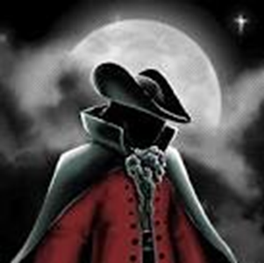
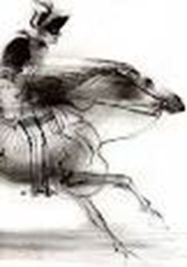
The End of The Highwayman
A devious Highwayman has been halted and ended on the outskirts of Springfield. By Kenny Brocklstien 5th April 1769
Over the last 3 days (Friday to Sunday) tragic events happened, including, who is an Inn Landlords daughter, and a local Highwayman, have a saddening ending. They bothy died on the outskirts of Springfield. The Highwayman fell when speeding away because Bess had died – who is believed too have ended her own life! After they inspected the Highwayman they figured it was an act of robbing. It is believed that Highwayman is a ghost and visits the Inn too see Bess in her ghostly form. A mysterious creature The Highwayman rode on a sleek black horse called, early on Friday evening. The local milkman – Mr Wiggum - was an eye witness and stated he saw the Highwayman wearing, elegant clothes (black), a French hat and a coat of claret velvet. As the Highwayman clattered on the cobblestone, he whipped at the window, no response, he whistled a tune and Bess was there as if she was there the whole time. Tim the Osler Tim, who was a humble Osler at Mr Syzlaks Tavern, was an eye witness and experienced the whole thing. He saw, out the side of his eye, the Highwayman boasting too Bess and protesting that he would come back with gold, he pecked Bess and promised that he will be back by midnight. | Tim the Osler Tim, who was a humble Osler at Mr Syzlaks Tavern, was an eye witness and experienced the whole thing. He saw, out the side of his eye, the Highwayman boasting too Bess and protesting that he would come back with gold, he pecked Bess and promised that he will be back by midnight. He then he spurred off towards his quarry in an explosion of dust. Ruthless Redcoats That Saturday evening, revellers at the tavern, were held in shock and despair as an army of King George’s men, also known as redcoats, marched rowdily through the tavern. After they smashed down the door and splinters flew everywhere, the Redcoats starting supping all of Mr Syzlaks priceless ale, in a boisterous way. A reveller later reported that the Redcoats went upstairs and never came back down. Upstairs, the Redcoats were hunting down Bess like dogs hunting down meat, they succeeded and tied up as bait. Bess knew and so did everyone, he was coming, all they needed too do was wait. The Highwayman returns Later that day, the Highwayman rode towards the tavern, which looked a broken, thought something was wrong. | The Highwayman returns Later that day, the Highwayman rode towards the tavern, which looked a broken, thought something was wrong. Bess had an idea, she wriggled and writhed, then at last the trigger was hers. With the mussel of the musket aimed at her chest she fired, warning the Highwayman with her life. The Highwayman turned and spurred away from the tavern knowing he wasn’t alone. On his horse, he galloped to the west, away. Until, word finally reached him the one too have gotten shot was Bess, he shouted a curse to the sky and spurred knowing all he wanted was revenge. The Highwayman got nearer and nearer the tavern was in sight and out of nowhere ‘BANG’ another musket went of. As the smoke cleared , the Highwayman lay motionless on the Highway. Ghostly Images Villagers believed that that was the last of the Highwayman and Bess, but local man ‘Jonny Johnson’ reported he saw a ghostly image of the Highwayman clattering and clanging in the tavern yard. He whips he window then whistles a tune. Then suddenly, a ghostly image of Bess appears plaiting the same red love knot in her dark black hair.
The Highwayman plotting revenge, on Saturday the day before his ending.
The Highwayman escaping to the West as Bess warns him with her death.

