Slide 1
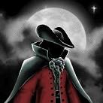
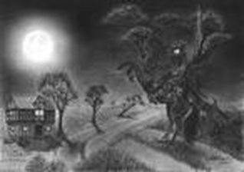
Criminal Subdued
17th June 1813 Highwayman removed from roads By Harry Shanahan
Last weekend, a tragic series of events have been taking place. Bess Copperson, of Goresly village, made the unfortunate decision of taking her own life. Her farther, the landlord of the old inn, was devastated, “I never expected that my Bess would be involved in such wrong events. She died so young.” The feared local highwayman was also involved in these few nights, and was shot down after robbing poor travellers. Bess took her life whilst gagged and tied as bait for the criminal. King George’s men have removed yet another criminal off the roads, but was it really worth it at the expense of a helpless innocent? The Criminal Arrives On Friday night, a witness spied the highwayman arrive over the cobbles on a horse. According to the witness, he wore a pistol, rapier, French cocked hat and a coat of velvet. The criminal then tapped on the shutters to attract | his love, Bess. When this did not work he whistled a tune and his girl appeared, plaiting a knot into her hair. Tim, who was just a humble ostler at the old inn, witnessed the highwayman promising his girl that he would be back with a prize the next night. Unluckily for the pair, Tim had witnessed every detail of this conversation, so he knew all of the criminal's plans. After saying farewell to Bess, the highwayman turned and spurred towards his quarry. The Redcoats Are Here! Thanks to the reported conversation, on Saturday evening the redcoat troop entered the Old Inn. Soon the whole troop were recklessly drinking ale. Their behaviour was reported as, “inappropriate and much too boisterous for soldiers.” They then disappeared upstairs to gag Bess, who was being used as bait for the highwayman. | Later on that night, the highwayman was heard returning to Goresly. Witnesses then reported hearing a gunshot from Bess’s prison, and then the highwayman turning to the west. One witness stated they saw the redcoats run out of the door shortly after, firing their guns at the sky and yelling curses at the criminal. However, the highwayman soon returned, but was soon silenced. Ghostly Glimpses Was that the end of the highwayman? No. Recently, almost a week after these terrible events, reports have come in stating supernatural events. Eyewitnesses reported about pale translucent figures. One always rides up to the window on a horse. Onlookers say he wears a pistol, rapier, French-cocked hat and a cloak of velvet. He then whistles a tune to the window and a pale, translucent character appears. It’s a woman plaiting a knot into her hair – Bess and the Highwayman have returned as ghosts.

