Slide 1
Welcome Meeting
9.9.26

Slide 2
Hello and welcome!
A little bit about me!
I joined Goostrey in January.
I have been a teacher for 3 years.
This is my 3rd year teaching in Year 1.
I am very passionate about learning through play and I have adapted the classroom this year to reflect this.

Slide 3
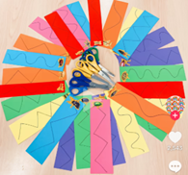
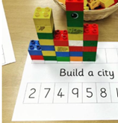
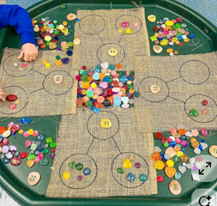
Autumn 1
To make the transition from reception as smooth as possible, the children will be continuing to work in small, adult led groups until October/November.
While children are working in these groups, the rest of the children will be accessing the provision.
This includes things like:
The construction area
Role play/café
Reading area
Outside play
Maths, writing, phonics and fine motor activities – these will be laid out on the tables for the children to access independently.

Slide 4
Post autumn 1…
We will move to a more formal learning style.
All children will work at the same time.
This will be done very gradually and only when the class are ready.
Children will still receive adult support.

Slide 5
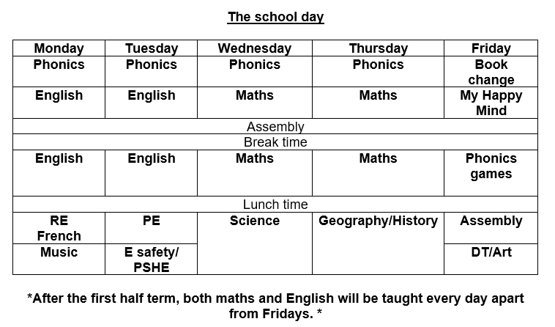
Timetable

Slide 6
PE and Homework
Our PE day is Tuesday. Please send your child into school wearing their PE kit on this day.
Reading books will be collected in on a Thursday to be changed and returned on Friday.
All children should have their reading folder with them EVERY THURSDAY.
Your child will have 1 phonics book linked directly to the stage they are currently working at, and 2 colour banded books of their choice.
On Friday, children that have read 5 or more times that week will receive a reading sticker.
At the end of the half term, they will receive a reading certificate.
Please record anything that your child reads in their reading diary.

Slide 7
Spelling homework
Spelling homework will start after Christmas.
The children will get 5 spellings each Friday.
They will be tested on these the following Friday.
4 words linked the phonics sound we have learnt that week.
1 ‘tricky word’ – learnt by sight.

Slide 8
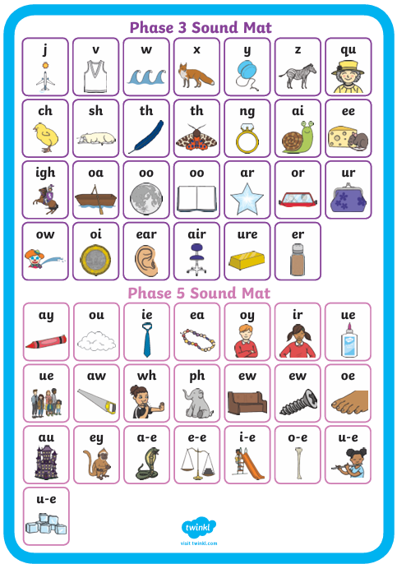
Phonics
Please read at home as much as you can.
We will be recapping phase 3 until October half term.
In year 1, the children learn phase 5 sounds.
These include alternate sounds.
For example
In phase 3 children learn the ai sound - ‘rain’
In phase 5, we learn that ai can also be written as ay – ‘play’

Slide 9
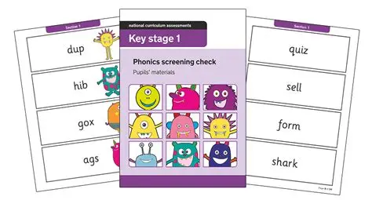
Phonics screening check
In June, all children in Year 1 will complete the Phonics Screening Check.
This is a national test.
It will be carried out 1-1 with a familiar adult.
Children will be asked to read 40 words containing the sounds they have learnt in reception and year 1.
Some of these words are alien words. They are not real.
It is designed to test that the child can use their phonics to sound out and blend the word.

Slide 10
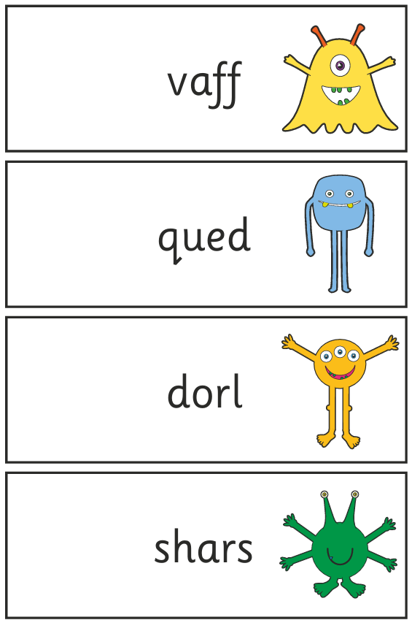
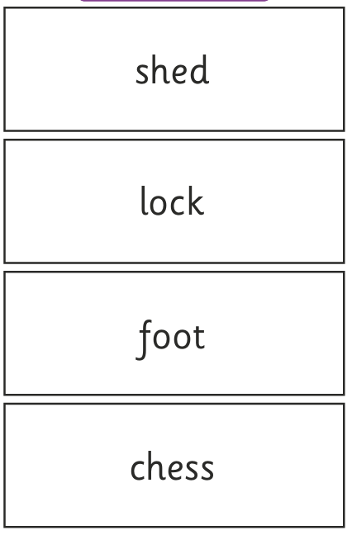

Slide 11
Maths
In maths we will be focusing on numbers to 10 until Christmas.
After Christmas will move to numbers to 20, 50 and finally 100.
To ensure your child is able to access the learning as best they can, if you can, support your child to become fluent with numbers to 10 at home.
This could include:
Counting forwards, backwards and from a given number.
Number bonds to 10 and within 10 – hit the button online.
Hit the Button - Quick fire maths practise for 6-11 year olds - Topmarks

Slide 12
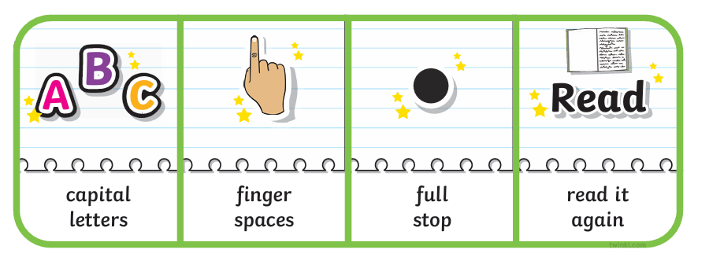
Writing
This year we will focus on:
Capital letters
Full stops
Using ‘and’
Using phonics to spell – if it is spelt phonetically, leave it - familee
Using adjectives
Exclamation marks
Question marks

Slide 13
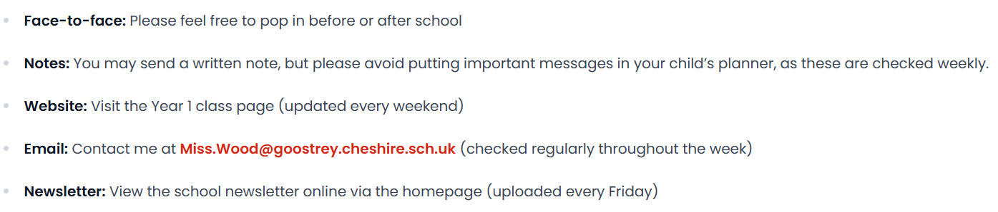
How to contact me

Slide 14
Thank you!

