Slide 1

Welcome to Year 3
Mrs Sant
mrs.sant@goostrey.cheshire.sch.uk

Slide 2
Teaching Team
Mrs Sant – Class Teacher
Mrs Riddell – Science & French Teacher Thursday mornings
Mrs McCabe and Mrs Hughes supporting children in class.

Slide 3
Routines in Class 3
School day start time for Year 3 is 8:50am and collection will be 3:25pm
PE – Autumn - until half term Tuesday unless stated otherwise so P.E kit, in line with the Start Of Year Pack information, will need to be worn on that day please (black jogging bottoms during colder weather.)
Swimming – during the Summer Term – start date to be confirmed
Spellings given – every Friday Tests – following Friday
Times Tables Test – every Friday
Homework: English and Maths based work – given every Friday
  To be handed in on the following Thursday
  Homework Club – Tuesdays until 4:10pm.

Slide 4
School website!

Slide 5
Rewards/Sanctions in Class 3
House points
Top of the Tree! – Certificate awarded
Marble Jar – working towards chosen treat voted for by the children
Verbal warning
Make the right decision
If not, 5 minutes of playtime lost

Slide 6
What the rest of our year looks like:
Autumn 1 & 2 | Exploring Africa (Comparing life in Elizabethfontein) including the exhibition ~ ‘A Good Book’
Spring 1 & 2 | Great Inventors from Around the World
Summer 1 & 2 | The Romans
Class trips TBC
Autumn Term~
Visit into class
Summer Term
Roman Day

Slide 7
Reading in Class 3
All children will be assessed using our Junior assessment program – Accelerated Reader which your child will soon love – they will then have a range of books to choose from and will be assessed going forward once every term to aid their progression and broaden their reading material.
Recommended Reading Shelf – each week, a child will be nominated by the other children in the class, to take their turn as the recommended reader. They will be asked to bring 4 or 5 books in which they have read and enjoyed and to write a brief note on a ‘post-it’ note explaining why they recommend them to their peers. They will then be invited to share their choice with the class – a very keen audience awaits!

Slide 8
Reading in Class 3 cont…
Recommended reading list for Year 3 – Updated on our Class Web Page – a taster from the current list is on next slide. If you visit the webpage detailed on the next slide, you are able to click on the books featured and be taken straight to the Amazon UK page to take a closer look. We already have many of the titles in school and so the children will have access to them as they progress through their reading across the year groups.
There is absolutely no expectation from us for you to go out and buy any of the books but at the same time, we thought that you may appreciate some guidance should you wish to invest from time to time ~ who knows, the odd book for Christmas might be an idea!

Slide 9






Recommended Reading
These books are suggestions from https://www.thereaderteacher.com/year3
We will be reading The Abominables, George’s Marvellous Medicine & The Iron Man in class!!

Slide 10
New to this year ~
Surprise
Parent / Grandparent
Reader

Slide 11
Year Group Standards/Expectations
Some key objectives to be aware of:
English -
Reading to an adult/discussing books is really important in Year 3 as in all years –
Use of a dictionary to check the meaning of words
Adding a prefix and suffix to root words
Planning for writing – developing vocabulary and grammar
techniques and being influenced by a selection
of authors
Build on their quality of joined handwriting
Re-reading their work to edit and improve

Slide 12
Year Group Standards/Expectations
Some key objectives to be aware of:
English – Spellings
Please have a look at the spelling lists!
These will be dropped into weekly spelling lists
Expected to spell them correctly within their writing with increased accuracy and will be practiced many times in class during Sentence
Accuracy.

Slide 13
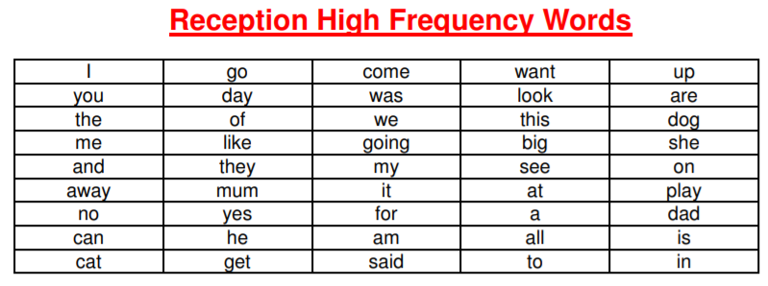

Slide 14
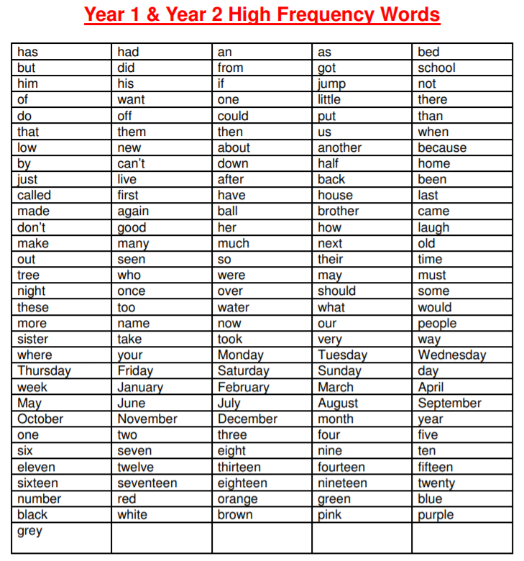

Slide 15
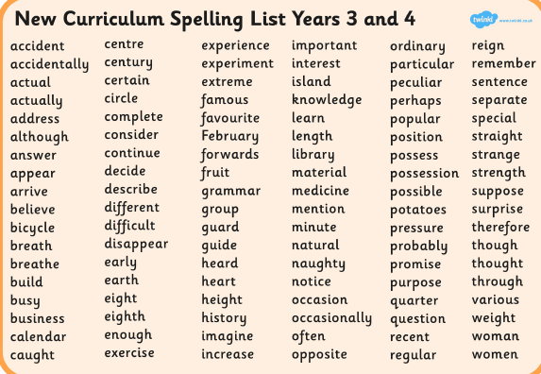

Slide 16
Year Group Standards/Expectations
Some key objectives to be aware of:
Maths
Year 3:
To rapidly recall and apply multiplication and division facts for 2s, 3s, 4s, 5s, 8s and 10s
Add and subtract using numbers up to 1000 – moving towards formal written methods
Multiplication ~ three digit by one digit
Division ~ using Bar Models, Place Value Charts or the inverse operation
Reasoning and problem solving using all four operations

Slide 17
Tips
Practice identifying money –
notes and coins
Practice telling the time on
analogue clocks

Slide 18
General School Info
The school rules are: Try your best, Be friendly and polite, Care for others and the environment, Work hard.
Newsletter information. Should you wish to make a contribution please send them as an ATTACHED WORD DOCUMENT. Thank you!
Weekly updates every week on the Class Page with details of the week and the days ahead.
We have a Before school club (8am start) and an Afterschool club – Goostrey Allstars (6pm latest finish)
There are NO BALL GAMES allowed in the playground before or after school. You are responsible for your children before and after school in the playground.
Breaktime snacks are available for the children to buy from our trolley which is a very exciting addition for the Juniors – items range from 25p to 55p – children to bring money in purse or envelope please – items on offer may include toast, tea cakes, crumpets and bagels.
Water bottles – every day please!

Slide 19
Music Lessons

Slide 20

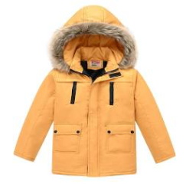
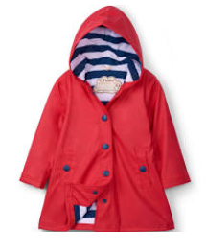

Slide 21
Thank you for your
continued support…

