Slide 1
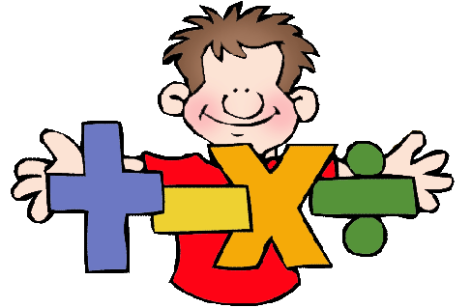
Maths Parent Workshop
Thursday January 25th 2018
Addition and subtraction

Slide 2
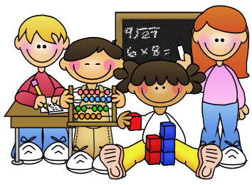
Key Aims
  To give you an overview of the maths curriculum principles
  To know the process that all maths skills work through so understanding happens
  To give you step by step progression for addition and subtraction within a key stage
  To see and experience the types of maths activities that happen in the classroom
  To use a range of concrete materials that support the children’s learning

Slide 3
The National Curriculum for Mathematics aims to ensure that all pupils:
  become fluent in the fundamentals of mathematics, including through varied and frequent practice with increasingly complex problems over time, so that they develop conceptual understanding and the ability to recall and apply knowledge rapidly and accurately.
  reason mathematically by following a line of enquiry, conjecturing relationships and generalisations, and developing an argument, justification or proof using mathematical language
  can solve problems by applying their mathematics to a variety of routine and non-routine problems with increasing sophistication, including breaking down problems into a series of simpler steps and persevering in seeking solutions. (DfE 2013)

Slide 4
Putting it all together

Slide 5
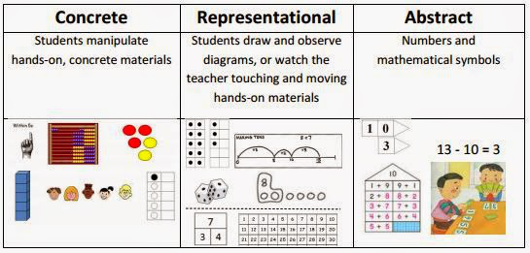
Building Mathematical Concepts
Three stages
Children need significant time working with concrete materials and constructing pictorial representations so that abstract symbols and operational understanding occur.

Slide 6
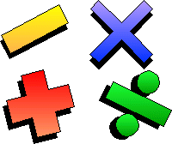
Progression in Calculations
Key stage One
Key stage Two

Slide 7
Understanding and Using Calculations
For all calculations, children need to:
Understand the = sign as is the same as, as well as makes.
See calculations where the equals sign is in different positions, e.g. 3 + 2 = 5 and 5 = 7 - 2.
Approximate before calculating and check whether their answer is reasonable.

Slide 8
Addition
Children need to understand the concept of addition, that it is:
Combining two or more groups to give a total or sum
Increasing an amount
They also need to understand and work with certain principles:
Inverse of subtraction
Commutative i.e. 5 + 3 = 3 + 5
Associative i.e. 5 + 3 + 7 = 5 + (3 + 7)

Slide 9
Progression
 | EYFS | Year 1 | Year 2
Addition and subtraction facts | Know number bonds to 10 | Represent and use number bonds and related subtraction facts within 20 | Recall and use addition and subtraction facts to 20 fluently, and derive and use related facts up to 100 Recall and use number bonds for multiples of 5 totalling 60 (to support telling time to nearest 5 minutes)
Mental methods | Using quantities and objects, they add and subtract two single-digit numbers and count on or back to find the answer | Add and subtract one-digit and two-digit numbers to 20, including zero (using concrete objects and pictorial representations) | Add and subtract numbers using concrete objects, pictorial representations, and mentally, including: - a two-digit number and ones - a two-digit number and tens - two two-digit numbers - adding three one-digit numbers

Slide 10
Counting All
Using practical equipment to count out the correct amount for each number in the calculation and then combine them to find the total, e.g. 4 + 2
Notes:
If you want children to progress from Kai’s method.
Dice/Dominoes – 1 labelled and 1 with dots (from 2 with dots) – 2 labelled
Need to be able to then identify the larger number – goes back to place value and lots of experience of amounts/ordering.

Slide 11
From Counting All to Counting On
To support children in moving from counting all to counting on, have two groups of objects but cover one so that it can not be counted, e.g. 4 + 2
4
Notes:
If you want children to progress from Kai’s method.
Dice/Dominoes – 1 labelled and 1 with dots (from 2 with dots) – 2 labelled
Need to be able to then identify the larger number – goes back to place value and lots of experience of amounts/ordering.

Slide 12
Adding Two Digit Numbers
Children can use base 10 equipment to support their addition strategies by basing them on counting, e.g. 34 + 29
Children need to be able to count on in 1s and 10s from any number and be confident when crossing tens boundaries.

Slide 13
Adding Two Digit Numbers
Children can support their own calculations by using jottings, e.g. 34 + 29

Slide 14
Subtraction
Children need to understand the concept of subtraction, that it is:
Removal of an amount from a larger group (take away)
Comparison of two amounts (difference)
They also need to understand and work with certain principles:
Inverse of addition
Not commutative i.e. 5 - 3 ≠ 3 - 5
Not associative i.e. (9 – 3) – 2 ≠ 9 – (3-2)

Slide 15
Taking Away
Using practical equipment to count out the first number and removing or taking away the second number to find the solution, e.g. 9 - 4

Slide 16
Taking Away Two Digit Numbers
31
Children can use base 10 equipment to support their subtraction strategies by basing them on counting, e.g. 54 - 23

Slide 17
Taking Away Two Digit Numbers
Children can support their own calculations by using jottings, e.g. 54 - 23
31

Slide 18
Taking Away Two Digit Numbers (Exchange)
26
Children can use base 10 equipment to support their subtraction strategies by basing them on counting, e.g. 54 - 28

Slide 19
Taking Away Two Digit Numbers (Exchange)
Children can support their own calculations by using jottings, e.g. 54 - 28
26

Slide 20
Finding the Difference (Counting Back)
Children need to understand how counting back links to subtraction, e.g. 7 – 4
Make the large tower the same size as the small tower.

Slide 21
Finding the Difference (Counting On)
Children need to understand how counting on links to subtraction, e.g. 7 – 4
Make the small tower the same size as the large tower.

Slide 22
Finding the Difference (Counting On)
To begin linking to number lines, this can be looked at horizontally instead of vertically.

Slide 23
Activities
Ten frames / counters
Bead strings
Exchange up What Calculation
Calculation Patterns Subtraction Problems
Difference Battle Number Story Match

Slide 24
Application

Slide 25
Key Stage 2

Slide 26
Understanding and Using Calculations
For all calculations, children need to:
Understand the = sign as is the same as, as well as makes.
See calculations where the equals sign is in different positions, e.g. 3 + 2 = 5 and 5 = 7 - 2.
Approximate before calculating and check whether their answer is reasonable.

Slide 27
Addition
Children need to understand the concept of addition, that it is:
Combining two or more groups to give a total or sum
Increasing an amount
They also need to understand and work with certain principles:
Inverse of subtraction
Commutative i.e. 5 + 3 = 3 + 5
Associative i.e. 5 + 3 + 7 = 5 + (3 + 7)

Slide 28
Progression
 | Year 3 | Year 4 | Year 5 | Year 6
Addition and subtraction facts | Recall and use addition and subtraction facts for 100 (multiples of 5 and 10) Derive and use addition and subtraction facts for 100 Derive and use addition and subtraction facts for multiples of 100 totalling 1000 | Recall and use addition and subtraction facts for 100 Recall and use addition and subtraction facts for multiples of 100 totalling 1000 Derive and use addition and subtraction facts for 1 and 10 (with decimal numbers to one decimal place) | Recall and use addition and subtraction facts for 1 and 10 (with decimal numbers to one decimal place) Derive and use addition and subtraction facts for 1 (with decimal numbers to two decimal places) | Recall and use addition and subtraction facts for 1 (with decimal numbers to two decimal places)
Mental methods | Select a mental strategy appropriate for the numbers involved in the calculation | Select a mental strategy appropriate for the numbers involved in the calculation | Select a mental strategy appropriate for the numbers involved in the calculation | Select a mental strategy appropriate for the numbers involved in the calculation
 | Add and subtract numbers mentally, including: - a three-digit number and ones - a three-digit number and tens - a three-digit number and hundreds | Add and subtract mentally combinations of two and three digit numbers and decimals to one decimal place | Add and subtract numbers mentally with increasingly large numbers and decimals to two decimal places | Perform mental calculations, including with mixed operations and large numbers and decimals
Written methods | Add and subtract numbers with up to three digits, using formal written methods of columnar addition and subtraction | Add and subtract numbers with up to 4 digits and decimals with one decimal place using the formal written methods of columnar addition and subtraction where appropriate | Add and subtract whole numbers with more than 4 digits and decimals with two decimal places, including using formal written methods (columnar addition and subtraction) | Add and subtract whole numbers and decimals using formal written methods (columnar addition and subtraction)

Slide 29
Adding Two Digit Numbers
Children can use base 10 equipment to support their addition strategies by basing them on counting, e.g. 34 + 29
Children need to be able to count on in 1s and 10s from any number and be confident when crossing tens boundaries.

Slide 30
Adding Two Digit Numbers
Children can support their own calculations by using jottings, e.g. 34 + 29

Slide 31
Adding Three Digit Numbers
Children can support their own calculations by using jottings, e.g. 122 + 217

Slide 32
Beginning Column Addition
T U
6 7
+
2 4
1 1
8 0
9 1

Slide 33
Continuing Column Addition
e.g. 164 + 257
H
T
U

Slide 34
Efficient Column Addition
H T U
1
6
4
+
2
5
7
4
2
1
1
1

Slide 35
Subtraction
Children need to understand the concept of subtraction, that it is:
Removal of an amount from a larger group (take away)
Comparison of two amounts (difference)
They also need to understand and work with certain principles:
Inverse of addition
Not commutative i.e. 5 - 3 ≠ 3 - 5
Not associative i.e. (9 – 3) – 2 ≠ 9 – (3-2)

Slide 36
Taking Away Two Digit Numbers
31
Children can use base 10 equipment to support their subtraction strategies by basing them on counting, e.g. 54 - 23

Slide 37
Taking Away Two Digit Numbers
Children can support their own calculations by using jottings, e.g. 54 - 23
31

Slide 38
Taking Away Two Digit Numbers (Exchange)
26
Children can use base 10 equipment to support their subtraction strategies by basing them on counting, e.g. 54 - 28

Slide 39
Taking Away Two Digit Numbers (Exchange)
Children can support their own calculations by using jottings, e.g. 54 - 28
26

Slide 40
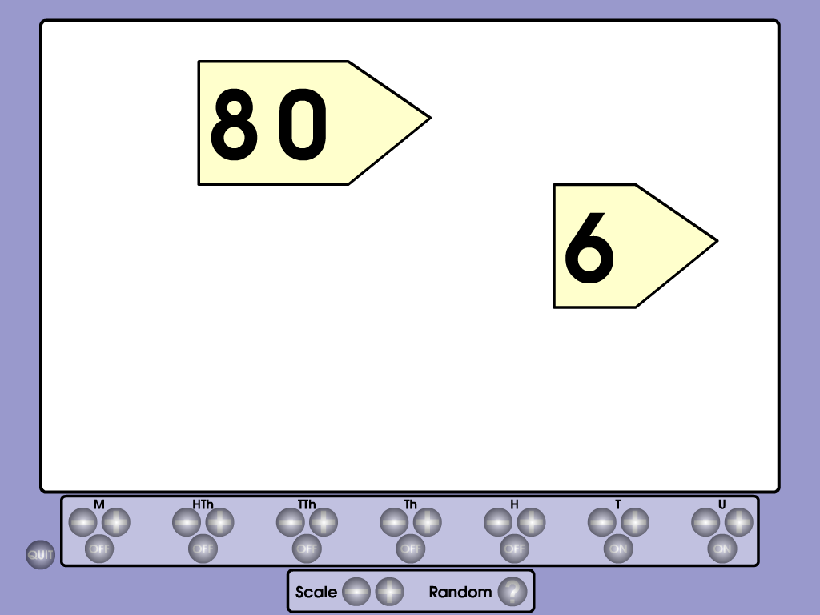
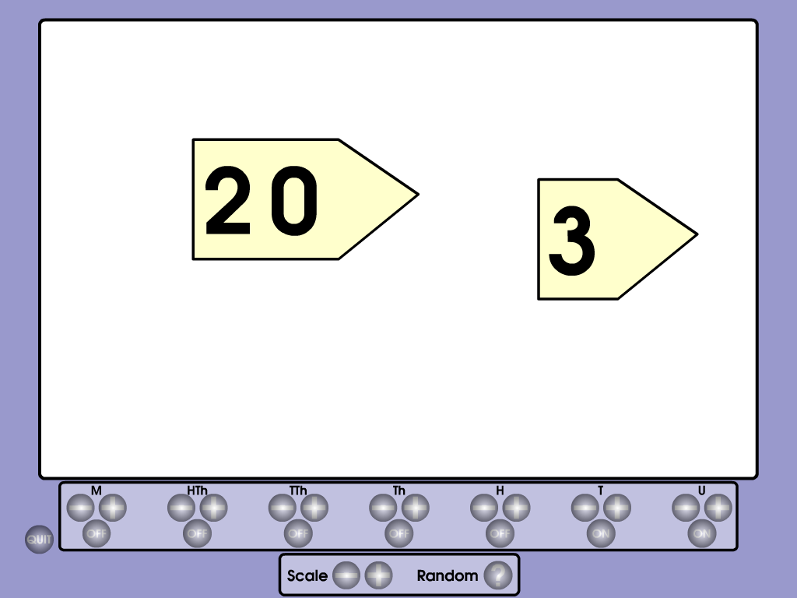
Beginning Column Subtraction

Slide 41
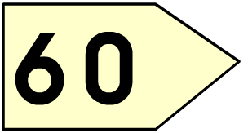

Slide 42
Beginning Column Subtraction (Exchange)

Slide 43
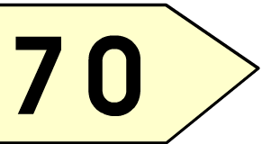
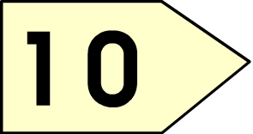
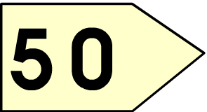
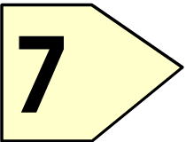

Slide 44
Continuing Column Subtraction
e.g. 321 - 157
H
T
U
200
1
10
300
20
1
1
-
100
50
7
100
60
4
= 164

Slide 45
Efficient Decomposition
H T U
2
1
1
1
3
2
1
+
1
5
7
6
4
1

Slide 46
Finding the Difference (Counting Back)
Children need to understand how counting back links to subtraction, e.g. 7 – 4
Make the large tower the same size as the small tower.

Slide 47
Finding the Difference (Counting On)
Children need to understand how counting on links to subtraction, e.g. 7 – 4
Make the small tower the same size as the large tower.

Slide 48
Finding the Difference (Counting On)
To begin linking to number lines, this can be looked at horizontally instead of vertically.

Slide 49
Moving on to Number lines
61 - 52
52
61

Slide 50
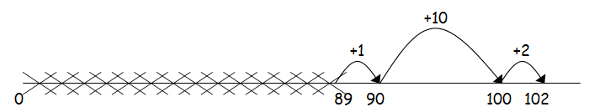
Consolidating Number Lines

Slide 51
Activities
Choose a strategy Race to 100 What are the steps 3
Bridging – Addition and subtraction Digit reversal
Crafty Calculations Calculation Targets Ribbon Lengths

Slide 52
Application

Slide 53
Key Messages
For written calculations it is essential that there is a progression which culminates in one method.
The individual steps within the progression are important in scaffolding children’s understanding and should not be rushed through.
Practical equipment, models and images are crucial in supporting children’s understanding.

