Slide 1
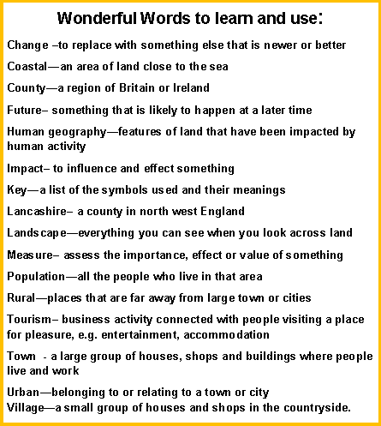
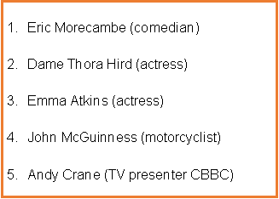
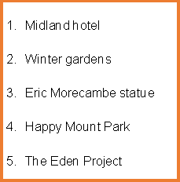
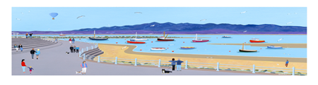
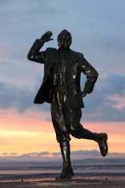
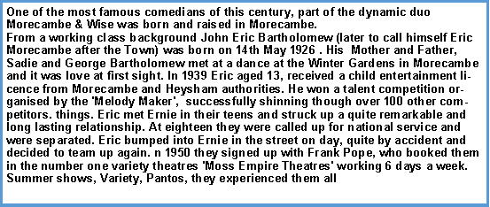
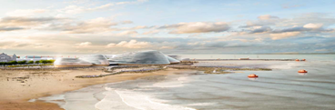
The new Eden Project! How will this change

Slide 2
What type of settlement is Morecambe? | Start | End
A city
A town
A village
A hamlet
What 5 rivers run into Morecambe Bay?
Start: ____________________________________________________________________________________________________________
End: ____________________________________________________________________________________________________________
What is Morecambe famous for? | Start | End
The view of the Lake District
Morecambe Bay potted shrimps and cockles
Having had piers that have burnt down
Being a seaside town
Who was Eric Morecambe? | Start | End
Butcher
Baker
Comedian
Soldier
Which county is Morecambe in? | Start | End
Lancashire
Yorkshire
Cumbria
Lincolnshire
To understand what the symbols mean on a map a look at the | Start | End
Index
Glossary
Key
Pictures
What is the Winter Gardens? | Start | End
A garden
A winter wonderland
A hotel
A theatre
How many people live in Morecambe? | Start | End
2000
20000
35000
50000
How can you travel to Morecambe from Warton? | Start | End
Walk or cycle
Take a plane
Catch a bus
Get on a train

