Slide 1

4
Welcome to year four
Croeso i flwyddyn pedwar

Slide 2

Homework
In year four the children receive a termly ‘homework grid.’ They complete an activity of their choice and then hand in their homework every Monday. When applicable there will also be extension tasks, to challenge the children further or support work to support your child’s understanding.
Times tables
Times table testing will be done at different times throughout the term. Please ensure your child is still continuing to practice these. All children have 2 times tables targets for the Autumn term and these will also be set as homework.

Slide 3

Spellings
There are weekly spellings given to each child and these are kept at the back of their homework book. These spellings will be reviewed at the end of each half term, so that if children are maintaining good spelling scores they will be moved into the next group.
In class the children will also be given a spelling book to record any spellings they miss spell in their work.

Slide 4


Reading
In year four reading takes place in differentiated reading groups, on a weekly basis.
There are also some children doing reading sessions 1-1 using staged texts. These children will be practicing their group guided reading skills with staged texts also. If your child has a yellow reading journal they bring home, please record any reading they do in it so we can track their progress.
This term the children are also using a class reading text called ‘Under the Rose’ which fits in with out Tudor / Historical Story theme.
The children also have a reading journal, in which they can record any independent reading they do in class.

Slide 5


Topic/Art/ D&T/ICT
Autumn Topic
Our Topic this term is The Tudors. This will include: Tudor houses, Tudor clothes, Tudor food and Tudor Kings and Queens
Science
Air resistance – Sir Francis Drake and his weapons
Design and Technology
Designing and making a Tudor house
Art
Designing and making a Tudor Coat of Arms.

Slide 6


How can I help my child at home?
Times table practice – please encourage children to learn them, if they are ready to be tested please record in homework book and we will test them
Reading as much as possible
Toe by Toe / Power 2
Spelling practice
Any additional work sent home to support learning - when applicable.

Slide 7

How can I help my child at home?
Reasoning materials – emphasis on working out, all Welsh government resources will be used in school. Any focus on problem solving would be helpful. The children will have test practices every half term for reasoning, maths papers and reading papers.
Mathematical outcomes – what children should achieve by the end of year four
Language outcomes what children should achieve by the end of year four

Slide 8
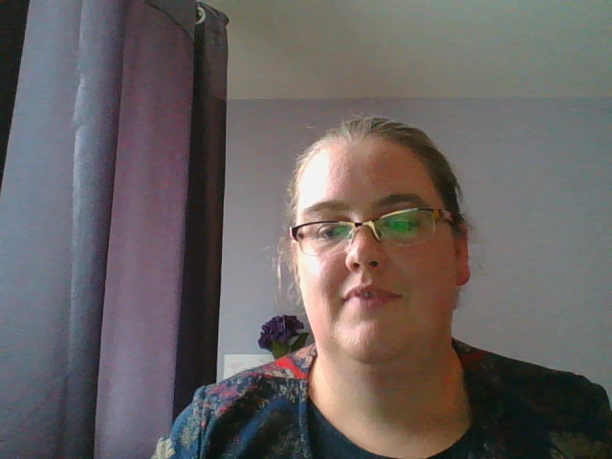
How can I help my child at home?
Useful websites
www.bbc.co.uk/education
http://resources.woodlands-junior.kent.sch.uk/homework/
www.topmarks.co.uk
www.mathszone.co.uk

Slide 9


Have a lovely summer!
4

