Slide 1
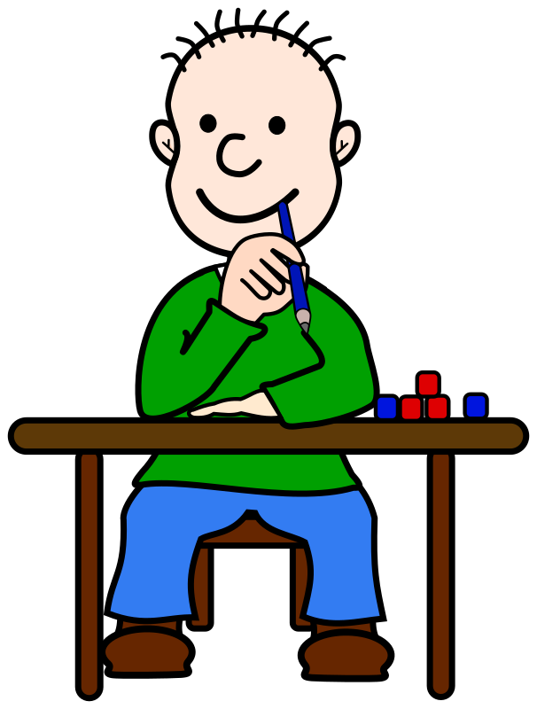

Welcome to the
Upper Juniors
ALL ABOUT YEAR 5

Slide 2

Homework will be linked to our topic and you will be given a choice of different activities to complete over the half term. This will be similar to how you did it in Year 4.
We will continue to use Google Classroom so you can share your homework on there with me or bring it in to school.
We also asked that pupils work on multiplication tables each week as well as reading at home regularly.
We do not have weekly spelling tests in year 5. Often children learn the words for the test and then still misspell them in their free writing. So in year 5 we have spelling lessons where we correct any errors from our free writing.

Slide 3
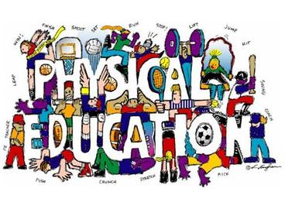
There is an expectation that children will have a PE kit in school everyday.
Regrettably if children forget their kit we are unable to call parents.
We will be doing games outside during the first half term so need shorts, t-shirt, jumper/fleece and suitable outdoor footwear.

Slide 4


Reading
In year 5 we do a reading task and a reading assessment with the teacher once every fortnight.
We also have a free choice reading book for when we have time for silent reading. This can be a book from school or home.
Our class reader for the Autumn term is Street Child, which is a text set in Victorian times.
We still expect children to continue to read books of their own choice at home. Please encourage your child to record this in the reading log in their homework book.

Slide 5

Topics
In the Autumn term our main topic is the Victorians. The children will be given more responsibility in deciding their learning outcomes in line with the new curriculum for Wales in 2022. I want you to have an input in to what we learn in school so get your thinking caps on! You might even want to do some research about the Victorians over the summer holidays.
In language we will be doing story writing and recount work.
We will be doing a project in Design Technology about making bread.
In art we will be studying the work of William Morris.
We will be learning how to use a spreadsheet in ICT and will be using our numeracy skills to track and budget money.

Slide 6
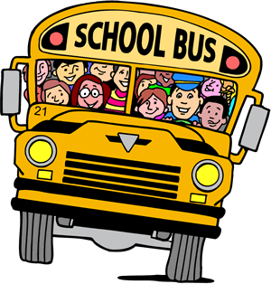
Class Trips
These are the trips that we usually do in Year 5 but due to the COVID-19 pandemic I am unsure as to whether they will be able to go ahead:
Autumn term
Blists Hill Victorian Museum, Telford
Spring term
Glan Llyn 3 day residential visit
I am hopeful that we will be able to eventually go on at least one trip even if it is much later in the year. I will let you know when I have any information regarding any of the trips.

