Slide 1
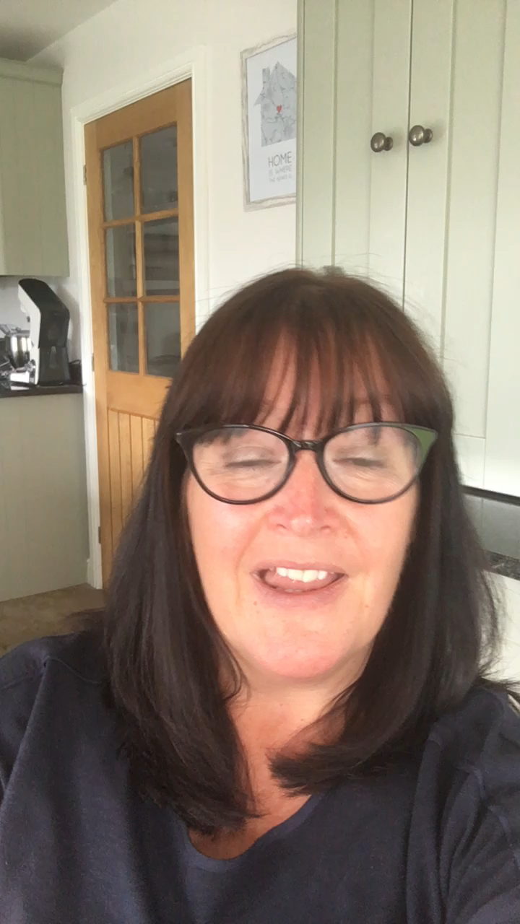


Welcome to the
Upper Juniors
ALL ABOUT YEAR 6

Slide 2

At the start of term you will be given a grid with lots of different homework activities that you can choose from. You can return them to me when you have done them. This is the same as you have been doing in Year 5.
We will still be using Google Classroom so you can bring them into school or upload them onto our Google Classroom.
We are also asked to work on our times-tables each week as well as reading at home regularly.
We do not have weekly spelling tests in year 6.
Often children learn the words for the test and then still misspell them in their free writing. So in year 6 we have spelling lessons where we correct any errors from our free writing.

Slide 3

Our P.E. days are Wednesday and Friday.
We will be doing games outside up until half term so your child will need shorts, t-shirt, jumper/fleece and suitable outdoor footwear.

Slide 4


Reading
In year 6 we do a reading task and a reading assessment with the teacher once every fortnight.
We also have a free choice reading book which we keep in our tray for when we have time for silent reading. This can be a book from school or home.
We still expect children to continue to read books of their own choice at home and we ask that you help your child to record this in the reading log in their homework book

Slide 5
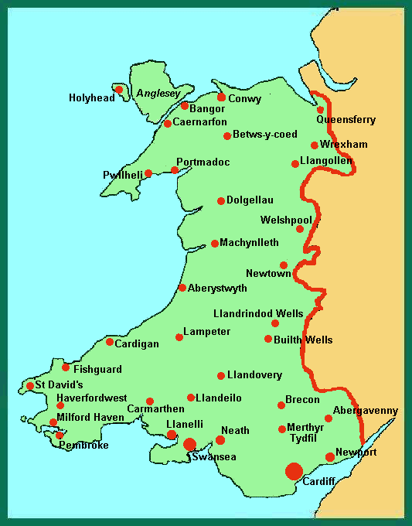
Topics
Our topics this year are:
Mae Hen Wlad Fy Nhadau (Land of my Fathers). This is a Geography topic where we look at Wales.
World War II
Un Byd, Ein Byd(One world, Our World). This is a Geography Science topic where we look at a range of environmental issues that impact upon our planet.
As we are having a new curriculum in Wales I like yo to have an input into what we learn iin school. Get your thinking caps on!

Slide 6

Class Trips
These are the trips that we usually do in Year 6 but due to the COVID-19 pandemic I am unsure as to whether they will be able to go ahead:
Residential to Cardiff
Stockport Air Raid Shelters
Year 6 Canoeing trip
I am hopeful that we will be able to eventually go to Cardiff even if it is much later in the year. I will let you know when I have any information regarding any of the trips.

Slide 7

How can I help my child at home?
Share and discuss books with your child, they may be an independent reader but it is still important to discuss what they have read with them. Check their understanding of the texts they read and look up the meanings of any unfamiliar vocabulary.
Continue to test them on their times tables, both written and verbally. If they have completed their times table card they still need continuous practice so they don’t forget.
There are lots of resources, apps and games now available online. Look for anything that’s aimed at year 6 and things that your child enjoys.

Slide 8
How can I help my child at home?
Useful websites
www.bbc.co.uk/education
www.woodlands-junior.kent.sch.uk
www.topmarks.co.uk
www.mathszone.co.uk

Slide 9
General Information
If you have any concerns regarding your child please do not hesitate to contact me via the school office and I will get back to you as soon as I can.
I wish you all a very happy summer holiday and will look forward to seeing you in September.
Mrs King

